Slide 1
welcome

Slide 2
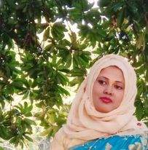
Teacher’s Introduction
Mst.Sharmin Akter
Assistant teacher
Matoin Govt. Primary School Hajigonj, Chandpur.
E-mail: mstsharminakter1985@gmail.com

Slide 3
Lesson Identity
Class : Two
Subject : English
Lesson :7-9 (A)
Unit:29
Parts of the lesson : The………no eggs !
Time : 40 min
A
s
h

Slide 4
Student’s will be able to-
Listening:1.1.1-become familiar with English sounds by listening to common English word.
Speaking:1.1.2-say simple words and phrases with proper sounds and stress.

Slide 5
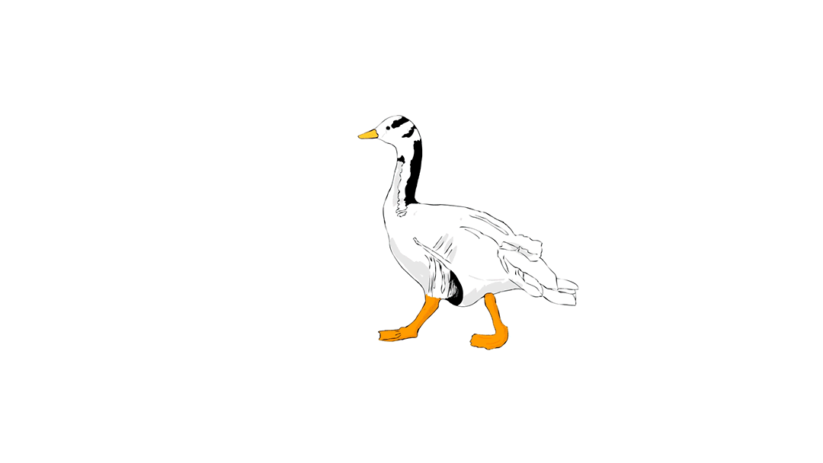
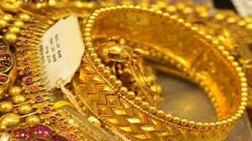
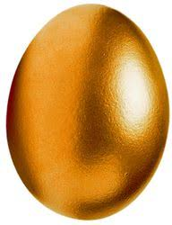
Look at the picture.

Slide 6
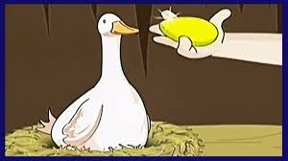
Todays lesson is The golden goose.

Slide 7
sad
money
New word
listen
story
has

Slide 8
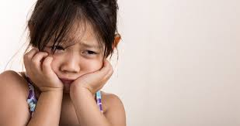
sad
unhappy

Slide 9
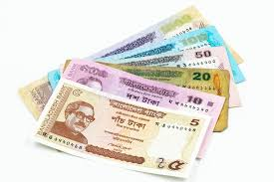
money
currency

Slide 10
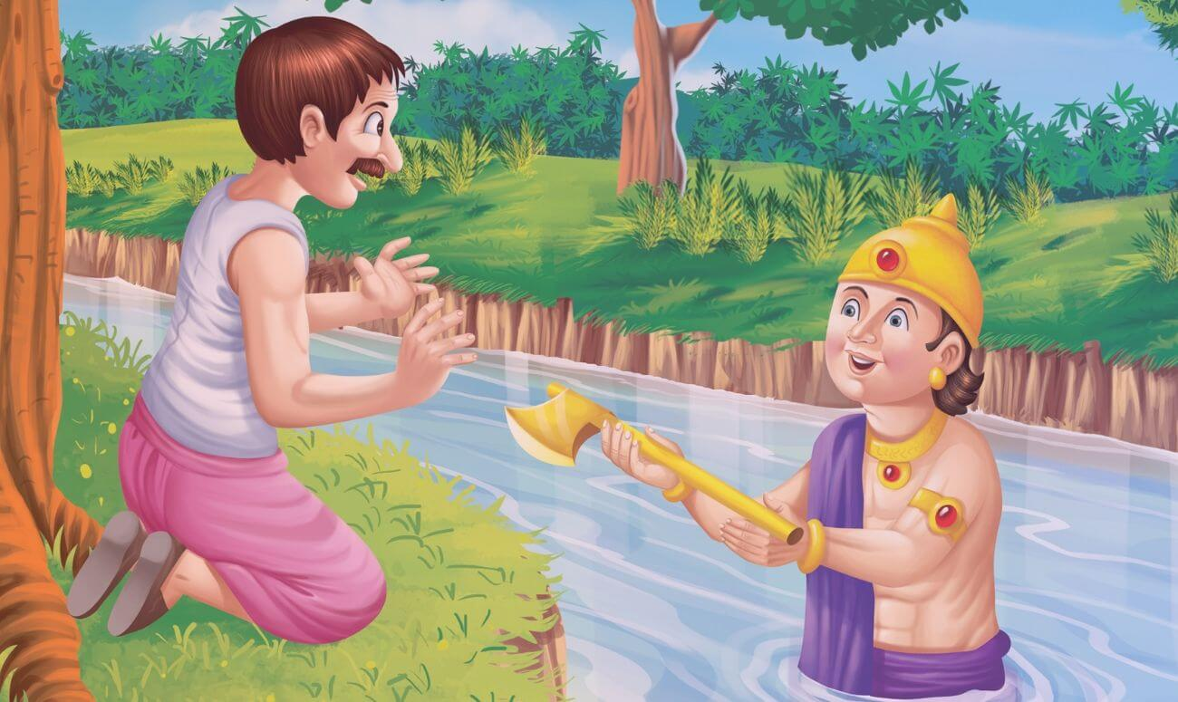
story
tale

Slide 11
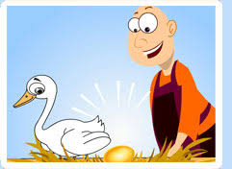
has
have

Slide 12
listen
hear

Slide 13
Teacher’s Reading

Slide 14
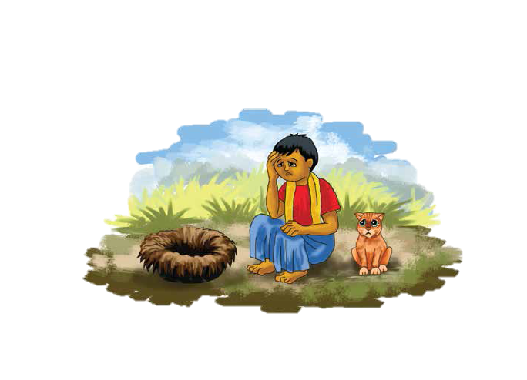
The farmer has no goose.
He has no money .
He is sad.

Slide 15
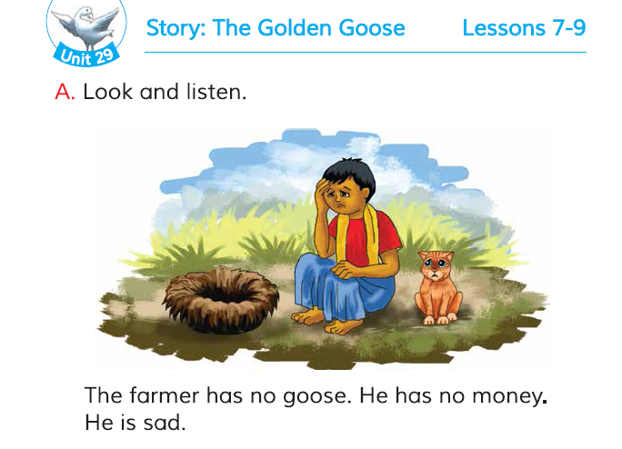
Open your book.

Slide 16
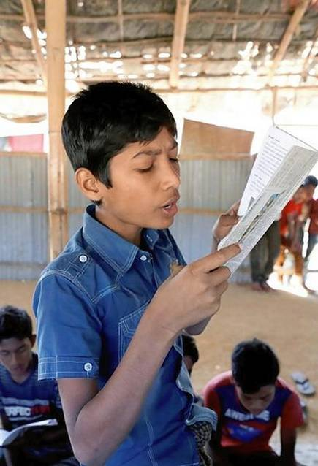
Student’s reading

Slide 17
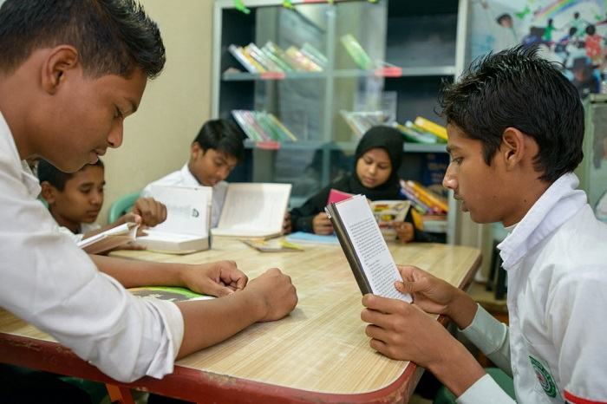
Group reading

Slide 18
Read in pair

Slide 19
Questions
1.How is the farmer ?
2.What does the farmer think ?
3.Why the farmer is sad?

Slide 20
Answer
1.The farmer is sad.
2.The farmer thinks all the eggs are inside the goose.
3. The farmer is sad because he has no goose and no money .

Slide 21
One day one word.
Money-টাকা

Slide 22
That’s all for today.

