Slide 1
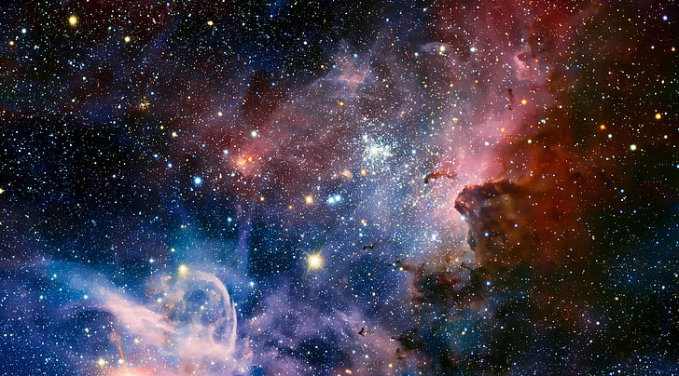

Slide 2
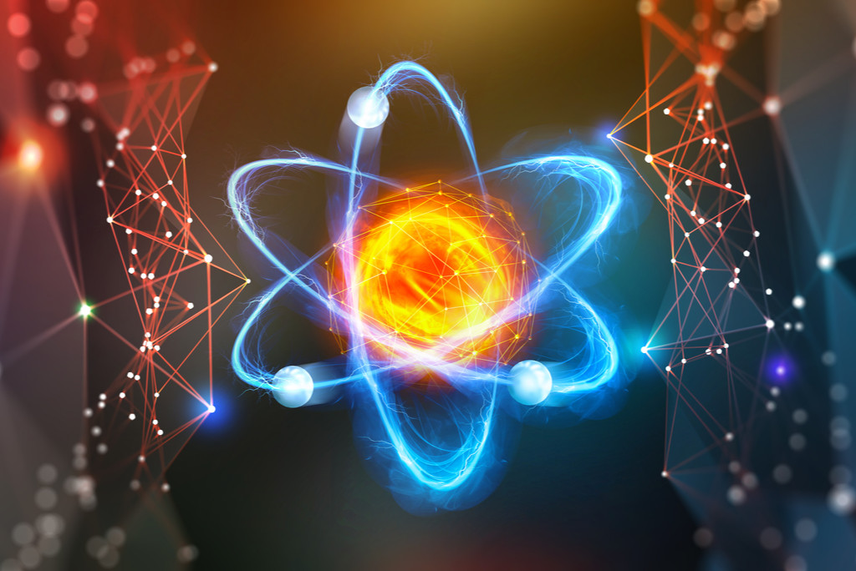
Good Morning

Slide 3
Teacher’s Identity
Md. Al Momin
B.Sc.(Hons.), M.Sc. (Physics), RU
Bachelor of Education(B.Ed.)
Lecturer(Physics)
Square High School & College, Pabna.
STD-IX
Subject : Physics
Chapter-1 : Physical quantities and their measurements
Time : 40 min.

Slide 4
Look at the pictures below…
10 m
5 kg
Here, 5 kg is the______ of potato.
length
mass
Here, 10 m is the______ of cable.
Here, mass and length are physical quantity, kg and m are their units.

Slide 5
Our Today’s Topic is-
Physical quantities and their measurements

Slide 6
Physical Quantity:
Something that can be measured is called physical quantity.
Example: Mass, Time, Temperature etc.
There are two types of physical quantity:
Fundamental physical quantity.
Derived physical quantity.
Fundamental Physical Quantity:
The physical quantity which does not depend on other quantity i.e independent is called fundamental physical quantity.
There are seven fundamental quantities.
Derived Physical quantity:
The physical quantities which are derived from fundamental quantities are called derived physical quantities.

Slide 7
Physical Quantity:
Seven fundamental quantities:
Quantity
Length
Mass
Time
Temperature
Amount of substance
Electric Current
Luminous Intensity

Slide 8
Physical Quantity:
Seven Fundamental Quantities and their S.I units:
Quantity | Unit | Symbol
Length | meter | m
Mass | kilogram | kg
Time | second | s
Electric Current | ampere | A
Temperature | kelvin | K
Amount of substance | mole | mol
Luminous Intensity | candela | cd

Slide 9
Physical Quantity:
Seven Fundamental Quantities and their S.I units:
The seven defining constants of the SI are:
the cesium hyperfine frequency, (Δv_{cs})
the speed of light in vacuum c;
the Planck constant h;
the elementary charge e;
the Boltzmann constant k;
the Avogadro constant N_{A}; and
the luminous efficacy of a defined visible radiation K_{cd}.

Slide 10
Physical Quantity:
Magnitude of seven fundamental constants essential to measure seven fundamental units:
Constants | Magnitude
Velocity of Light(c) | 299792458 ms⁻¹
Plank’s constant(h) | 6.62607015 × 10⁻³⁴ Joule second
Charge of electron | 1.6 × 10⁻¹⁹ Coulomb
The cesium hyperfine frequency, (Δv_{cs}) | 9192631770 Hertz
Boltzmann constant(K_{B}) | 1.380649 × 10⁻²³ Joule/kelvin
Avogadro constant(N_{A}) | 6.02214076 × 10⁻²³ particles/mol
luminous efficacy (K_{CD}) | 683 lumens/watt

Slide 11
Physical Quantity:
New definition of seven fundamental units:
Second(s):
The time required to complete 9192631770 vibrations by Cesium-133 atom is one second.
Meter(m):
In vacuum the distance travelled by light in 1/299,792,458 second is called one meter.
Kilogram(kg):
The mass which is obtained by dividing Plank’s constant by 6.62607015 × 10⁻³⁴ m²/s is called one kilogram.

Slide 12
Physical Quantity:
New definition of seven fundamental units:
Ampere (A):
Flow of 1/1.602176634 × 10⁻¹⁹ numbers of charge equivalent to charge of electron in one second is called one ampere.
Mole (mol):
Amount of substance that contains 6.02214076 × 10²³ particles (Avogadro’s number) is called one mole.
Kelvin (K):
Amount of change of temperature with the change of
1.380649 × 10⁻²³ joule thermal energy is called one kelvin.

Slide 13
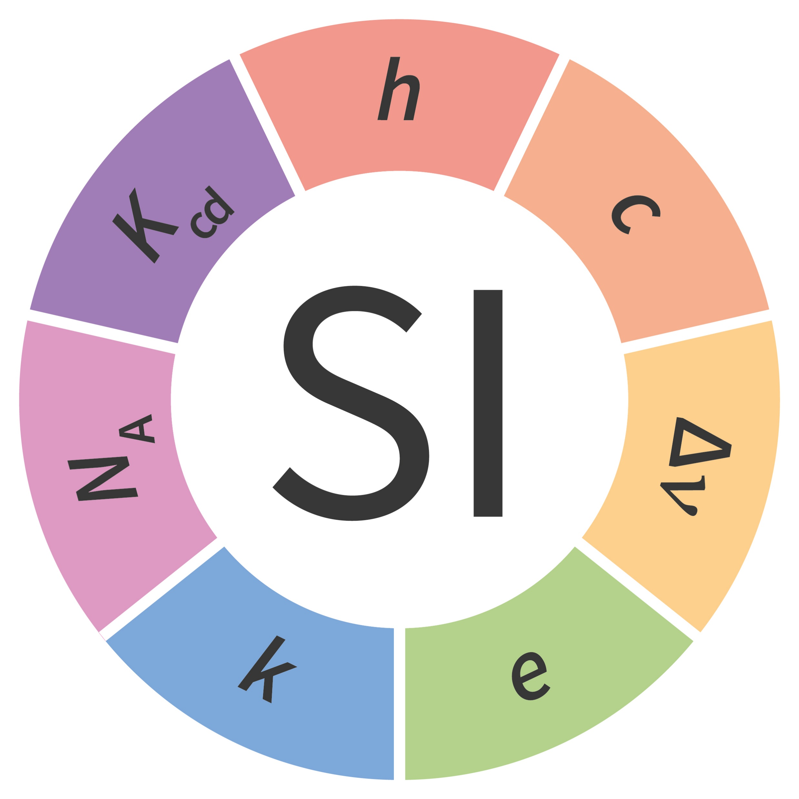
Physical Quantity:
New definition of seven fundamental units:
Candela (cd):
The candela (cd) is the luminous intensity, in a given direction, of a source that emits monochromatic radiation of frequency
540 × 10¹² hertz and that has a radiant intensity in that direction of 1/683 watt per steradian solid angle.

Slide 14
Evaluation:
What is the unit of luminous intensity?
2. Which one is not a fundamental quantity?
a. K
b. A
c. s
d. cd
a. weight
b. time
c. temperature
d. electric current

Slide 15
H.W
What is the difference between fundamental quantity and derived quantity.

Slide 16
THANK YOU

