Slide 1
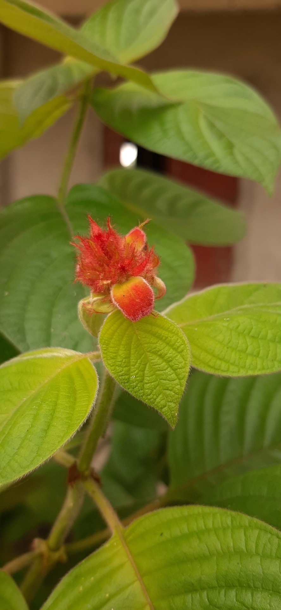
Welcome

Slide 2
Teacher’s Identity
Md. Mostafizur Rahman
Assistant Teacher
Batisa Balika Government Primary School

Slide 3
Lesson’s Identity
Class : Five
Subject : English
Unit : 1
Lesson : 4-5

Slide 4
Learning outcomes.
By the end of the lesson,students will be able to….
Read the text.
know the new words.
write the answer of the small questions from the text .

Slide 5
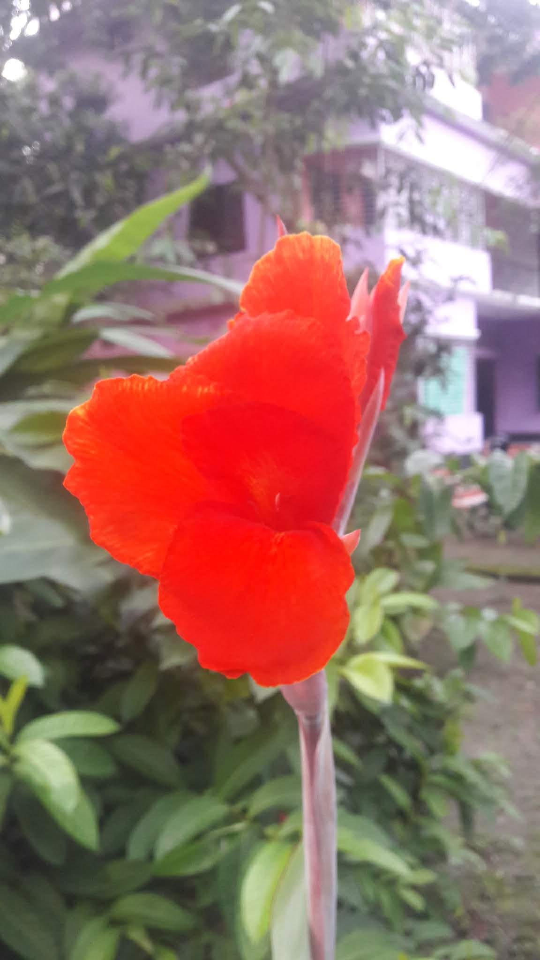
See you tomorrow.
Bye

Slide 6
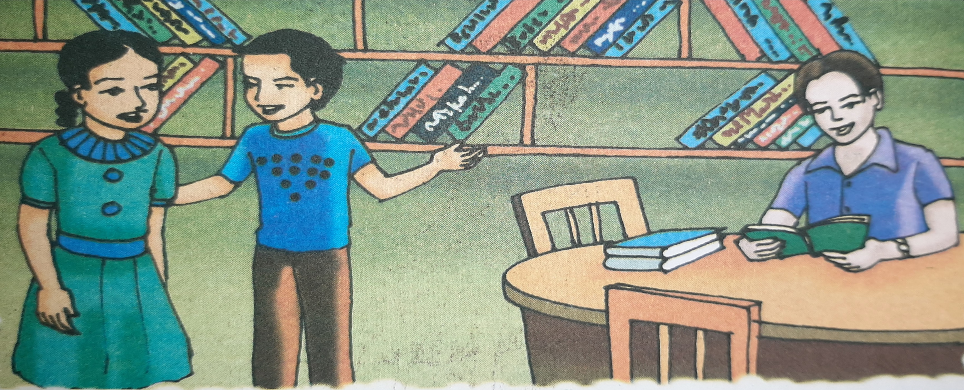
See the picture and think

Slide 7
New words
fvlv
Language
PP©v Kiv
Practise
K_v ejv
Speak
‡`Lv
Watch
f`ª †jvK
Gentleman
Work
KvR Kiv

Slide 8
Today our lesson is,
Hello

Slide 9
Everybody open your book at page number – 4
Listen to me.

Slide 10
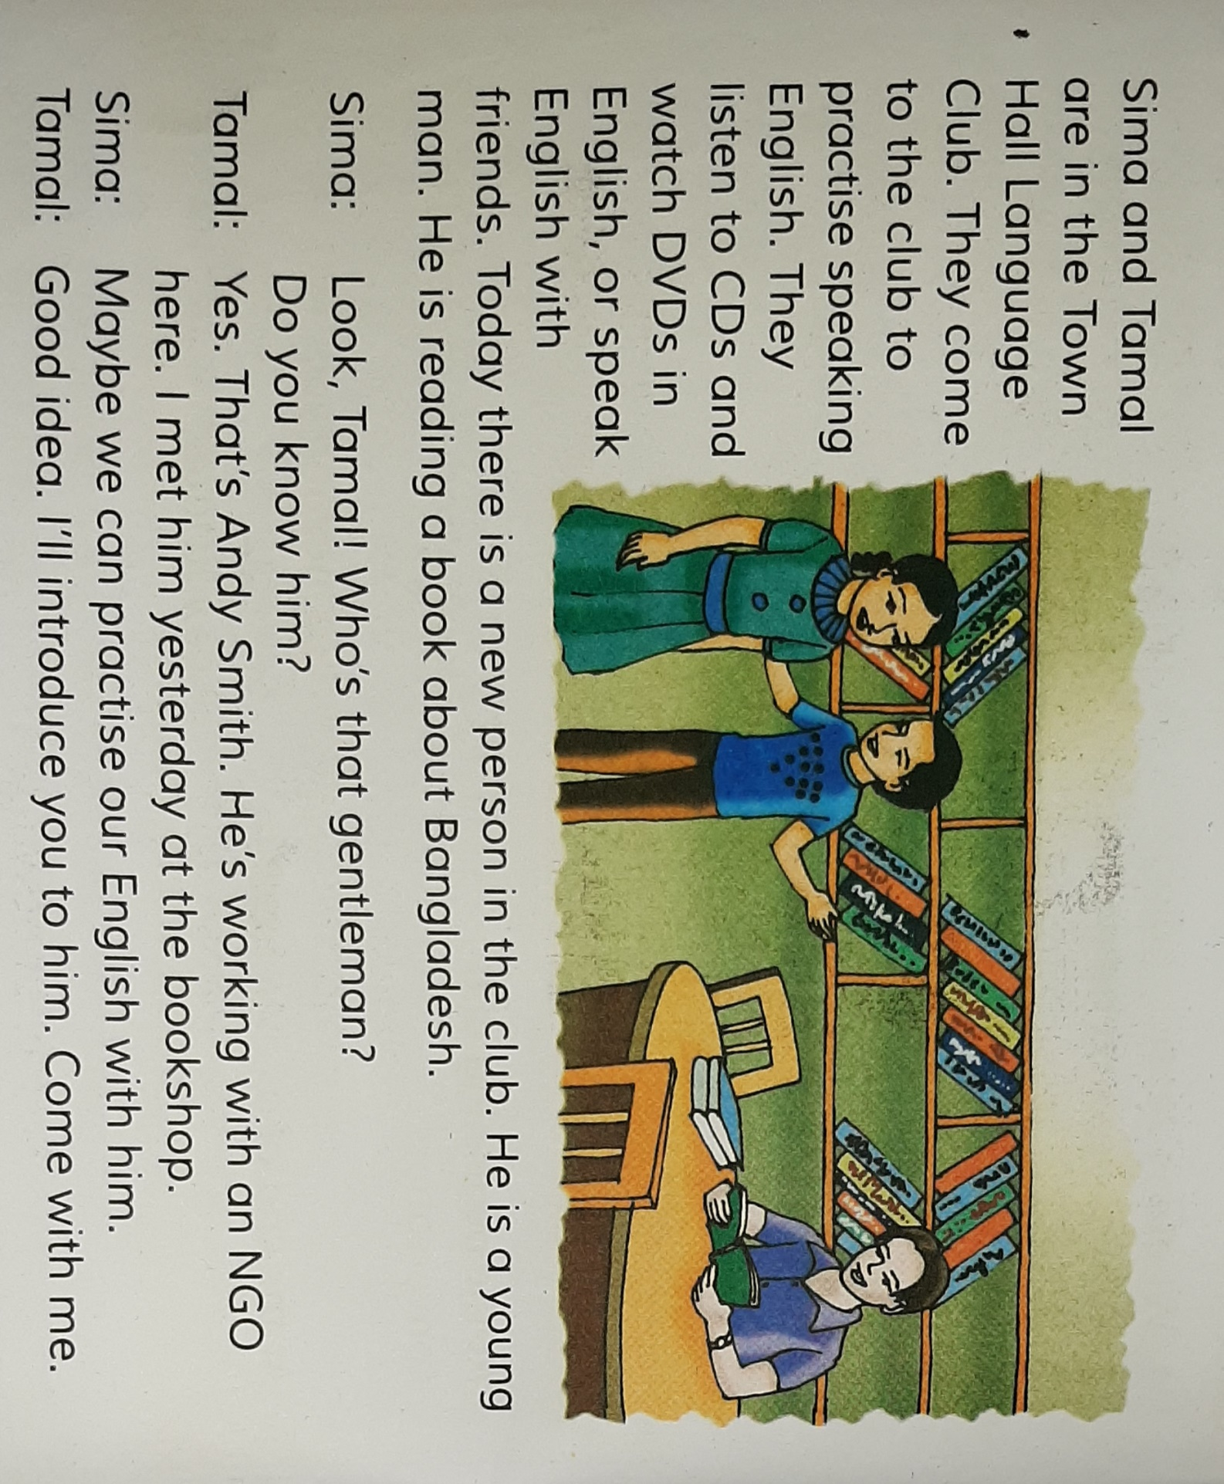

Slide 11
Please Read Alone

Slide 12
Read in pair

Slide 13
Evaluation
Please write the answer of the questions in your exercise khata.
Where are Sima and Tamal ?
Why do they go there ?
Who is the new person there ?
What is he reading ?
Where did Tamal meet new person ?

