Slide 1
welcome

Slide 2

Identity
Class: Five
Sub:English For Today
Unit:11
Lesson: 4-5
Md. Mostafizur Rahman
Assistant Teacher
Batisa Balika govt.Primary School

Slide 3
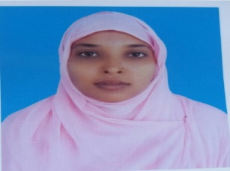
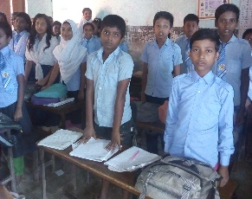
GREETINGS
Teacher
Students
Good morning, students.
Good morning, teacher.
How are you today?
Fine,and you?
Fine, thank you.
You are welcome sir.

Slide 4
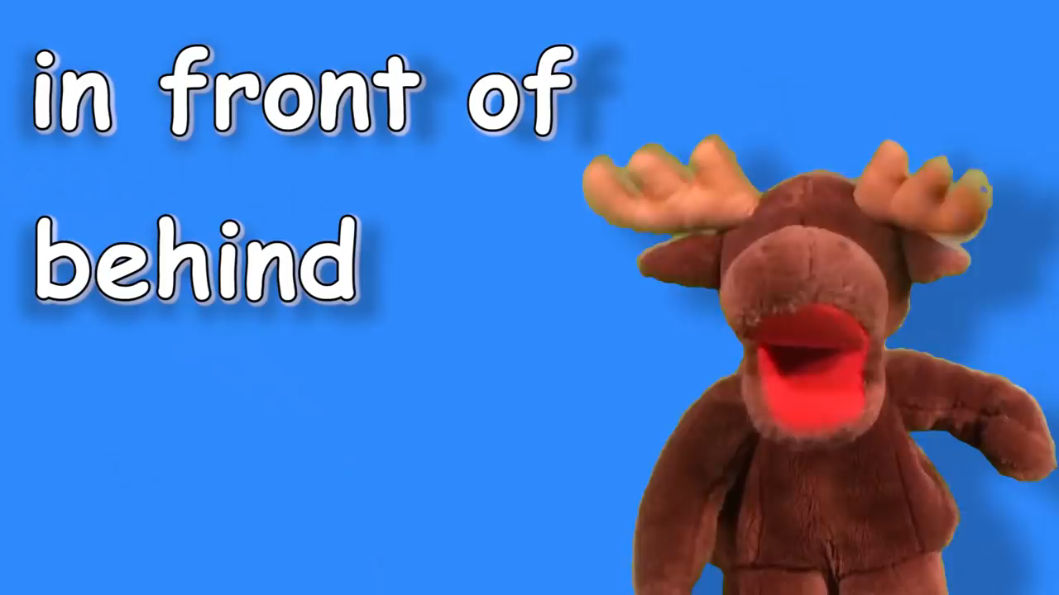
Dear students, let us go to watch a video.
Discuss about the video with the students.

Slide 5
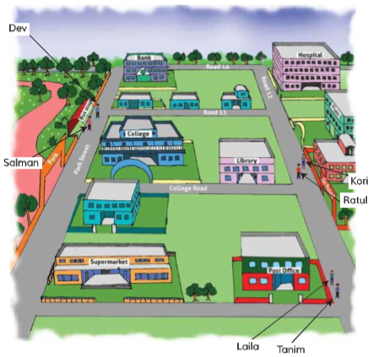
Review the previous lesson
A supermarket is next to a post office.
Can you give the location of the bus stop?
The bus stop beside the park.
Where is the bank located?
The end of park street.
Where can I find the post office?

Slide 6
Lesson Declaration
Where’s the library?

Slide 7
Learning outcomes
By the end of the lesson students will be able to
Listening :
2.1.1 carry out simple commands and instuctions.
Speaking:
6.2.1 talk about people, objects,events,etc.
Reading:
1.5.1 read words,phrases and sentences in the text with proper pronunciation,stress and intonation.
Writing: 8.1.1 make sentences using words and phrases given in the textbook.

Slide 8
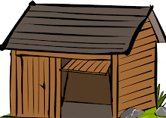



Look and say name of the pictures
hut
jeep
school
park

Slide 9
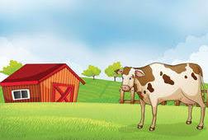
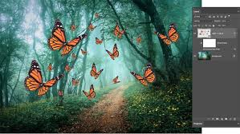
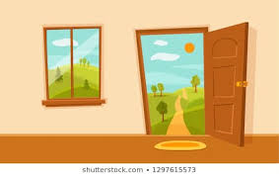
Look and say name of the pictures
hut
cow
window
butterflies

Slide 10
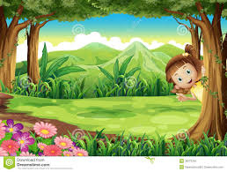
Look and say name of the pictures
girl
tree

Slide 11
Dear students do you know?
what is preposition?
A preposition is a word placed
Before a noun or a pronoun to show its relation to some other words in the sentence.

Slide 12
Say words with me.
behind
opposite
In front of
outside
Next to

Slide 13
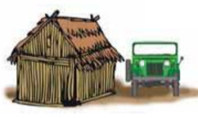
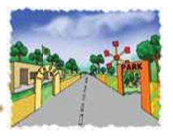
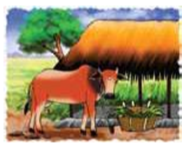
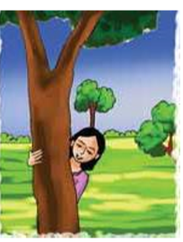

Meaning of words
Next to
পাশে
opposite
বিপরীত দিকে
In front of
সামনে
outside
বাইরে
behind
পিছনে

Slide 14
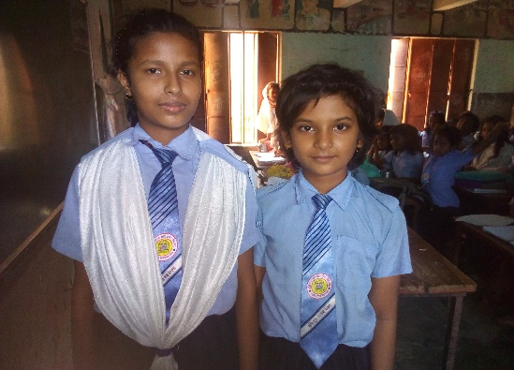
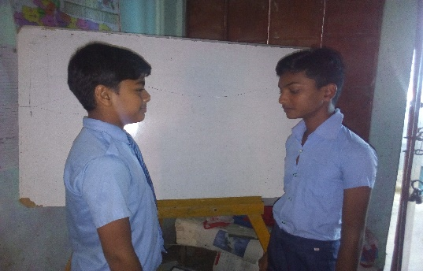
Dear students,let’s look at some pictures.
Next to
opposite

Slide 15
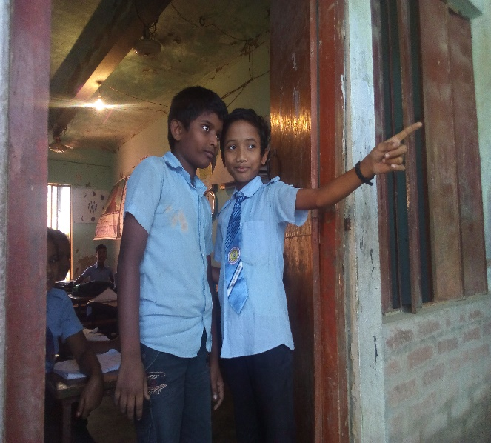
outside

Slide 16
Look at the picture and say the situation
jeep
hut
What is the condition of the jeep and hut?
Next to

Slide 17
Look at the picture and say the situation
school
park
What is the condition of the school and park?
opposite

Slide 18
Look at the picture and say the situation
hut
cow
window
butterflies
In front of
What is the condition?
What is the condition?
outside

Slide 19
Look at the picture and say the girl situation
Behind the tree

Slide 20
One day one word
Outside
বাইরে
The butterflies are outside the window.

Slide 21
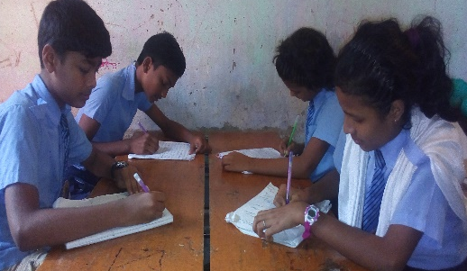
Which preposition will fill in the gap?
SGW
opposite
Next to
The school is----------the park.
The jeep is ----------the hut.

Slide 22
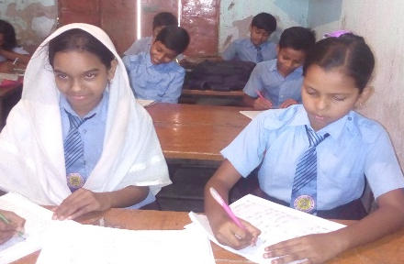
Which preposition will fill in the gap?
Pair work
The girl is--------the tree.
behind
The cow is---------the hut.
In front of

Slide 23
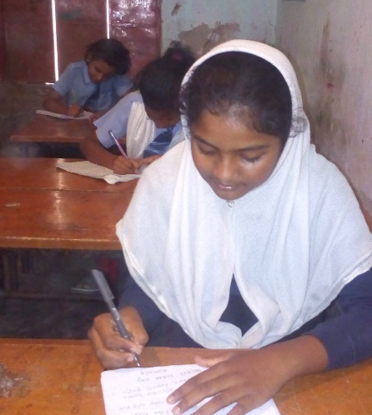
Which preposition will fill in the gap?
Individual work
The butterflies are-------the window.
outside

Slide 24
Evaluation
Dear students,complete the sentences with the correct preposition.
1. The jeep is---------the hut.
2.The school is-------the park.
3. The cow is--------the hut.
4.The girl is--------the tree.
5.The butterflies are--------the window.

Slide 25
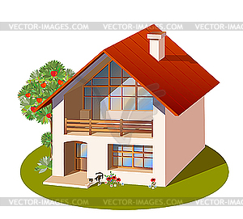
Home work
Write the new two sentences with the outside and opposite.

Slide 26


