Slide 2
Teacher’s Identity
Md. Mostafizur Rahman
Assistant Teacher
Batisa Balika gps
Chauddagram,Cumilla

Slide 3
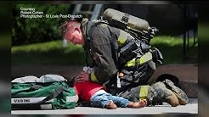
Warm up:
1. What do you see in the picture?
2. What are they doing in the picture

Slide 4
Solution:
In the picture, we see a fire incident and a fire fighter.
In the picture, we see a fire fighter and a fire burnt person.

Slide 5
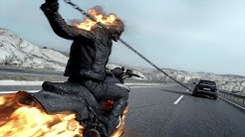
Declaration of lesson and title:
Class: Five
Subject: English
Unit: 9
Lesson: 1-2
Title: Occupation
Image of a fire-fighter

Slide 6
Learning Outcomes:
By the end of the lesson Ss will be able to—
Tell some vocabularies
Explain the consequence of fire accident.
Illustrate what to do and how to do in case of fire incident.

Slide 7
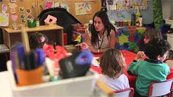
Individual work:
Teacher will read out the text loudly and ss will fill in the gap individually.

Slide 8
Fill in the gaps:
Once Raju was a (a) ---- of class five. Suddenly there was a (b) ---- in their school building. Seeing the fire, every one was © ----. But the teachers assisted them to (d) ---- the school building quietly. Hearing this mishap, fire fighters came and (e ) ----- the fire.
Ans:
a) student, b) fire, c) afraid, d) leave, e) put out.

Slide 9
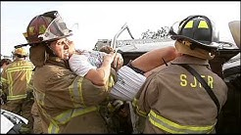
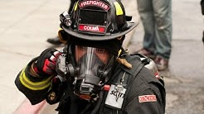
Pair work:
Ss will read the text in pair and will say true/false.

Slide 10
True or False:
1. Raju was a fire fighter from class 5.
2. There was a fire in the building near the school
3. Seeing the fire, all got frightened.
4. The fire was put out by the volunteer students.
5. Raju earns money because he is a full time fire fighter.
6. The teachers assisted to quit the building safely.
Ans:
1. False, 2. False, 3. True, 4. False, 5. True, 6. True

Slide 11
Group Work:
Ss will read the text in group and answer the question below.
Class room activities are going on.

Slide 12
Answer the questions:
What happened in Raju’s school when he was in
class five.
2. How did the teacher help them?
3. Why were all afraid?
4. Who put out the fire?
5. When did Raju join a volunteer fire department?
6. What is the main work of a fire fighter?

Slide 13
Solution:
When Raju was in class five there was a fire in their school building.
The teacers helped them to quit the building quietly and safely.
All were afraid seeing the fire.
The fire fighters came and put out the fire.
Raju joined a volunteer fire department after college/HSC.
The main work of a fire fghter is to put out fire.

Slide 14
Evaluation:
Match column A with column B
Column A | Column B
a) The fire incident took place | i) Volunteer fire department.
b)Seeing the fire | ii) When Raju was in class 5
c) The students left | iii) All were afraid.
d) Raju joined a | iv) Building safely.

Slide 15
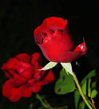
Solution:
(a+ii), (b+iii), (c+iv), (d+i)

Slide 16
Home task:
Write a paragraph about ‘Your aim in life’.

Slide 17
Thanks a lot all the Ss.

