Slide 1
WELCOME TO MY ENGLISH CLASS

Slide 2
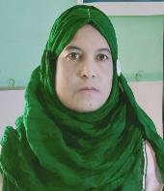
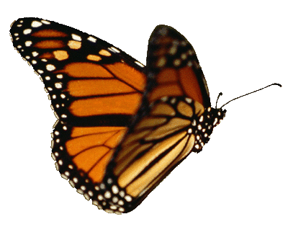
Identity:
Mst. Hosneara Parvin
Head Teacher
Sholotaka gps.
Gangni, Meherpur.
Subject: English
Class: Three
Unit: 25

Slide 3
Learning Outcomes
Students will be able to
Listening:
3.2.1 understand simple questions about familiar objects.
Speaking:
1.1.2 say words, phrases and sentences after the teacher with proper sounds and stress.

Slide 4
Let’s enjoy audio
What did you understand from audio?

Slide 5
Today’s Lesson
What sounds do they make?

Slide 6
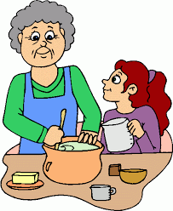
Introducing new words:
Make
তৈরি করা
To create something.

Slide 7
Introducing new words:
Sound
ধ্বনি, আওয়াজ
Something that you can hear.

Slide 8
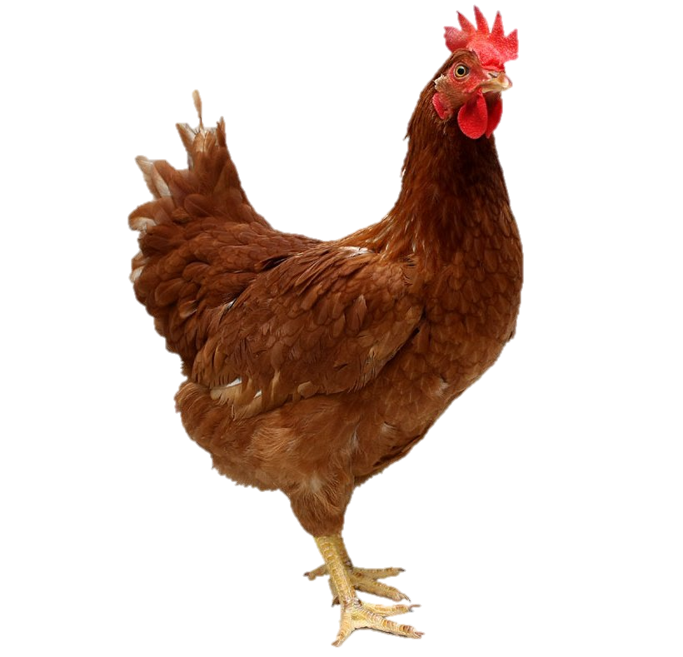
What is this?
What sound does it make?
clucks
মুরগির ডাক
কঁক কঁক
This is a hen.

Slide 9
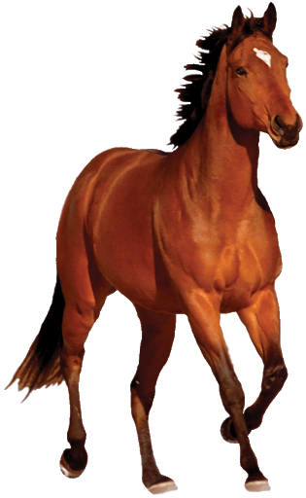
What is this?
What sound does it make?
neighs
ঘোড়ার ডাক
চি-হি-হি
This is a horse.

Slide 10
What is this?
What sound does it make?
roors
সিংহের ডাক
গর্জন
This is a lion.

Slide 11
What is this?
What sound does it make?
growls
বাঘের ডাক
হুংকার
This is a tiger.

Slide 12
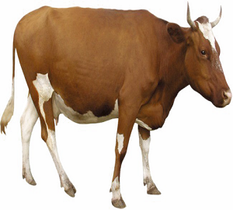
What is this?
What sound does it make?
moos
গরুর ডাক
হাম্বা হাম্বা
This is a cow.

Slide 13
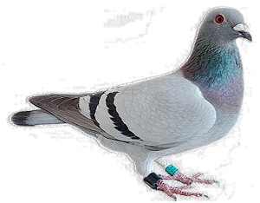
What sound does it make?
What is this?
coos
কবুতরের ডাক
বাকবাকুম
This is a pigeon.

Slide 14
Individual
Work
Say the name of animals.
Hen
Horse
Tiger
Lion
Cow
Pigeon

Slide 15
Pairwok
What sound does a horse make?
What sound does a hen make?
What sound does a lion make?
roors
neighs
Clucks

Slide 16
Pairwok
What sound does a tiger make?
What sound does a cow make?
What sound does a pigeon make?
coos
growls
moos

Slide 17
Teacher’s read

Slide 18
Students reading

Slide 19
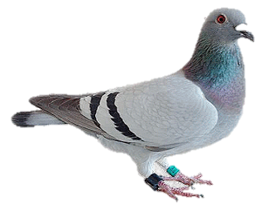
Evaluation
What is this?
hen
horse
pigeon
What sounds do they make?

Slide 20
Planned activity
All of you will read and write the below sounds:
Cluck
Neigh
Roor
Growl
Moo
Coo

Slide 21
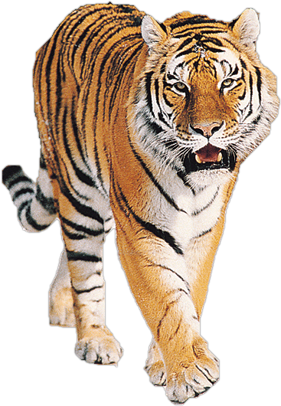
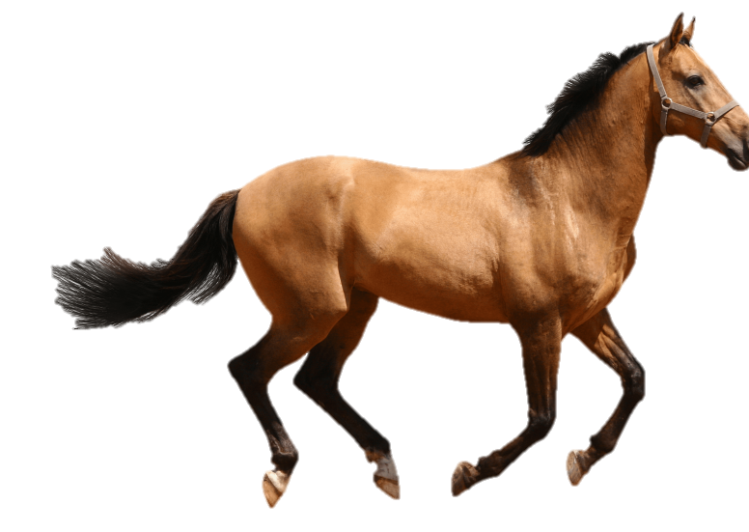
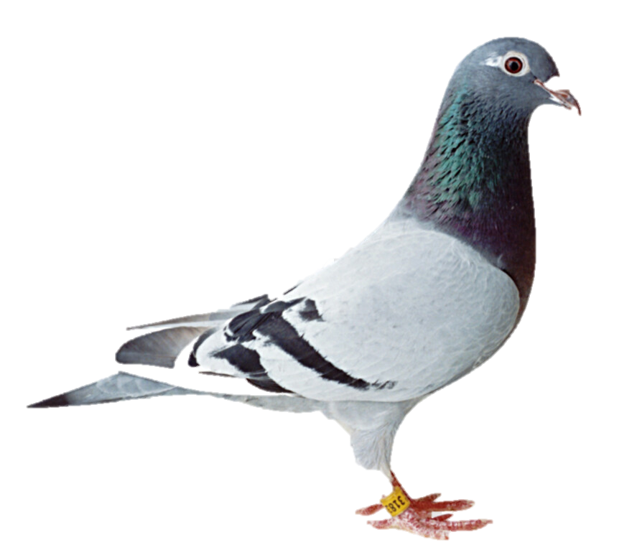
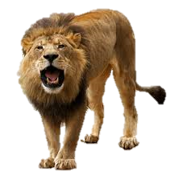
SEE YOU !

