Slide 1
WELCOME

Slide 2
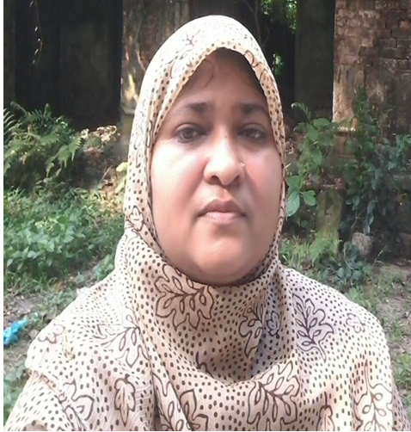
Teacher’s Introduction
Zannaton Nahar
Head Teacher
Teknogopara Govt. Primary School
Gazipur citycorporation, Gazipur.
Mobile-01768031223
Mail-zannatonnahar@gmail.com

Slide 3
LESSON’S INTRODUCTION
Class : Two
Sub :English
Unit : 19
Lessons :1-3; Topic:Shapes

Slide 4
Learning outcomes
By the end of the lesson of student will be able to-
1.1.1 repeat after the teacher and
say words with proper stress
and intonation.
1.1.4. read words with the help of
visual clues.

Slide 5
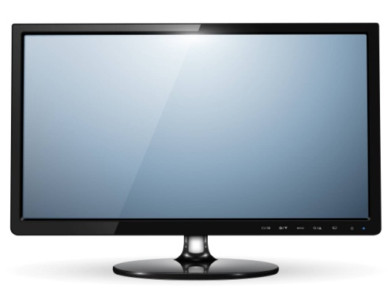
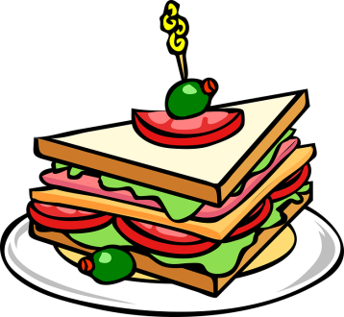
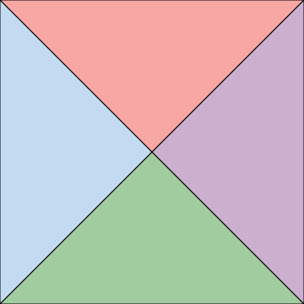

Slide 6
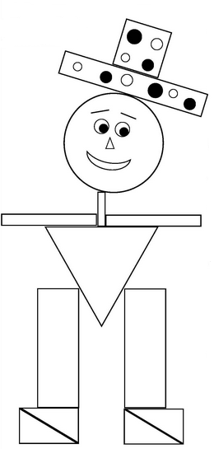

Slide 7
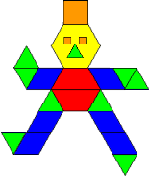

Slide 8
Declaration of lesson
Unit:19
Lesson:1-3
Topic: Shapes
Page no.-38

Slide 10
Look and say
Circle
Triangle
Square
Rectangle

Slide 11
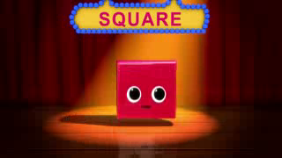
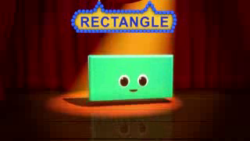

Slide 12
Triangle

Slide 13
Circle

Slide 14
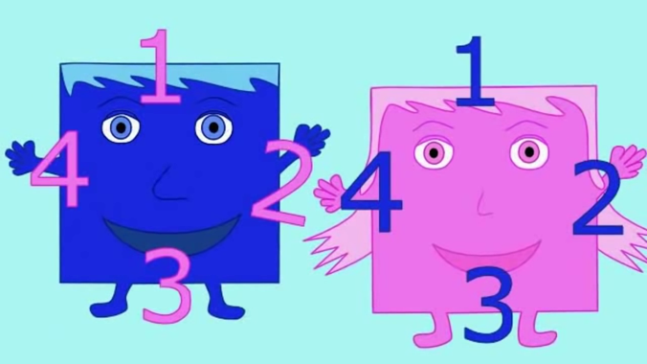
Square

Slide 15
Rectangle

Slide 16
circle
square
triangle
rectangle
1
2
3
4

Slide 17
Let’s draw
a shape

Slide 18
Pair work
Each pair get one shape card. Learn name with spelling.

Slide 19
Group work
Write the name of shapes
Group-1:
Group-2:

Slide 20
Evaluation
Match the shapes to shapes
1
2
3
4
A
B
C
D

Slide 21
Home work
Draw a Mr. Shape by using circle, triangle,
square and rectangle.

Slide 22
THANKS

