Slide 2
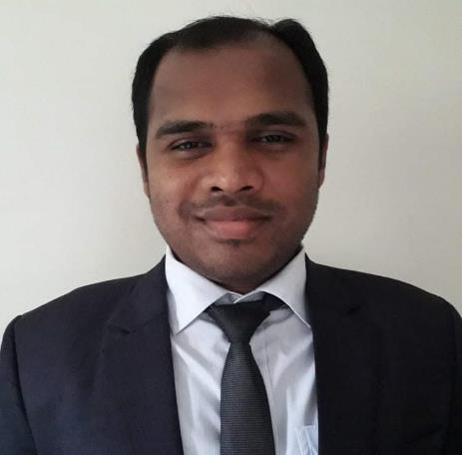
Teacher’s Identity
Anwar Hossain
Assistant teacher in English
34th BCS non-cadre
Jaintapur Govt.High School, Jaintapur, Sylhet.
Email: hossainanwar1516@gmail.com

Slide 3
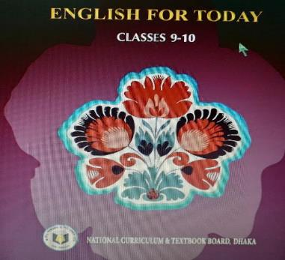
Introduction of the Topic
Class: 9-10
Unit: One

Slide 4
Suppose your mother is sick at home and there is none at that moment.
What will you do in that case?
What does it call?

Slide 5
Our Today’s Lesson
Unit: One
Lesson: 2
(Knowledge, skills and attitudes)

Slide 6
Learning outcomes
After studying the lesson, the students will be able to;
apply new word in real life situations
choose the best answer from alternatives
write answer of the questions.

Slide 7
Vocabulary presentation
Vocabulary Presentation
Include---insert
Difficulty---problem
Constitution---the basic principles and laws of a nation
Behaviour---conduct
Noticeable--- remarkable

Slide 8
Pair work
Choose the correct answer from the following alternatives
Which of the following word has closest meaning of the word Knowledge?
a)learning b)know c) enforce d) item
ii) You should have knowledge about ---
a) The geography of your country b) the judicial system of your country c)your government d) all of the above

Slide 9
iii) Group work removes---
a) Shyness b)cowardice c) gentleness d) courtesy
iv) In the passage the word ‘legislative’ means---
a)law b) law maker c) law making d)regarding law
v) To be a good citizen one should have -------
money
Power
Knowledge
property

Slide 10
vi) Knowledge of science and technology is essential for leading a ----life
ordinary b)simple c) good d)normal
Vii)What is the main theme of the passage?
To make people aware of the rules of being good citizen
b) to show the rules of citizenship
c) to highlight about the good citizens
d) to tell about behavioural change

Slide 11
Group work:
Answer the following questions.
How can you lead a good life?
What is meant by behavioural change?
What should you know to be a good citizen?
What are results of group work?

Slide 12
Home work:
Write a summary of the above passage

