Slide 1
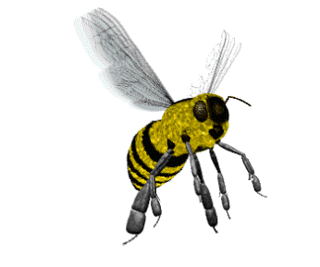
WELCOME

Slide 2
Presented by
Farzana chowdhury
Assistant teacher
Norpati Government primary school
Laksam,cumilla.
E-mail:sorna67m@gmail.com

Slide 3
SUBJECT:ENGLISH
Class : 3
Time 40 minutes.

Slide 4
Learning outcomes
Students will be able to
3.2.1 understant simple questions about familiar objects
8.1.1 write words from the textbook
1.4.1 read and match words with pictures.

Slide 5
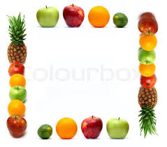
Mental preparation

Slide 6
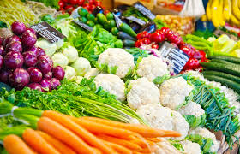
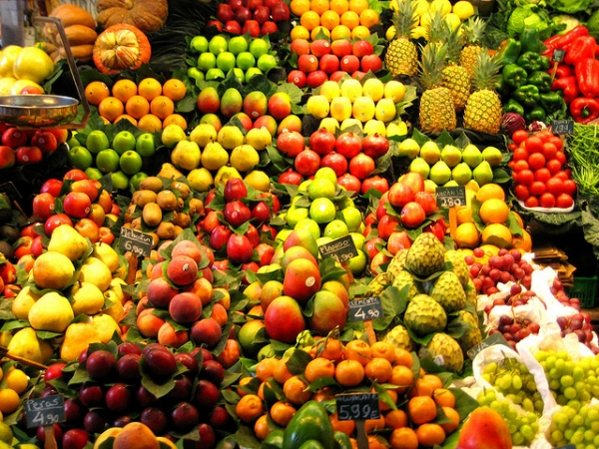

Slide 7
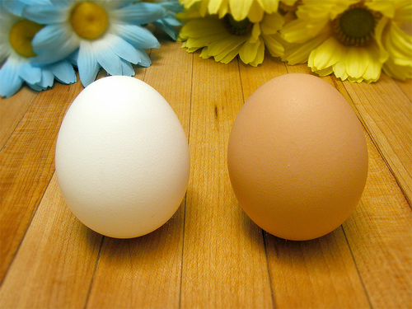
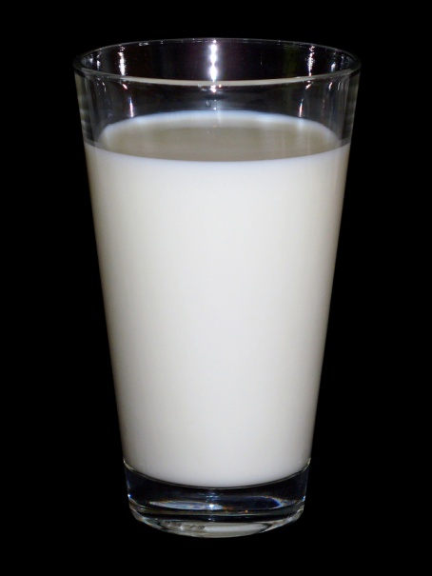
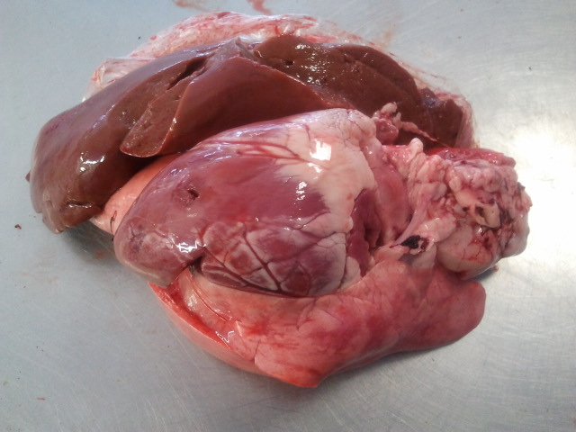
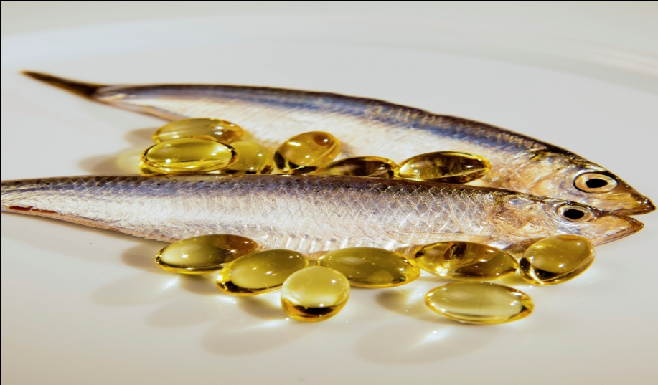

Slide 8
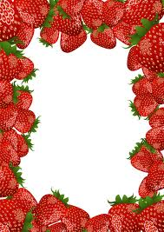
Lesson declaration
Unit- 36
Food we need

Slide 9
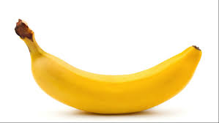
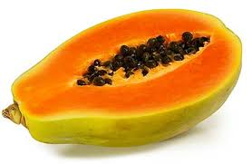
banana
papaya

Slide 10
carrot

Slide 11
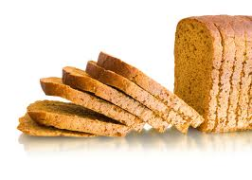
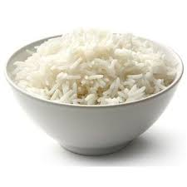
rice
bread

Slide 12
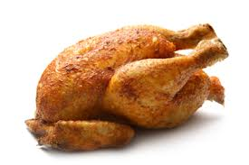
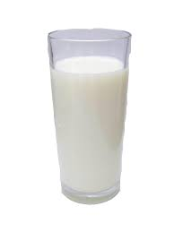
milk
chicken

Slide 13
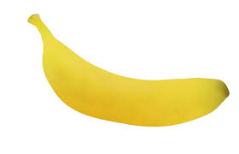
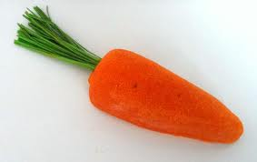
banana
One kind of fruit from tree.
carrot
One kind of vegetable from plants

Slide 14
papaya
One kind of Food from trees

Slide 15
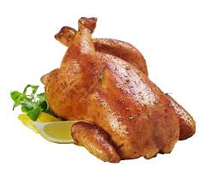
chicken
Food from animals
Food from animal
Milk

Slide 16
SGW
Food from plants and trees
papaya
banana
carrot

Slide 17
Food from animals
milk
chicken

Slide 18
IW
MATCHING
milk
papaya
carrot

Slide 19
chicken
Rice
banana

Slide 20
PW
Food from plants and trees | food from animals
banana
Milk
carrot
chicken
rice
papaya

Slide 21
milk
WCW
carrrot
banana
Bingo game
rice
papaya
chicken

Slide 22
GW
Answer the questionS
1. Which food we get from plants and trees?
2. Which food we get from animals?

Slide 23
Home work
Write 2 another foods from trees and plants.
Write 2 another foods from animals.

Slide 24
See you tomorrow

