Slide 1
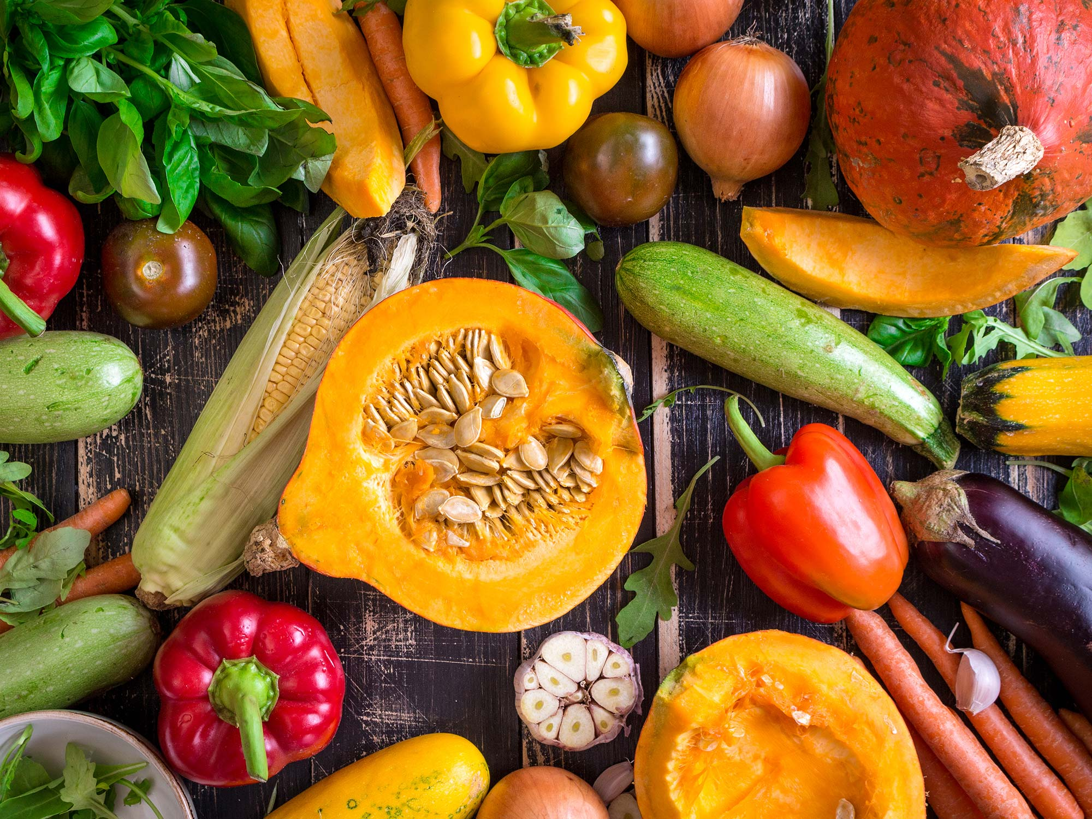
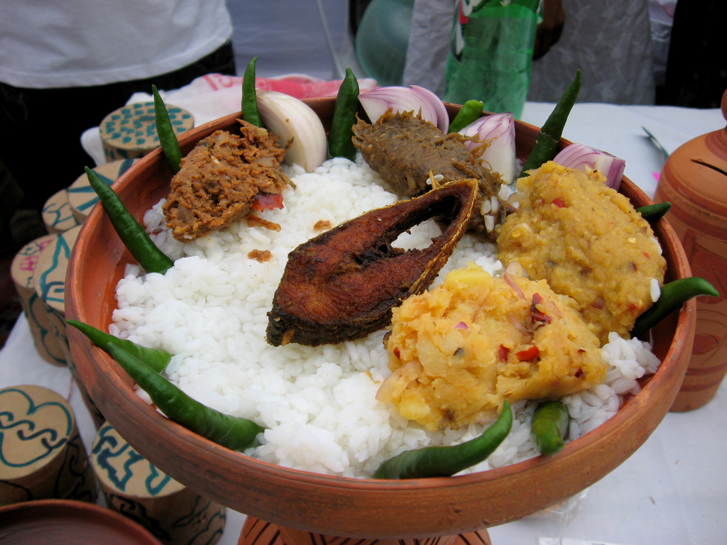

Slide 2
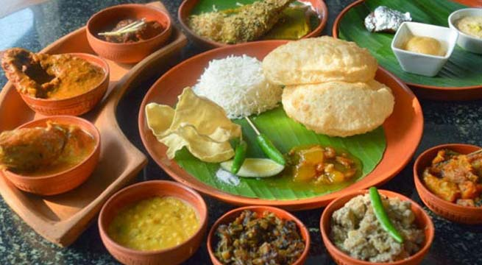
You are welcome.

Slide 3
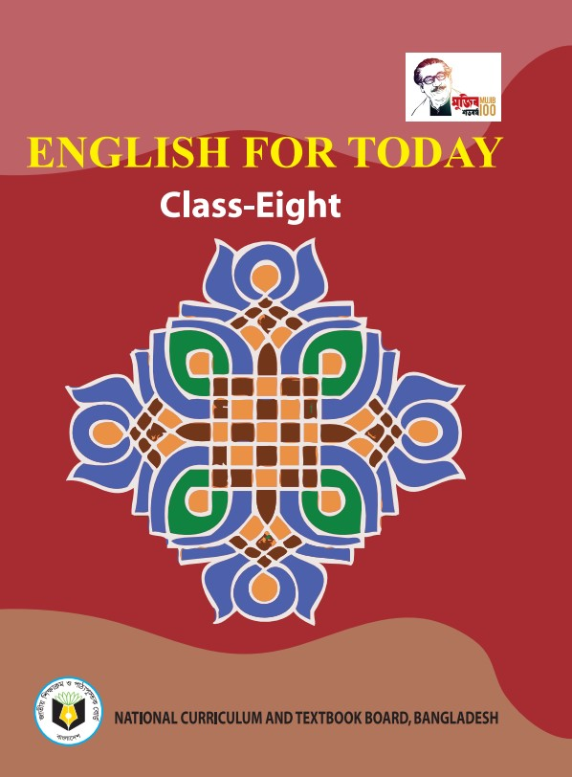
Identity
Swandip Banerjee
Assistant Teacher (English)
Pallimangal Secondary School Sonadanga, Khulna.
Email. swandipb1@gmail.com
Mobile: 01718503573

Slide 4
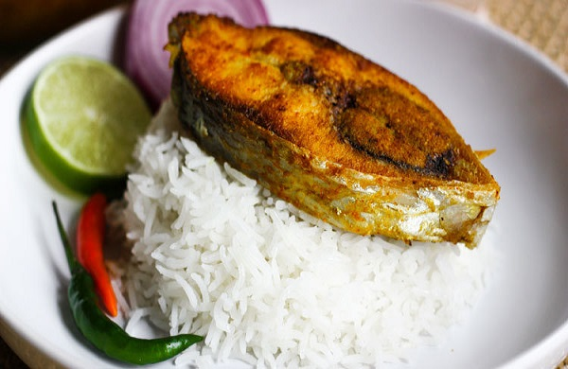
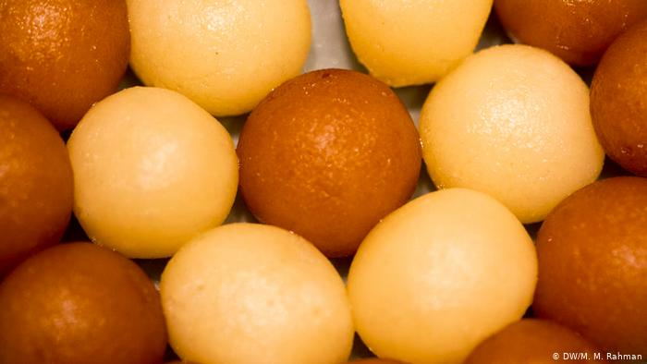
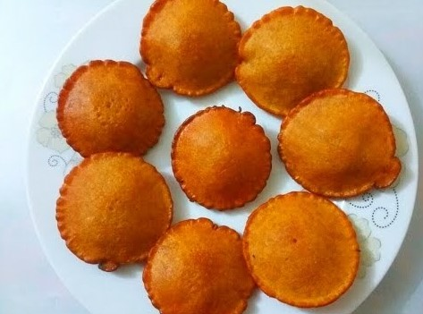
Look at the pictures.

Slide 5
Our today’s lesson is….?
Bangladeshi cuisine
Unit : 01
[ A glimpse of our culture]
Lesson : 05

Slide 6
Learning outcomes.
After we have studied this lesson, we will be able to…………
read and understand texts through silent reading.
infer meaning from context.
ask and answer questions.
write answers to questions.

Slide 7
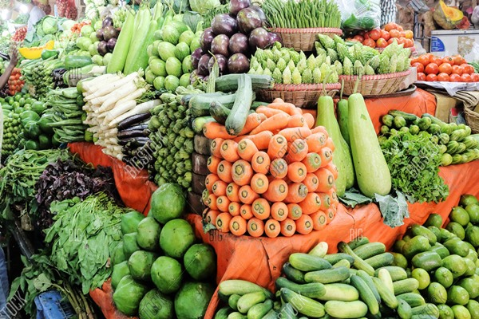
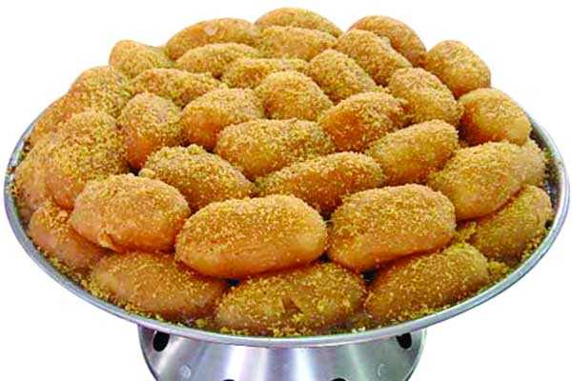
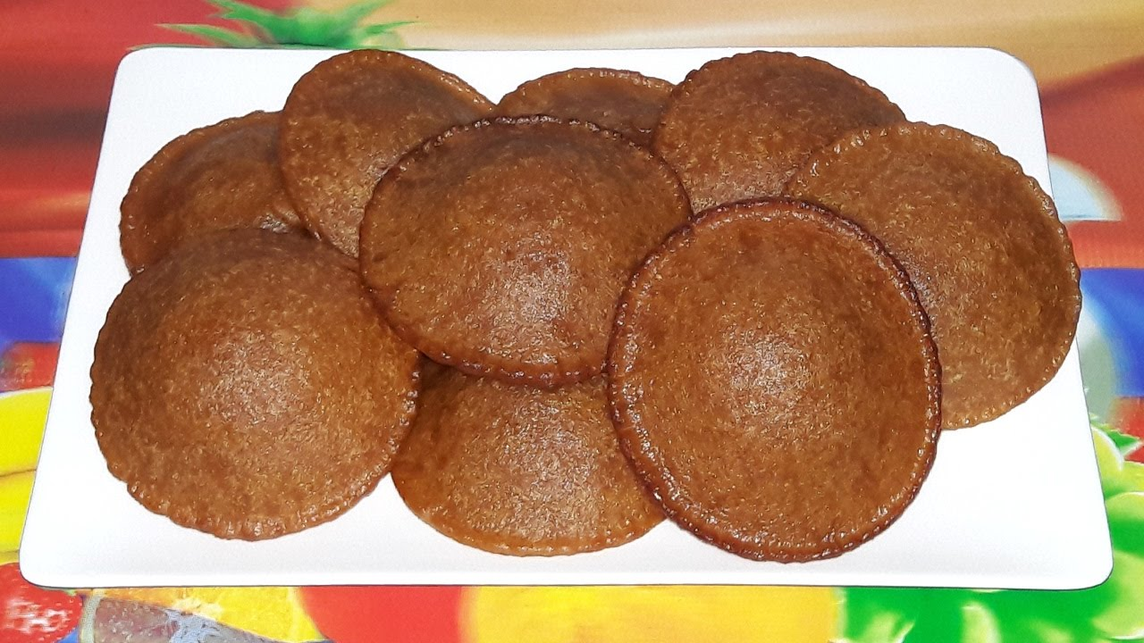
A. Look at the pictures and discuss in pairs.
What do you see in the pictures?
Which foods are seen in the pictures? Do you prepare/eat them at home?
Among the foods, which one is your favourite? Why?

Slide 8
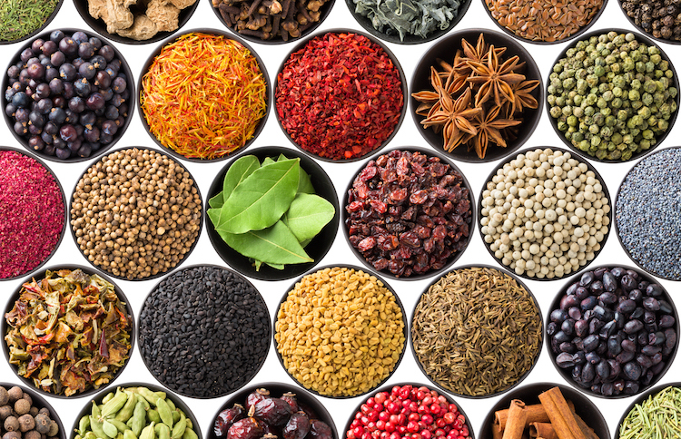
New word
Cuisine
A style or manner of cooking
Synonym: cooking.

Slide 9
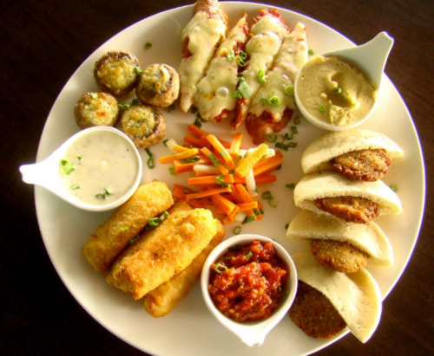
New word
Platter
A large plate that is used for serving food
Synonym: salver, dish.

Slide 10
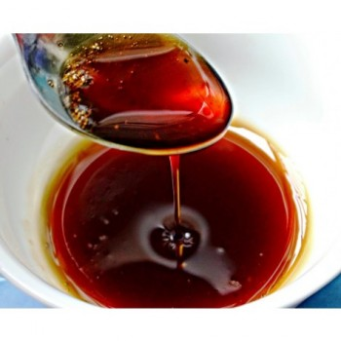
New word
Molasses
Thick sweet sticky liquid produced from date juice by boiling.
Synonym: treacle

Slide 11
B. Read the text below and answer the following true-false activity in section C.
Bangladeshi cuisine is rich and varied with the use of many spices. We have delicious and appetizing food, snacks, and sweets.
Boiled rice is our staple food. It is served with a variety of vegetables, curry, lentil soups, fish and meat. Fish is the main source of protein. Fishes are now cultivated in ponds. Also, we have fresh-water fishes in the lakes and rivers. More than 40 types of fishes are common, Some of them are carp, rui, katla, magur (catfish), chingri (prawn or shrimp), Shutki or dried fishes are popular. Hilsha is very popular among the people of Bangladesh.
Panta ilish is a traditional platter of Panta bhat. It is steamed rice soaked in water and served with fried hilsha slice, often together with dried fish, pickles, lentil soup, green chilies and onion. It is a popular dish on the Pohela Boishakh.

Slide 12
The people of Bangladesh are very fond of sweets. Almost all Bangladeshi women prepare some traditional sweets. Pitha, a type of sweets made from rice flour, sugar syrup, molasses and sometimes milk, is a traditional food loved by the entire population. During winter, Pitha Utsab, meaning pitha festival, is organized by different groups of people.
Sweets are distributed among close relatives when there is good news like births, weddings, promotions etc.
Sweets of Bangladesh are mostly milk-based. The common ones are roshgolla, sandesh, rasamalai, gulap jamun, kalo jamun and chom-chom. There are hundreds of different varieties of sweet preparations. Sweets are, therefore, an important part of the day-to-day life of Bangladeshi people.
Back

Slide 13
C. True or false? If false, give the correct information.
Our foods are rich because they have a lot of oil in them.
We get protein mostly from fish.
On Pohela Boishakh, the traditional food is steamed rice and fried hilsha.
Pitha Utshab takes place almost all the year round in Bangladesh.
Sweets are not much appreciated by the people of Bangladesh.

Slide 14
E. Discuss and answer the questions in pairs.
Describe a Bangladeshi food that you like best.
Make a list of the things you and your partner eat every day.
Make two lists of food one eaten by the urban and the other by the rural people.
Why are there differences between the food eaten by the urban and the food eaten by the rural people?
Text

Slide 15
F. How fast can you say this sentence?
Casual clothes are provisional for leisurely trips across Asia.

Slide 16
Evaluation
Guess the meaning of the following words and choose the correct meaning closest to the text.
1. Cuisine— (i) cook (ii) food (iii) cooking (iv) cooking process
2. Platter— (i) a large, flat dish (ii) plate (iii) utensil (iv) pot
3. Molasses—(i) molecule (ii) a thick treacle (iii) sugar (iv) sweet
4. Staple— (i) step (ii) measure (iii) main (iv) steep
5. Traditional—(i) of trade (ii) commercial (iii) heritage (iv) conventional
(iv) cooking process
(i) a large, flat dish
(ii) a thick treacle
(iii) main
(iv) conventional

Slide 17
Home work
D. Read the text in B again and answer the following questions.
What has made Bangldeshi food so special?
Where do we get the fishes from?
Apart from fish, what other foods do we eat with rice?
Why are sweets an important part of our life?

Slide 18
Thank you all.

