Slide 2
Identity
Sabina Yeasmin
Lecturer in English
Baridhara Nazmul Ulum Alim Madrasah
Badda, Dhaka

Slide 3
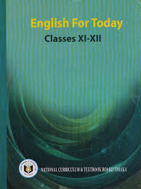
Class : Alim/HSC
Subject : English 1st Paper

Slide 4
Let’s enjoy the video
https://www.youtube.com/watch?v=ZsQfqlkayJ4

Slide 5
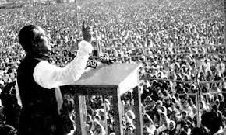
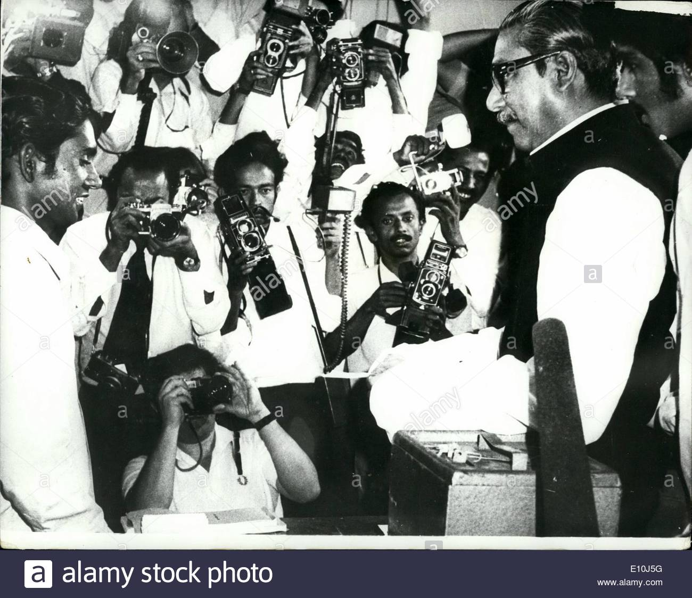
Let’s watch some images attentively

Slide 6
Can you guess what’s the today’s topic by watching this video and images?
Part-1
Exactly today’s topic is-
Unit:1, Lesson: 1
The Unforgettable History

Slide 7
Learning outcome
At the end of the lesson, students will be able to-
Increase vocabulary
1
2
Achieve the reading skill.
Answer the questions easily.
3
Fill in the blanks without clues spontaneously.
4

Slide 8
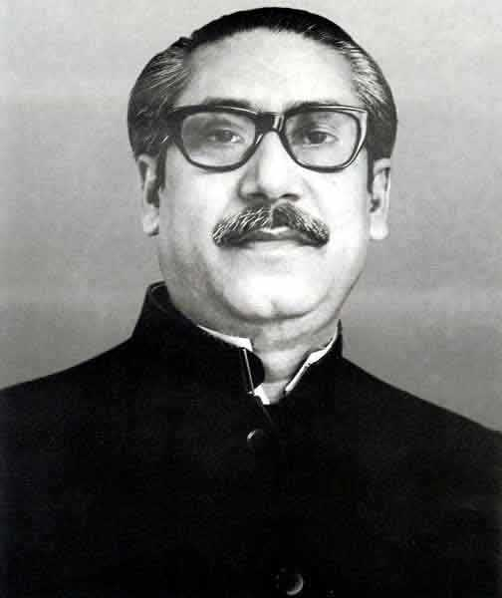
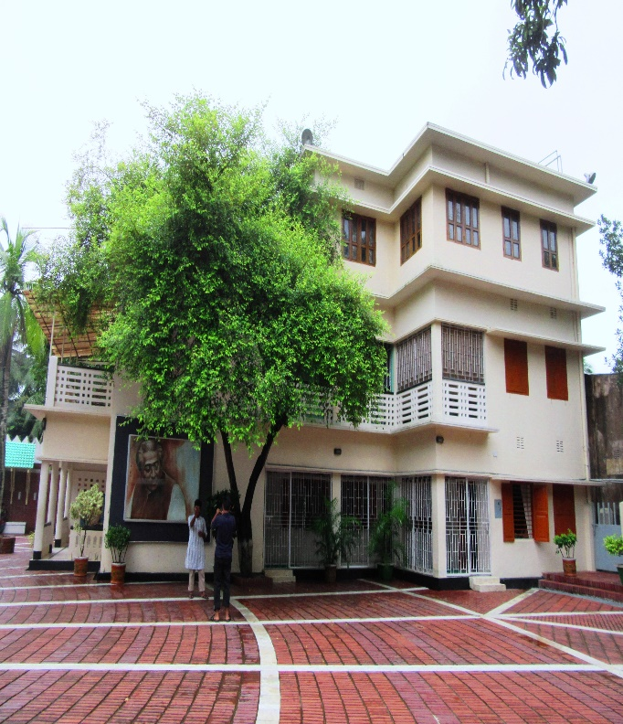
Sheikh Mujibur Rahman shortened as Sheikh Mujib or Just Mujib was born on 17 March, 1920 in Tungipara a village in Gopalganj District in the province in British India. His father’s name is Sheikh Lutfur Rahman and his mother’s name is Sheikh Sayera Khatun. He was the third child in a family of four daughters and two sons. His parents adoringly called him “Khoka”.
Mujibur Rahman
Palace of Tungipara

Slide 9
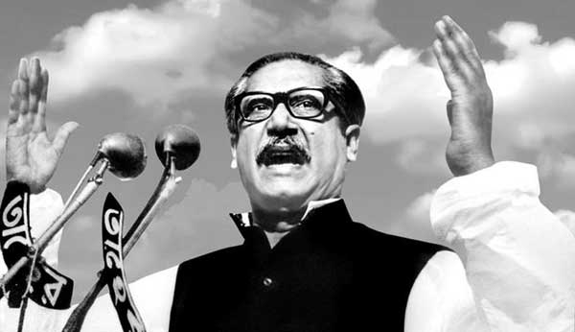
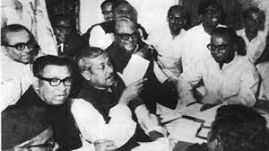
He was a Bangladeshi politician and statesman. He served as the first President of Bangladesh and later as the Prime Minister of Bangladesh from 17th April 1971 until his assassination on 15 August, 1975. He is considered to be driving force behind the Independence of Bangladesh. He is popularly dubbed with the title of “Bangabandhu” by the people of Bangladesh.
As a president

Slide 10
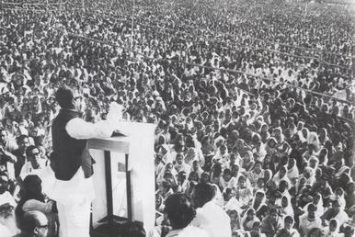
He became the leading figure in and eventually the leader of the “Awami League” founded as an East Pakistan – based on political party in Pakistan. Mujib is credited as an important figure in efforts to gain political autonomy for East Pakistan and later as the central figure behind the Bangladesh liberation Movement and Bangladesh liberation war in 1971.
Founded Awami League
Speech of 7th March

Slide 11
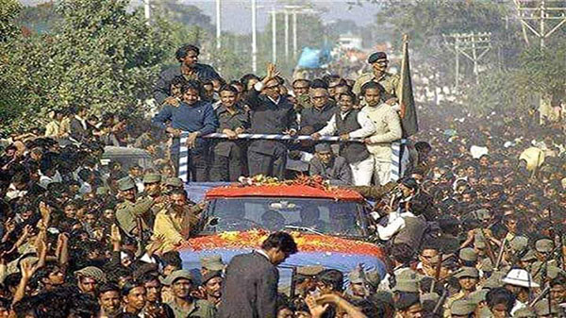
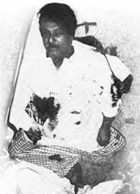
Thus he regarded “Jatir Janak” or Jatir Pita both meaning “Father of The Nation” of Bangladesh. On 15 August, 1975 he was killed by a group of junior army officers at the age of 55.

Slide 12
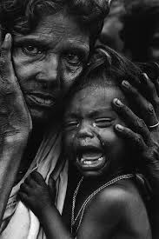
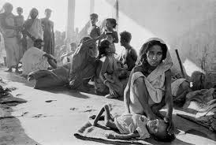
Agony
Vocabulary
Mean: Extreme physical or mental suffering
Syn: Misery, trouble, suffering
Ant: Happiness,comfort, pleasure
Ex: We have passed through 23 tragic years in agony.

Slide 13
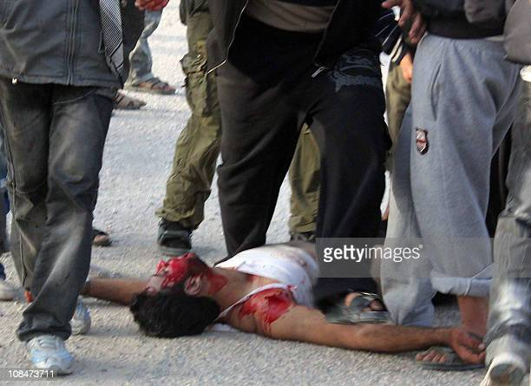
Crimson
Vocabulary
Mean: Of a rich deep red color
Syn:Booldshot, reddish, scarlet
Ex: The Pakistani Army made our highways crimson with ours blood.

Slide 14
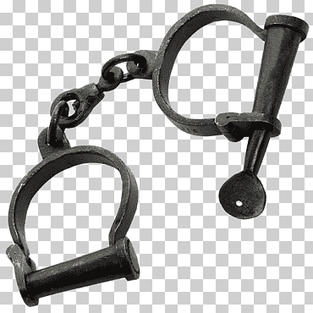
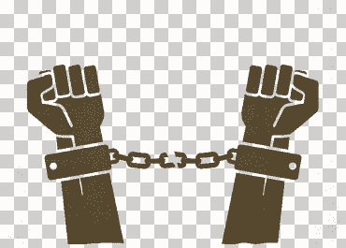
enslave
Vocabulary
Mean: Make someone a chain
Syn: enthrall, beslave, chain
Ant: emancipate, free
Ex: Ayub Khan declared Martial Law to enslave us.

Slide 15
Now read the text.
My brothers,
I stand before you today with a heart overflowing with grief .You are fully aware of the events that are going on and understand their import .we have been trying to do our best to cope with the situation.

Slide 16
And yet, unfortunately, the street of Dhaka, Chattagram, Khulna, Rajshahi and Rangpur are awash with the blood of our brothers. The people of Bengal now want to be free, the people of Bengal now want to live, and the people of Bengal now want their rights.
Bloodshed

Slide 17
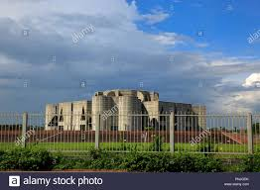
What have we done that was wrong? After the elections, the people of Bangladesh voted as one for me, for the Awami League. We were to sit in the National Assembly, draft a constitution for ourselves there, and build our country; the people of this land would thereby get economic, political, cultural freedom.
President
Parliament

Slide 18
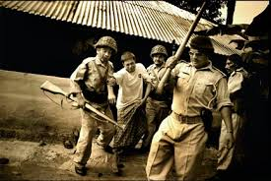
But it is with regret that I have to report to you today that we have passed through twenty-three tragic years; Bengals history of those years is full of stories of torture inflicted on our people of blood shed by them repeatedly. Twenty three years of a history of man and women agony!
Torture
Agony

Slide 19
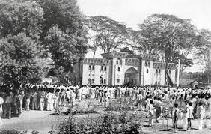
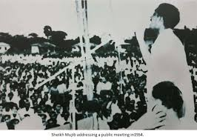
21 February 1952
The history of Bengal is the history of a people who have repeatedly made their highways crimson with their blood. We shed blood in 1952; even though we were the victors in the elections of 1954 we could not form a government then.
Elections of 1954

Slide 20
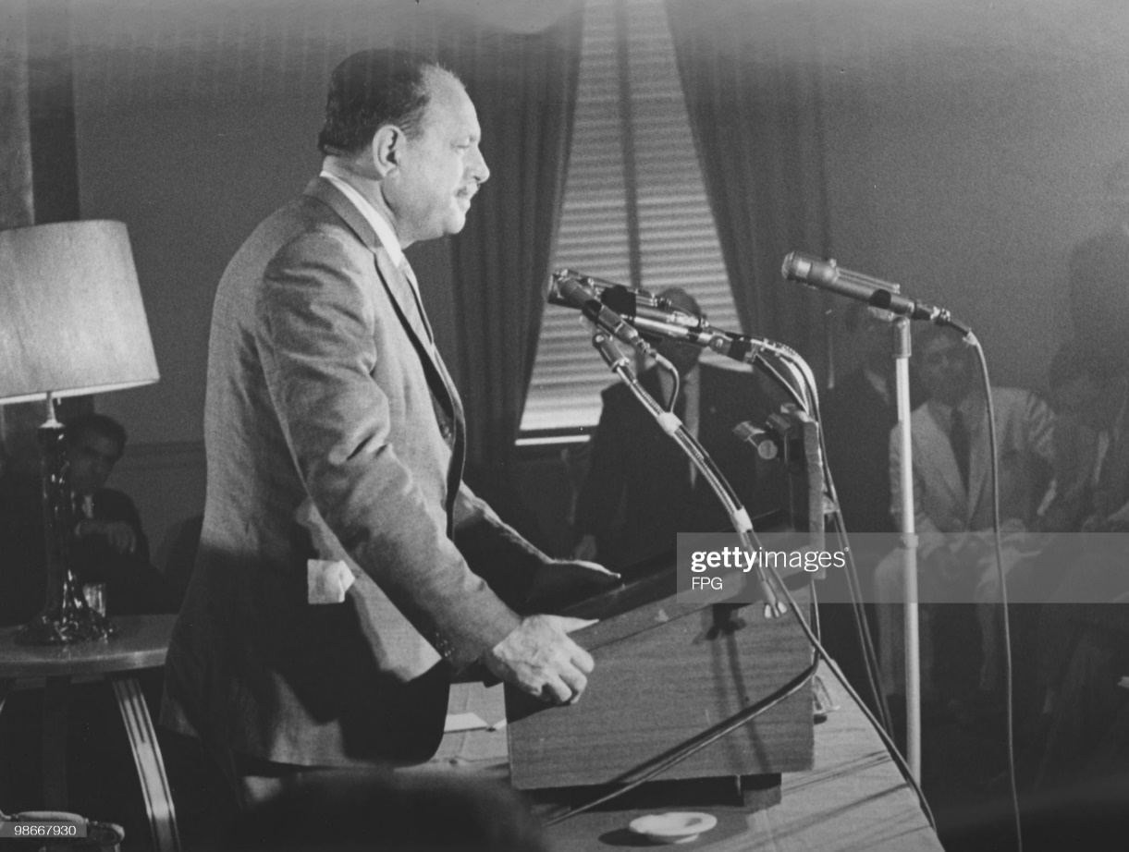
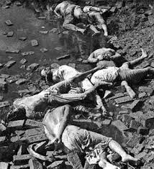
In 1958 Ayub Khan declared Martial Law to enslave us for the next ten years. In 1966 when we launched the six –point –movement our boys were shot dead on 7 June.
Ayub Khan
Shot dead

Slide 21
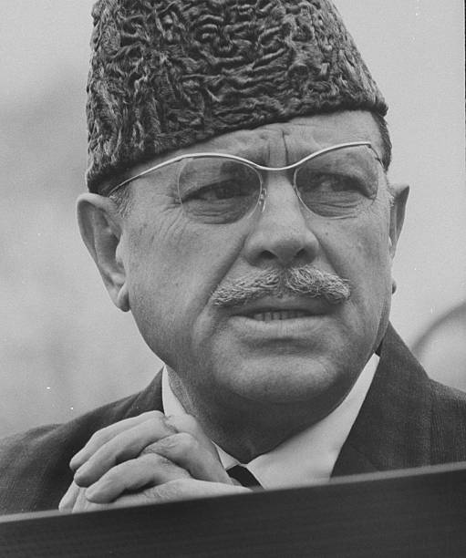
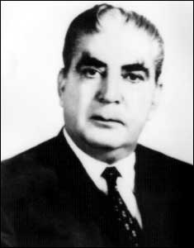
When after the movement of 1969 Ayub Khan fell from power and Yahya Khan assumed the reins of the government the later declared that he would give us a constitution and restore democracy; We listened to him then. A lot has happened since and election have taken place.
Ayub Khan
Yahya Khan

Slide 22
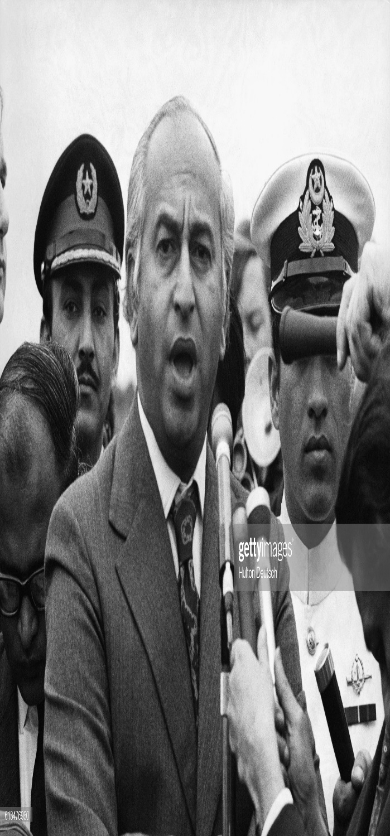
I have met president Yahya khan. I have made a request to him not only on behalf of Bengal but also as the leader of the party which has the majority in Pakistan; I said to him: “You must hold the session of the National Assembly on 15 January.” But he did not listen to me. He listened to Mr. Bhutto instead.
Bhutto

Slide 23
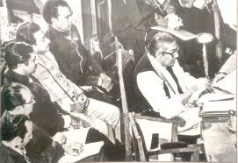
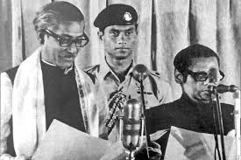
At first he said that the meeting would take place in the first week of March. We said,” Fine, we will be taking our seats in the Assembly then,” I said we will carry out our discussions in the Assembly. I went so far as to say that if any one came up with an offer that was just, even though we were in the majority, we would agree to that offer.
Discussions

Slide 24
Individual work
Fill in the blanks
Bangabandhu Sheikh Mujibur Rahman was born on 17 March 1920 at Tungipara in the district of Gopalganj. He is called the Father of the Nation (a) Bangladesh gained Independence under his leadership. He (b)
his primary education in the village. He(c)
Matriculation from Gopalganj Mission School in 1942 (d) passed B.A. Examination from Kolkata Islamia College (e) 1947. He involved in politics (f)
his student life. He got in touch (g) so
as
started
passed
and
in
during
with

Slide 25
Individual work
Fill in the blanks
president
Some great politicians in those days. As (h) of Awami League, he declared the six point (i) for the autonomy of Bangladesh in 1966. (j) the victory of Bangladesh, Bangabandhu Sheikh Mujibur Rahman at first took over as the prime Minister and thereafter as the President.
Program
After

Slide 26
Pair work
Talk about Sheikh Mujibur Rahman

Slide 27
Choose the correct answer from the alternatives
Group work
1. What is the meaning of the word ‘agony’?
(a).painful (b). anguish (c). miserable (d). suffering
2. What does the word ‘crimson’ in the text mean?
(a). radish (b).redish (c). red (d) deep red
3. The word ‘negotiation’ refers-
(a)discussion(b)problem(c)understanding (d)nemesis
4. What does the word ‘slaughter’ means?
(a).save (b).murder(c).damage (d).destroy
5.Awami League had a victory in the election of?
(a).1952 (b). 1954 (c). 1966 (d). 1969

Slide 28
Evaluation
Answer the questions
1.When did Sheikh Mujibur Rahman make this speech?
2.What is unforgettable history and why?
3.Why is1966 important for us?
4.What caused the downfall of Ayub Khan?
5.”People of Bangladesh now want to be free”. –Explain the line.

Slide 29
Home work
Write a short paragraph on ‘Historical Speech of Sheikh Mujibur Rahman’.

Slide 30
Thank you so much
For watching

