Slide 1
Welcome Everybody
To
Bhabanipur Sefatia Kamil Madrasah

Slide 2
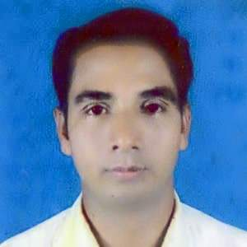
Introductions
Md. Moksed Ali
Assistant Teacher(English)
Bhabanipur Sefatia Kamil Madrasah,
Hatibandha, Lalmonirhat.
Mobile: 01717292475
Email:moksedali1980@gmail.com

Slide 3
More Introduction
Class
Subject
SixTo Ten
English 2nd Paper
Changing Sentence (Interrogative To Assertive )
Part : One

Slide 4
Now Start Our
Today’sLesson

Slide 5
To days Topic
Changing Sentence (Interrogative to Assertive)
Rules - 1 & 2

Slide 6
Learning Out comes:
The students will be able to..
Identify the sentences.
Say the sentences.
Change the sentences.

Slide 7
1. Hasn’t the man a house?
The man has a house.
2.Can the man live in the house?
The man can not live in the house.

Slide 8
Rule-1:
If there is Auxiliary Verb
1. AV+n’t/ AV
After Sub
2. Other Parts
Are Same
3. Full Stop
New (.)

Slide 9
Examples :
1. Shan’t I go home?
=I shall go home.
2. Are we the singers?
=We are not the singers.

Slide 10
Who hasn’t a pen like a sord?
Every student has a pen like a sord
Rule -2:

Slide 11
If there is
Who
AV
1. Who
Every + Noun
After Noun
2. Av+not/Av
Are Same
3. Other Parts
3. Full Stop
Int Sign Omitted

Slide 12
More Examples
=Who must not call him?
Every one must call him.

Slide 13
Exercise:
1. Who mustn’t pray for him?
2. Don’t the farmers work in the field?
3. Haven’t they pens in the bag?
4. Weren’t we little one day?
5.Who had to do the sum well?

Slide 14
GOOD BYE TO EVERYBODY

