Slide 1
Lesson 24
Aesop’s fables
SA Asha

Slide 2
Prepared by
Shamima Aktar Asha
Info:
SA Asha

Slide 3
Learning objectives:
Students will be able to-
read and understand the text
understand and enjoy the story
learn some new words with their meaning and correct pronunciation
know the synonyms and antonyms of some words
answer short questions using the text
realize the morality of the story
SA Asha

Slide 4
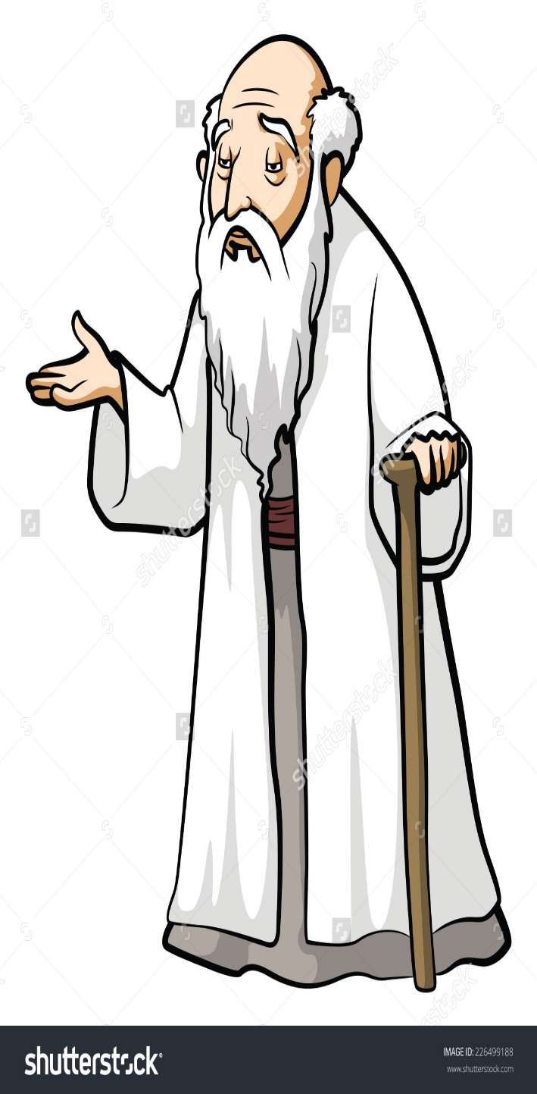
Introduction
Many hundreds of years ago, Aesop, a Greek slave, became famous for the fables he told. After so many years, people all over the world still enjoy reading them today as much as the Greeks enjoyed listening to them long, long ago..
SA Asha

Slide 5
Words Focus
Hundred
=
hʌndrəd
=
শত
Slave
=
sleɪv
=
কৃতদাস
Famous
=
feɪməs
=
বিখ্যাত
Fable
=
feɪbl
=
উপকথা, রূপকথা
Enjoy
=
ɪnˈdʒɔɪ
=
উপভোগ
SA Asha

Slide 6
Story: The Seven Sticks
Long ago and far away , there was an old farmer who had seven sons. One day, the old farmer was lying on his bed and he thought that he would not live much longer. He gathered his sons about him. He told a servant to bring..
SA Asha

Slide 7
Words Focus
Lying
=
laɪɪŋ
=
শয়ন
Thought
=
θɔːt
=
চিন্তা, ভাবনা
Gathered
=
ɡæðə(r)
=
একত্রিত করা
Servant
=
sɜːvənt
=
চাকর, ভৃত্য
SA Asha

Slide 8
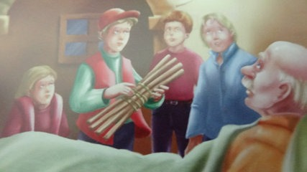
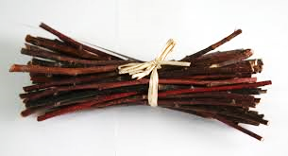
Story Continued…
…in a bundle of seven sticks tied together. He handed the bundle to his oldest son and said to him, “Son, now break the bundle”…
SA Asha

Slide 9
Words Focus
Bundle
=
bʌndl
=
গুচ্ছ
Handed
=
hændɪd
=
হস্তান্তর, হাত-বদল
SA Asha

Slide 10
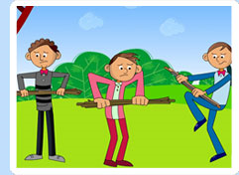
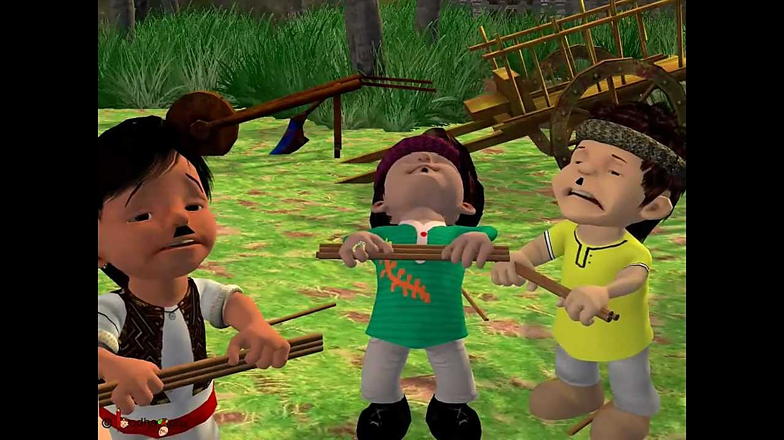
Story Continued…
The son tried with all his might, but he could not break the bundle. One by one, the other brothers tried. Not one of them was strong enough…
SA Asha

Slide 11
Words Focus
Might
=
maɪt
=
শক্তি, সামর্থ্য
Strong
=
strɒŋ
=
শক্তিশালী
Enough
=
ɪˈnʌf
=
যথেষ্ট
SA Asha

Slide 12
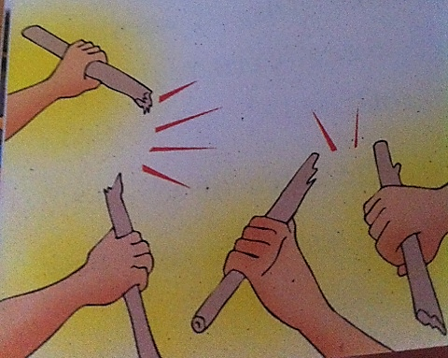
Story Continued…
The father smiled, “Now, my sons, untie the bundle. Each of you, take a stick and try to break it.” This time they had no difficulty breaking the sticks. In a few moments all the sticks were broken.
The old man looked at his sons affectionately and said,
“Remember, in unity there is strength.”
SA Asha

Slide 13
Words Focus
Untie
=
ʌnˈtaɪ
=
বন্ধনমুক্ত করা
Difficulty
=
=
অসুবিধা, বাধা
dɪfɪkəlti
Moment
=
məʊmənt
=
মুহূর্ত
=
একতা, ঐক্য
Unity
=
juːnəti
SA Asha

Slide 14
Synonyms… Antonyms…
Word | Synonyms | Antonyms
Slave | Servant [কৃতদাস] | Master [মনিব]
Famous | Renowned [প্রখ্যাত] | Unknown [অপরিচিত]
Fable | Tale [রূপকথা] | Non-Fiction [প্রকৃত তথ্যভিত্তিক গল্প]
Enjoy | Pleasure [আনন্দ পাওয়া] | Suffer [কষ্ট পাওয়া]
Gather | Collect [সংগ্রহ] | Spread [বিস্তার]
Bundle | Bunch [আঁটি] | Individual [একক]
Difficult | Hard [কঠিন] | Easy [সহজ]
Unite | Unify [ঐক্যবদ্ধ করা] | Divide [বিভক্ত করা]
SA Asha

Slide 15
Word Focus…
Tie = Untie [Un-tie]
Here, un- used to mean not or opposite
Like the un-, also we can use im-, in-, dis-,
Tie= Untie
Fold = Unfold
Like= Dislike
Possible= Impossible
Correct= Incorrect
SA Asha

Slide 16
Questions…
Who is Aesop?
What made him famous?
How many sons did he have?
Who was lying on bed?
Whom did the old farmer ask to bring the bundle of sticks to?
How many sticks were there in the bundle?
Who tried first to break the bundle?
SA Asha

Slide 17
Thank
You
SA Asha

