Slide 1
Instructions for the teachers
There may be something confusion in different places of this content. But all are done clear in the ‘Click to add notes’ option. Please see the instructions below each slide before presentation in the class.
Md. Abdul Kader Bhuiyan
Arkandi High School
Baliakandi, Rajbari.

Slide 2
Assalamu Alaikum
Notes:
This is a welcome slide

Slide 3
Introduction
Md. Abdul Kader Bhuiyan
Assistant Teacher
Arkandi High School
Baliakandi, Rajbari.
English 2nd paper
Class- VIII-X
Notes:
Introduction of the teacher and the class

Slide 4
The sight looks so nice.
Doesn’t the sight look so nice?
Isn’t it a very beautiful sight?
It is a very beautiful sight.
Notes:
Suspension to lead the lesson

Slide 5
Our today’s lesson is--
Transformation of sentence
Part-2 (Assertive to Interrogative)
Notes:
Lesson declaration.

Slide 6
Learning outcomes
After completing this lesson, we will be able to—
apply the use of be verb with negative
apply the use of auxiliary verbs with negative
apply question word (‘wh’ word) in interrogative
change from assertive to interrogative
Notes:
How to change from assertive to interrogative in different criteria.

Slide 7
Notice carefully
Computer is most essential for us. (Interrogative)
Isn’t computer most essential for us?
It plays a very important role in our life. (Interrogative)
Doesn’t it play a very important role in our life?
Everybody needs it. (Interrogative)
Who does not need it?
Notes:
Different applications of changing into Interrogative sentence shown here to lead the main lesson.

Slide 8
How to change Assertive(with be verb) to Interrogative
Human mind is very short.(Interrogative)
Isn’t human mind very short?
I am the best gift of Allah to my mother. (Interrogative)
Amn’t I the best gift of Allah to my mother?
Akbar was the greatest king of India. (Interrogative)
Wasn’t Akbar the greatest king of India?
If the assertive sentence is, subject + be ( am, is, are, was, were) + extension,
it will be--
Be(amn’t /isn’t/aren’t/wasn’t/weren’t +subject +extension +?
Notes:
What is to be done if the sentence is with be verb shown here.

Slide 9
Activities
Change the sentences into Interrogative
1. I am an ardent follower of Hazrat Muhammed (SM).
2. He is the guide of the human being.
3. We are obedient to him.
4. Hazrat Abu Bakar (R) was the first man to receive his invitation.
5. Hazrat Omar & Ali (R) were the next caliphs of Hazrat Abu Bakar.
Notes:
This is for class work as evaluation.

Slide 10
How to change Assertive (with action verb) to Interrogative
I say my prayer five times regularly. (Interrogative)
Don’t I say my prayer five times regularly?
My mother wants me to be a model of truth. (Inter)
Doesn’t my mother want me to be a model of truth?
Our prophet ordered us to follow him (Interrogative)
Didn’t our prophet order us to follow him?
If there is action verb in the sentence, Interrogative will be started with Don’t/Doesn’t/Didn’t according to tense, subject & number.
Notes:
The verb that refers doing something is an action verb. Action verb always takes auxiliary don’t/doesn’t/didn’t at the time of changing into negative and interrogative.

Slide 11
Activities
Change the sentences into Interrogative
1. Religion plays an important role in human life.
2. Noble people follow their religions properly.
3. All the prophets sacrificed their lives for the sake of religion.
4. Religions teach us morality.
5. It shows the way of truth.
Notes:
Class work for evaluation

Slide 12
Assertive (with Every) to Interrogative
Everybody wishes to be happy.(Interrogative)
Who does not wish to be happy?
Change the sentences into negative
1. Everybody loves flowers.
2. Nobody hates it.
3. Everyone smells flowers.
4. Everybody enjoys it.
5. All desire its beauty.
Notes:
‘Who does not’ is used in place of everybody, everyone. But Nobody, No one takes only who, not other auxiliaries. Such as “Nobody could do this.” Answer: “Who could do this?”

Slide 13
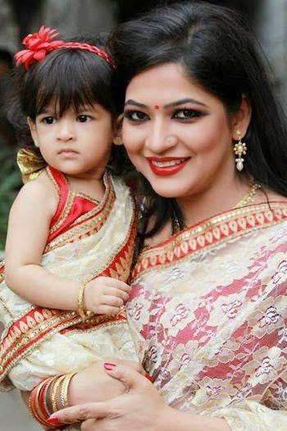
Assertive (with Every+ noun) to Interrogative
Every mother loves her child.(Interrogative)
Is there any mother who does not love her child?
Change the sentences into negative
1. Every man loves flowers.
2. Every person hates a liar.
3. Every woman likes ornament.
4. Every baby wants toys.
5. Every man desires more and more.
Notes:
In the previous slide it is shown the use of ‘Everyone/Everybody’ as pronoun but here it is shown ‘Every + Noun’. So it takes the rule ‘Is there any + noun + who does not+ extension +?’

Slide 14
Assertive (with never/nothing) to Interrogative
I never drink tea.
Do I ever drink tea?
I had nothing to say.
Had I anything to say?
Notes:
Other rules are the same . At the time of changing ‘never’ changes into ‘ever’ and ‘nothing’ changes into ‘anything.’

Slide 15
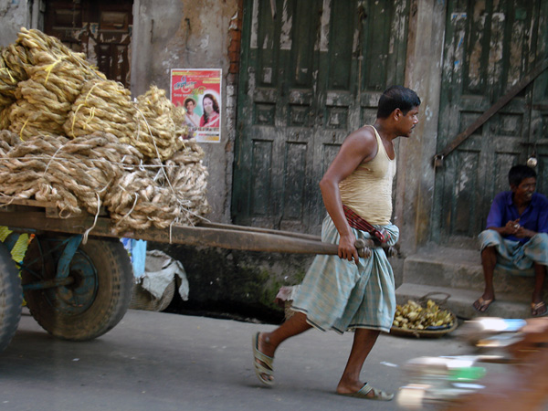
Assertive (with do not/does not/ did not) to Interrogative
He does not work hard.
Does
not
he work hard?
If the assertive sentence begins with do not/does not/did not,
‘not’ will be omitted at the time of changing into interrogative.
Notes:
Remember , Affirmative is always turned into negative while changing into interrogative but negative is always omitted while turning it into affirmative in interrogative form.

Slide 16
Activities at home
Change the sentences into Interrogative.
1. He is a noble man.
2. Everybody likes him.
3. He was a bright student.
4. He studied regularly in his student life.
5. He did not do any work subversive to state and society.
6. He is now a model of the society.
7. We are proud of him.
8. We pray for him to be a famous person.
Notes:
Mixer use of changing into interrogative are given as home work.

Slide 17
Inviting you to enjoy part-3
Allah Hafez
Notes:
Leading into the next content it is ended here.

Slide 18
Acknowledgement
We would like to express our cordial gratitude to the Ministry of Education, Directorate of Secondary & Higher Education, NCTB, A2i and the panel of honorable editors to enrich the contents.

