Slide 1
welcome

Slide 2
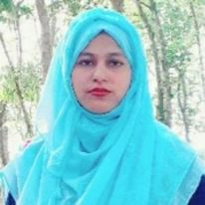
Rajia Akter koli
Assistant teacher
Aralia Government Primary School

Slide 3
Introduction of Lesson Class:Five Unit:13 Lesson:1 Lesson Title:Telling the time Todays Lesson:Listen,read and say Time:40

Slide 4
Learning outcomes: By the end of the lesson the student will be able to 5.1.1-Tell the time(hours and miniuts)and mention am/pm,half past,quarter to etc.

Slide 5
Worm up:

Slide 6
Telling the time

Slide 7
In put:
What is this?
It’s a clock.

Slide 9
Open your book:
50

Slide 10
New word
Pray
প্রার্থণা
Tick-tock
ঘড়ি চলার শব্দ

Slide 11
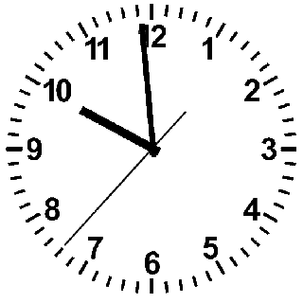
Pair work
What time is it ?
What are you doing at those time ?

Slide 12
Now we see the answer :
What time is it?
Its 10 o”clock.
What are you doing at those time?
We are on school.

Slide 13
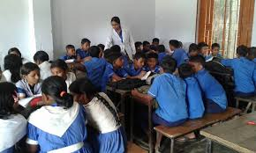
Group work:
What are you doing at those time?

Slide 14
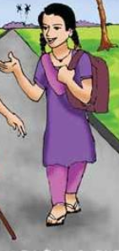
Take our bag and go to school.

Slide 15
Chain drill:
When you go to school?
When you go to pray?

Slide 16
Cheaking learning:
What time is it?

Slide 17
One day one word
প্রার্থণা
Pray

