Slide 1
Welcome to online class

Slide 2
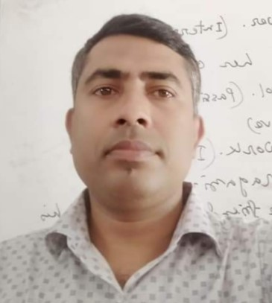
Identity
Md.Anamul Hoque
Assistant Teacher
Hazi konu miah High School
Dowara Bazar, Sunamgonj.
Class: 9-10
English Grammer
Date: 01.01.2021

Slide 3
Can you guess what type of sentences they are ?
1. He reads attentively so ----------------------------------------------
2. It is high time we ---------------------------------------------------------
3. If you play well ------------------------------------------------------------
Completing Sentence

Slide 4
Learning Outcome
After studying this lesson , students will be able to------------
1. Complete the sentences by using approprite clause .
2. Understand some important grammartical rules for completing sentence.

Slide 5
Our to day’s topic is ------------
Completing Sentence
Part- 2
Question No-7

Slide 6
It is time / It is high time
It is time / It is high time + Sub+ v2+ext
1. It is time / It is high time we changed our bad habit
2. It is time we gave up smoking
Note: Suppose something should be done. It is already a little bit late, in this case we use It is high time/ It is time.

Slide 7
As if / As though
1. Simple present +as if / as though + Simple past .
Karim talk as if / as though he knew everything.
2. Simple past + as if / as though + past perfect
Sub+ v2 + obj + as if / as though + sub + had + V3 + ext.
Karim talked as if / as though he had known everything.

Slide 8
Since
1.Present tense + since + simple past
It is long time since we met last
2. Past tense + since + past perfect tense
Sub+V2+obj+ Since + Sub + had + V3 + ext
It was a long time since we had met last

Slide 9
Would that / I wish
Would that / I wish + sub + were / could be + other word
I wish / would that I were / could be a bird.
Would that /I wish I were / could be a child again.

Slide 10
Relative pronoun
If there is relative pronoun (who,which,that,whom,whose) in any incomplete sentence ,these kind of sentences can be completed according to the antecedent that used before relative pronoun. For Example---
came here yesterday/ won lottery
a) I saw the man who-------------------
he wants to buy
b) This is the house that ---------------
which is small.
c) The writer took a cabin -----------------

Slide 11
Too…………To
Sub+verb+too+adj/adv+to+V1+other word
1.He is too poor to……buy the food
2.Mr Alom is too young to---perform the job
Note-Too-----to,is used to express something in negative way.

Slide 12
As soon as
As soon as+past tense+past tense
we stood up
1.As soon as we saw our teacher---------------------------------
the train started
As soon as we reached the station…………………
Note- As soon as is used to do something instantly

Slide 13
Home work
1.It is high time………………………...........
2.He is too weak………………………………
3.Unless you take physical exercise……………
4.He pretends as if ………………………………
5.Walk fast lest…………………………………..
6.It is a long time since………………………….
7.When I went to market……………………….
8.As soon as he saw me…………………………….

Slide 14
Thanks every body

