Slide 1
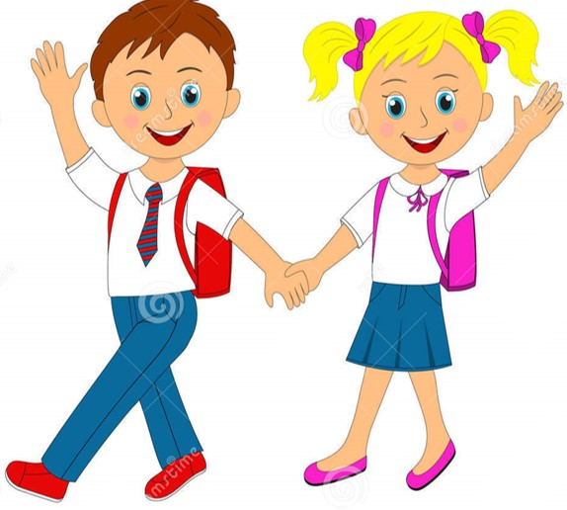

Slide 2
Umme Sabiha
ASISSTANT TEACHER
KAJIRBAG GOVT. PRIMARY SCHOOL
SIJDIKHAN , MUNSHIGONJ.
Sub: English
Class: Two
Lesson : Colours
Parts of the lesson: (Activity-B)
Page No-33
Mosa.Hajera Begum
Assistant Teacher
Kharatiya Govt. Primary School.
Burichang. Cumilla.

Slide 3
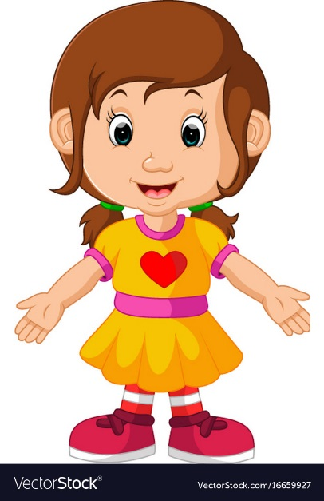
Safety environment by greetings song.
Hello! Hello! How are you?
I’m well, I’m good.
I’m great, I’m wonderful.
Hello! Hello! How are you?
I’m fine! I’m great today.

Slide 4
Learning Outcomes:
By the end of the lesson the students will be-
use the words (rainbow, yellow, indigo, violet) in small group.
sing the song along with others in WCW.

Slide 5
Lead In activities:
Dear students-
Do you find anything that is yellow?
How the color is red?
Now try to say-
What can be the topic of our today’s lesson?

Slide 6
RED
blue
GREEN
White
VIOLET

Slide 7
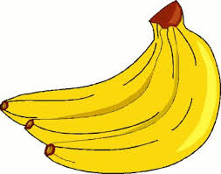
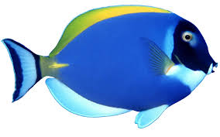
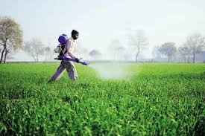
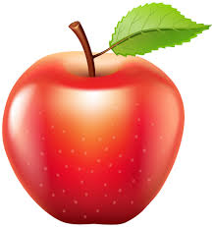
Yellow
A
B
C
D
Blue
Green
Red

Slide 8
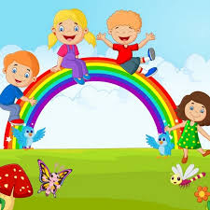

Slide 9
Beautiful butterfly,
Beautiful butterfly,
I see you!
Where do you go?
I have red flowers to give honey to you.

Slide 10
Fill in the gaps:Group-1
The roses are __________.
Where does ________ go.
The butterfly is of ________ color.
Group-2:
1.What does butterfly do?
2.How many colors are there in the butterfly?

Slide 11
That’s all for today. Goodbye. See you tomorrow.

