Slide 1
Welcome Everybody for todays multimedia class.

Slide 2
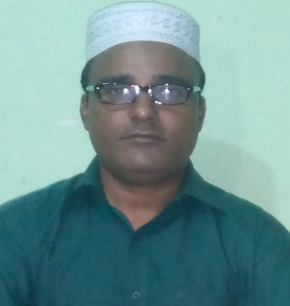
Introduction
Class: Three
Subject: English
Unit: One
Lesson: Greetings and introductions
Time: 40 minutes
MUHAMMED BURHAN UDDIN
Assistant Teacher
Hemu Govt. Primary School
Jaintapur, Sylhet.

Slide 3
Learning outcomes
1> Students able to know greetings.
2>Students able to know itroductions.

Slide 4
Lets we sing a song
Welcome welcome

Slide 5
Look at the pictures bellow

Slide 7
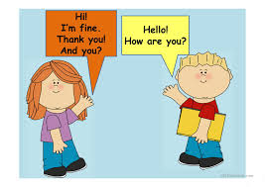

Slide 8
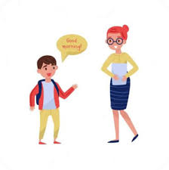

Slide 10
Open the taxtbook

Slide 11
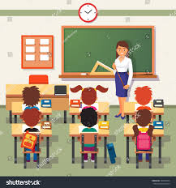
Teachers lesson

Slide 12
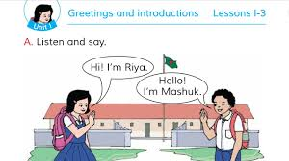

Slide 13
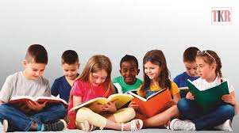
Read the lesson

Slide 14
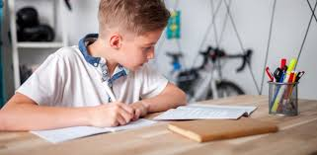
Pair work

Slide 15
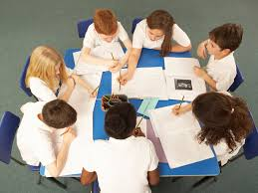
Group work

Slide 16
Assessment
Read the sentences . Write T for True or F for False.
1.The girle name is Rima.---------------- F
2. She is 9 years old.------------------- F
3. She is a student. ----------------- T
4. She is in class 2.---------------- F
5. She is at Mirpur Primary School.--------------------F

Slide 17
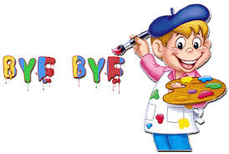
Thanks so much

