Slide 1
Lesson 25
We Live in a
global village
SA Asha

Slide 2
Prepared by
Shamima Aktar Asha
info
SA Asha

Slide 3
Learning objectives:
Students will be able to-
read and understand the text
understand and enjoy the story
learn some new words with their meaning and correct pronunciation
Understand how to write a letter
know the synonyms and antonyms of some words
SA Asha

Slide 4
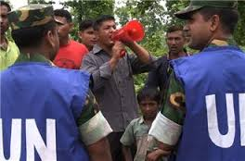
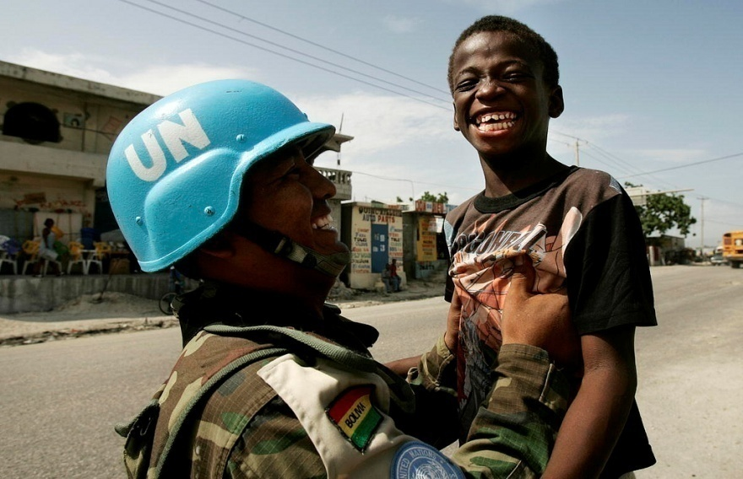
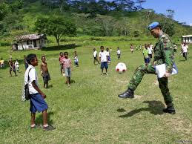
Bangladesh in UN
SA Asha

Slide 5
letter
Dear Sohan,
I got your letter two days ago. But I was very busy here. So, I’m late to reply…
Congo is a central African country. There is violence among political groups. So our life here is very challenging. We maintain peace and security. We distribute food, water, medicine……
SA Asha

Slide 6
Words Focus
Letter = letə(r) = চিঠি
Busy = bɪzi = ব্যস্ত
Violence = vaɪələns = হিংসা, তীব্রতা
Political = pəˈlɪtɪkl = রাজনৈতিক
Challenging = tʃælɪndʒɪŋ = প্রতিদ্বন্দ্বিতাপূর্ণ
Peace = piːs = শান্তি
Security = sɪˈkjʊərəti = নিরাপত্তা
Distribute = dɪˈstrɪbjuːt = বন্টন করা
SA Asha

Slide 7
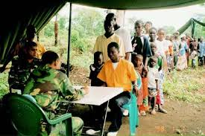
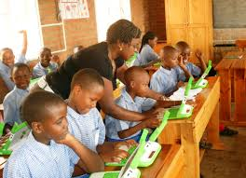
LETTER CONTINUED…
…to people. We sometimes build houses for them. We also teach children in small schools…
Last week I met an interesting young man here. His name is Gurmit Singh. He was born in India. In his early childhood,…
SA Asha

Slide 8
Words Focus
Sometimes = sʌmtaɪmz = কখনও কখনও
Early = ɜːli = আগে
Interesting = ɪntrəstɪŋ = উৎসাহজনক, আকর্ষণপূর্ণ
SA Asha

Slide 9
LETTER CONTINUED…
…he left for Singapore with his parents and went to a Singapore school. After a few years, he moved to Denmark and completed his school education there…
… For graduation, he went to the US and got a university degree. Then he left for the UK and completed his Master degree
there.
SA Asha

Slide 10
Words Focus
Singapore (country name) সিঙ্গাপুর
Parents = peərənt = মাতাপিতা
Denmark (country name) ডেন্মার্ক্
Education = edʒuˈkeɪʃn = শিক্ষা, পড়াশোনা
Graduation = ɡrædʒuˈeɪʃn = স্নাতকত্ব লাভ
University = juːnɪˈvɜːsəti = বিশ্ববিদ্যালয়
Degree = dɪˈɡriː = উপাধি
SA Asha

Slide 11
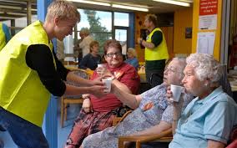
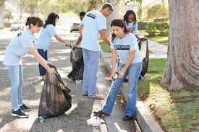
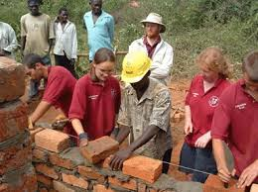
LETTER CONTINUED…
Gurmit came to Congo to work for a voluntary organization. His main job is to look after children’s education in a community school. He belongs to a group of ten workers. They all came from different countries.
SA Asha

Slide 12
Words Focus
Voluntary = vɒləntri = স্বেচ্ছাসেবী
Organization = ɔːɡənaɪˈzeɪʃn = সংস্থা
Community = kəˈmjuːnəti = সম্প্রদায়
SA Asha

Slide 13
LETTER CONTINUED…
He is a nice fellow and a good friend of ours. We call him ‘Mr Global Citizen’. I’m writing below the conversation I had with him the other day.
SA Shipa

Slide 14
Words Focus
Fellow = feləʊ = সহকর্মী, লোক
Global = ɡləʊbl = বিশ্বব্যাপী
Citizen = sɪtɪzn = নাগরিক
Conversation= kɒnvəˈseɪʃn =কথাবার্তা
SA Asha

Slide 15
Letter Continued…
“You’ve been to so many countries! How do you feel about that?’
“It’s nice to work with different people. I’ve come to know them…their language, culture, family, mind. I sort of think I belong to all.”
“Well, Gurmit you’re a true global citizen.”
SA Asha

Slide 16
Words Focus
Feel = fiːl =উপলব্ধি করা
Language = læŋɡwɪdʒ =ভাষা
Culture = kʌltʃə(r) =সংস্কৃতি
SA Asha

Slide 17
Letter Continued…
“Aren’t you too, Zul?’ smiled Gurmit Singh. ‘We all are the same human race, eh.”
Well, that’s all for today. Hope your exam is over by now. So write to me soon about what you think of Gurmit.
With love,
Uncle ‘Zul’
SA Asha

Slide 18
Words Focus
Same = seɪm =একই
Human = hjuːmən = মানুষ
SA Asha

Slide 19
Synonyms… Antonyms…
Word | Synonyms | Antonyms
Busy | Active [সক্রিয়] Engaged [জড়িত, ব্যস্ত] | Idle [অলস] Inactive [নিষ্ক্রিয়]
Violence | Renowned [প্রখ্যাত] | Unknown [অপরিচিত]
Security | Protection [রক্ষা] Cover [আবৃত করা, রক্ষা করা] | Danger [বিপদ] Trouble [যন্ত্রণা]
Distribute | Spread [বিস্তার] | Collect [সংগ্রহ]
Early | Beforehand [আগেভাগে] | Late [দেরিতে, বিলম্বে]
Interesting | Attractive [আকর্ষণীয়] | Disgusting [নিদারূণ বিরক্তিকর]
SA Asha

Slide 20
Synonyms… Antonyms…
Word | Synonyms | Antonyms
Education | Schooling [পড়াশোনা] Training [শিক্ষাপ্রাপ্তি] | Ignorance [অজ্ঞতা Illiteracy [নিরক্ষরতা]
Voluntary | Willing [ইচ্ছুক] | Forced [কষ্টকৃত]
Community | Neighborhood [আশপাশ] Society [সমাজ] | Difference [বৈসাদৃশ্য] Dissimilarity [ভিন্নতা]
Global | Universal [সার্বজনীন] | Particular [নির্দিষ্ট]
Culture | Civilization [সভ্যতা] | Barbarism [বর্বর অবস্থা]
SA Asha

Slide 21
Thank You
SA Asha

