Slide 2
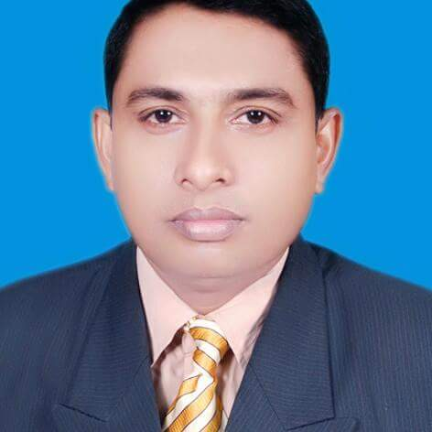
Teacher’s Identity
Mohammed Jalal Uddin
Head Teacher
Kachua Govt. Primary School
Chunarughat ,Habigonj .

Slide 3
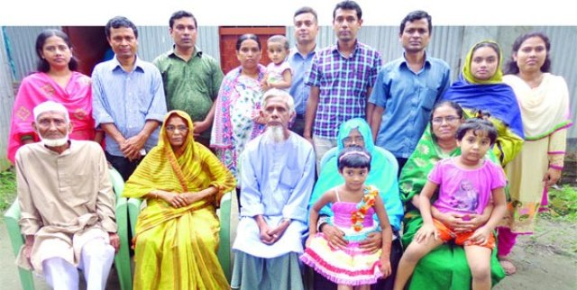
Can you guess what may be our
Today’s lesson?
What can you see in the picture?

Slide 4
Family

Slide 5
Lesson Introduction
Class: Four
Unit: 3, Family.
Lesson unit: B- Read. Farjana------- years old.
Time: 45 minutes

Slide 6
Learning outcomes
By end of the lesson student will be able------
1. To read the text with proper pronunciation.
2.To enrich their vocabulary.
3. Learn about their family.

Slide 7
Jamil
Farzana
Aziz Ahmed
Rehana Parvin
It’s Jamil and Farzana’s family.

Slide 8
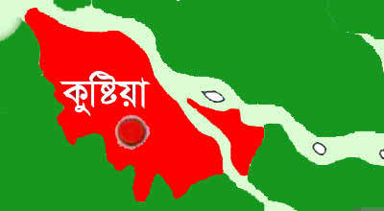
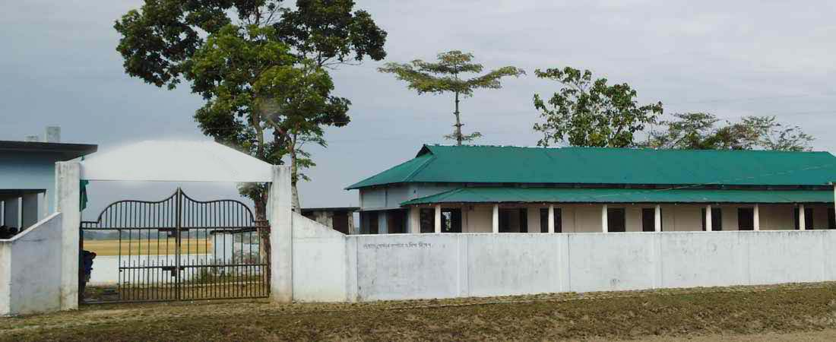
Farzana and Jamil are from Kushtia.
চাচুয়া প্রাইমারী স্কুল
They go to Chachuya Primary School.

Slide 9
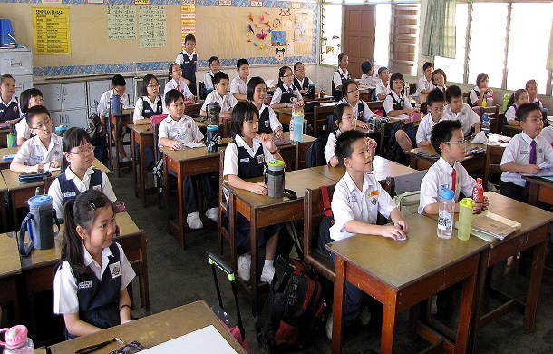
Who is the boy?
Who is the girl?
Farzana.
Jamil.
Jamil is seven years old.
Farzana is nine years old.
She is in class 4.
He is in class 2.
They like school and they are good students.

Slide 10
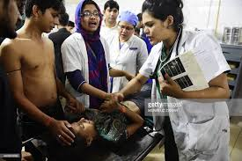
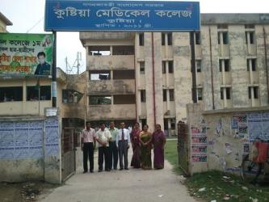
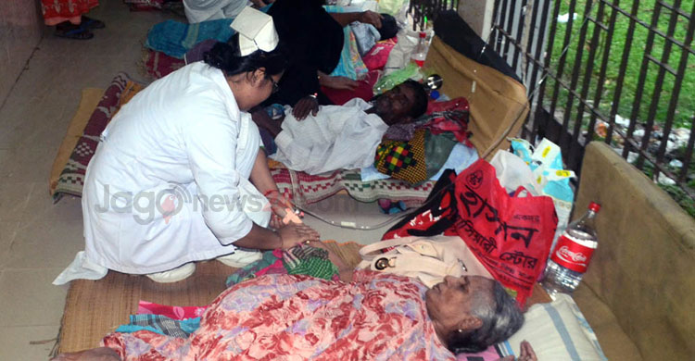
She is Farzana and Jamil’s mother .
Her name is Rehana parvin.She is 33 years old.
She takes care of many patients everyday. She likes her job very much.
What does she do?
Who is she?
She works at a hospital in Kushtia.
She is a doctor.

Slide 11
Look at the picture.
Who is he?
He is Farzana and Jamil’s father.
Aziz Ahmed
What is he?
He is a pilot of Biman Bangladesh Airlines.

Slide 12
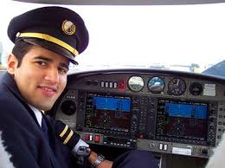
He travels to India, Thailand and China often.
He flies to other countries.
He loves to travels. He is 39 years old.

Slide 13
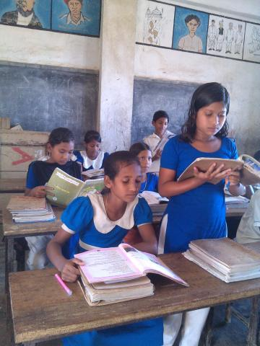
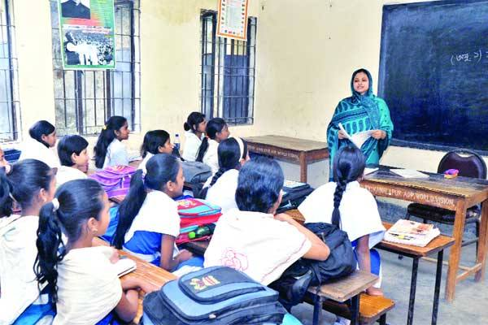
Student’s loud reading help by teacher.
Teacher’s loud reading and discuss the lesson.

Slide 14
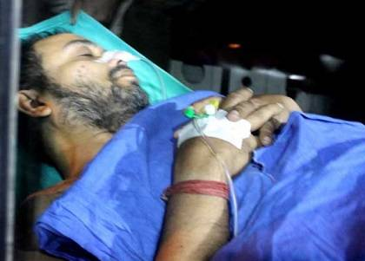
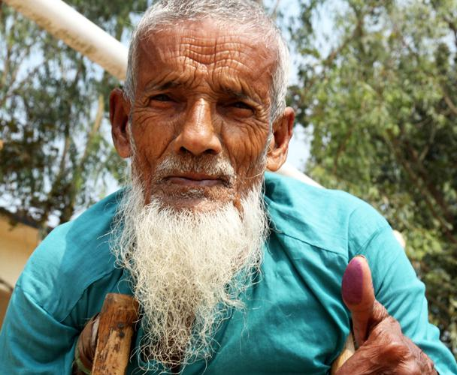
New words with sentences by using picture
A person receiving medical treatment.
Father and mother
Aged
Patient
Old
Parents
I’m 70 years old.
He is a patient.
My parents love me very much.

Slide 15
Individual work
1.Where do Farzana and Jamil’s family live?
2. Who is Rehhana Parvin?
3. How old is Aziz Ahmed?

Slide 16
Pair work
Complete the chart with information about the family.
Name
Age
Job
Work place
Farzana
Jamil
Rehana parvin
Aziz Ahmed

Slide 17
Group work
Look at the picture
Who is he? Write three sentences about him.
What does she do? Write three sentences about her.

Slide 18
Evualuation
Choose the best answer
Where do Farzana and Jamil’s family live?
(a) Bogra (b) Kushtia (c) Jessore (d) Dhaka
2. What class does Jamil read in?
(a) two (b) three (c) four (d) five
3.What is Rehana Parvin?
(a) A teacher (b) A doctor (c) A Banker (d)A Housewife
4. Aziz Ahmed is ------ years old.
(a) 49 (b) 39 (c) 59 (d) 79

Slide 19
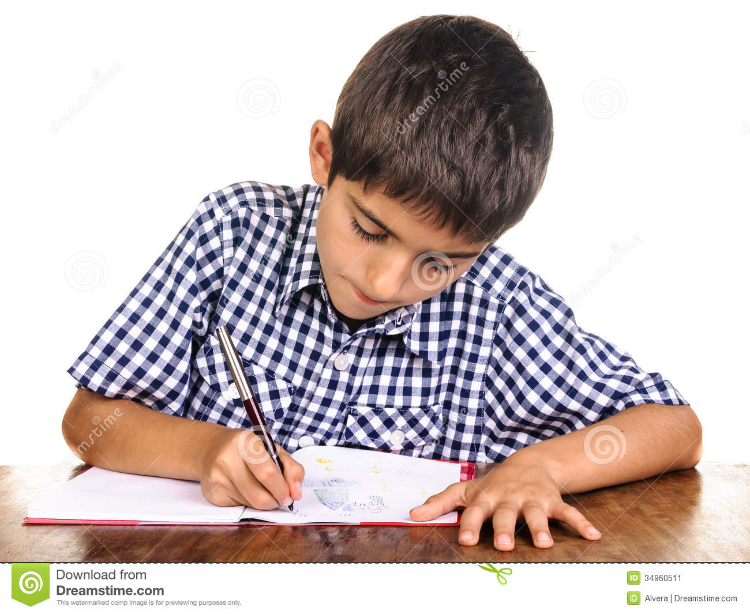
Home work
You will write five sentences about your family.

Slide 20
STAY FINE

