Slide 1
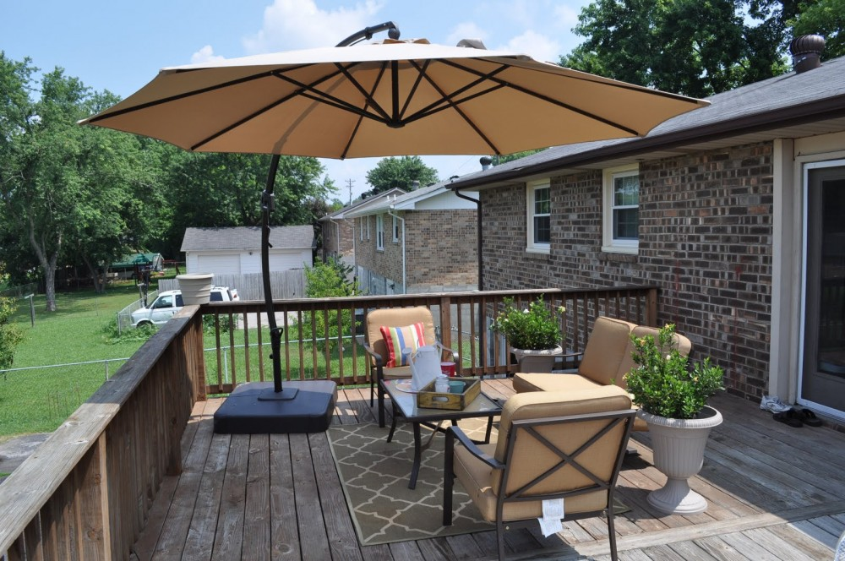
WELCOME
.

Slide 2
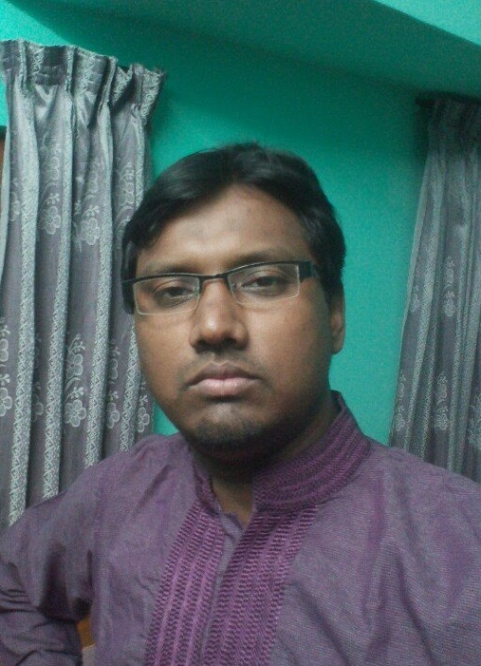
identity
Teacher
Kawsar ali
Assist teacher at
Moharajpur high school
Chapainawabganj. M:01718507168
Email: kawsarali021084@gmail.com
Class & Subject
English 2nd paper
Grammar item
Class IX to Xll

Slide 3
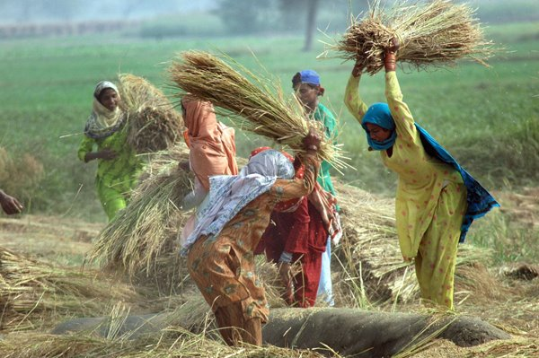
Because of working hard, they will succeed.
They work hard and they will succeed.
Since they work hard, they will succeed.
What do you understand from the sentences?
Simple to Compound & Complex

Slide 4
Yes, today’s topic is
Simple
Compound & Complex

Slide 5
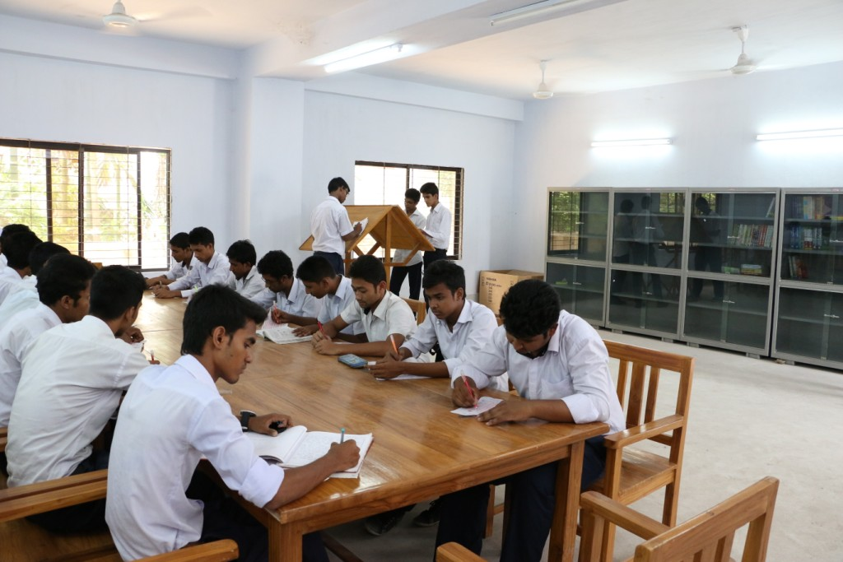
Learning out comes
At the end of the lesson the students will be able to
identify Simple, Compound & Complex.
change the Simple form into Compound & Complex.

Slide 6
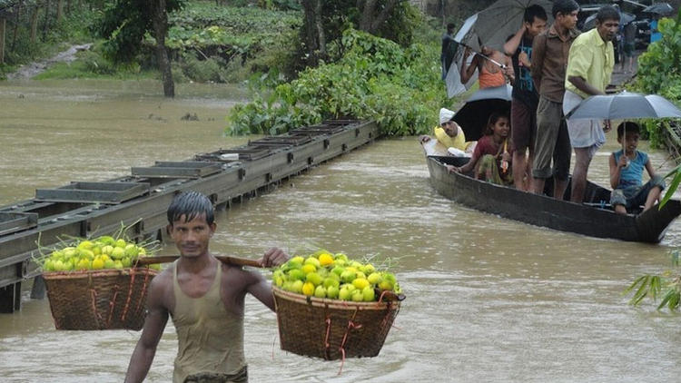
The simple sentence to compound & complex.4
Sim: Because of working hard, he can succeed.
Com: He works hard and he can succeed.
Cmx: Since he works hard, he can succeed.
Change the simple into compound & complex
Sim: Because of his reading attentively, he can pass.
Com: He reads attentively and he can pass.
Cmx: Since he reads attentively, he can pass.

Slide 7
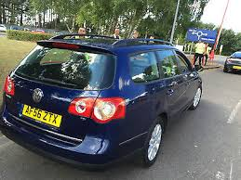
The simple sentence to compound & complex.4
Sim: Having a lot of money, you bought a new car.
Com: You had a lot of money and you bought a new car.
Cmx: Since you had a lot of money, you bought a new car.
Change the simple into compound & complex
Sim: Having power, he can do everything.
Com: He has power and he can do everything.
Cmx: Since he has power, he can do everything.

Slide 8
The simple sentence to compound & complex.4
Sim: Being poor, she couldn’t buy a new dress.
Com: She was poor and she couldn’t buy a new dress.
Cmx: Since she was poor, she couldn’t buy a new dress.
Change the simple into compound & complex
Sim: Being tired, she refuged to go.
Com: She was tired and she refuged to go.
Cmx: Since she was tired, she refuged to go.

Slide 9
The simple sentence to compound & complex.5
Sim: In spite of working hard, they can’t succeed.
Com: They work hard but they can’t succeed.
Cmx: Though they work hard, they can’t succeed.
Change the simple into compound & complex
Sim: In spite of his reading attentively, he will fail.
Com: He reads attentively but he will fail.
Cmx: Though he reads attentively, he will fail.

Slide 10
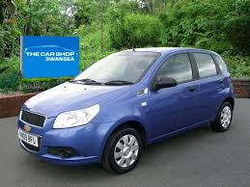
The simple sentence to compound & complex.5
Sim: In spite of having money, you can’t buy a new car.
Com: You have money but you can’t buy a new car.
Cmx: Though you have money, you can’t buy a new car.
Change the simple into compound & complex
Sim: In spite of the weather being cold, we went out.
Com: The weather was cold but we went out.
Cmx: Though the weather was cold, we went out.

Slide 11
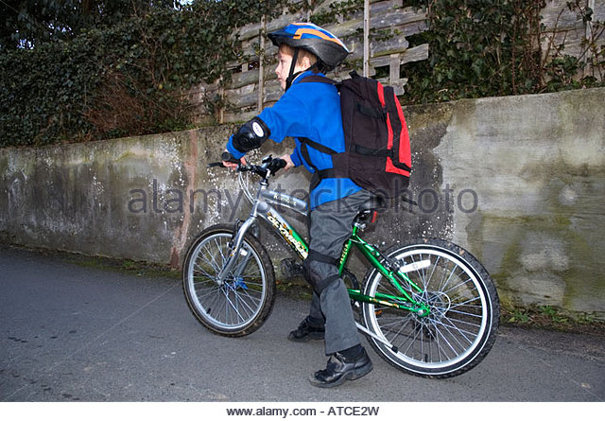
The simple sentence to compound & complex.5
Sim: In stead of going to school, he went to market.
Com: He went to market but he didn’t go to school.
Cmx: Though he went to market, he didn’t go to school.
Change the simple into compound & complex
Sim: In stead of killing her, they left her in the jungle.
Com: They left her in the jungle but didn’t kill her.
Cmx: Though they left her in the jungle, they didn’t kill her.

Slide 12
HOME WORK
Make the simple sentences into compound & complex.
Because of her poverty, she couldn’t buy a new dress.
Being salty, we couldn’t drink the water.
In spite of his poverty, he bought a new dress.
In stead of buying a book, I bought a new dress.

Slide 13
Thank you

