Slide 1
WELCOME

Slide 2
Teacher’s Identity
Abdul Alim
Assistant Teacher
Lokkhonkhola Govt.Primary School
Meghna, Cumilla

Slide 3
LESSON -INTRODUCING
SUBJECT –ENGLISH
CLASS-ONE
UNIT:22
TIME-40 M.

Slide 4
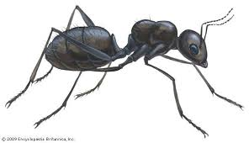
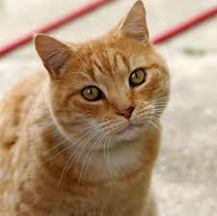
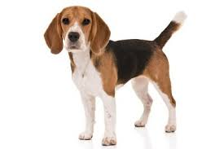
Ant
Cat
Ball

Slide 5
Lesson title
Alphabet
Lesson:4-6
Look,listen and say

Slide 6
Learning Outcomes
Listening
1.1.1.become familiar with English sounds by listening to common English words.
Speaking
1.1.1.repeat after the teacher simple words and phrases.
Reading
1.2.1.recongnize and read the alphabet both small and capital(non-cursive)
Writing
1.1.1.practice letter shapes/simple writing pattens etc.

Slide 7
D
Dog

Slide 8
d
dog

Slide 9
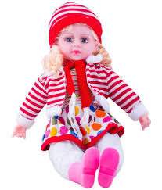
D
Doll

Slide 10
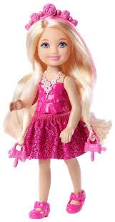
d
doll

Slide 11
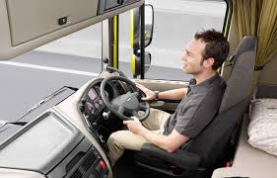
D
Driver

Slide 12
d
driver

Slide 13
Students say and read
Trace in the air.
D
D

Slide 14
d

Slide 15
Say and read. Trace and write

Slide 16
Say and read. Trace and write

Slide 17
Student Look at the picture and say.
doll
Doll
door
Door

Slide 18
Driver
driver

Slide 19
Group Work
Group:A
Dog,sound,doll,Day,sad
Dog,sound,doll,Day,sad

Slide 20
Group:B
Day,do,dog,good,Door
Day,do,dog,good,Door

Slide 21
Group:C
Dog,doll,food,Day
Dog,doll,food,Day

Slide 22
Evaluation
D
-og

Slide 23
-oll
D

Slide 24
-oor
D

Slide 25
Home Work
C. Say, trace and write

Slide 26
See you

