Slide 1

WELCOME
To our online class

Slide 2

Subject-English 1st.
Class-9/10
Lesson-1, unit-1
Introduction
Runa Begum
(Assistant Teacher)
Nandia Sangun Ideal Dakhil Madrasah.
Sreepur,Gazipur .

Slide 3

Look at the picture

Slide 4
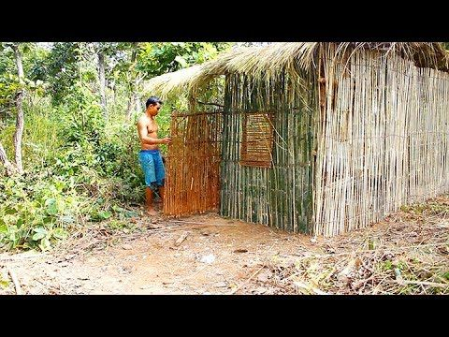
Look at the picture

Slide 5


Our today’s topic is…
Today’s Topic
Can you live alone?

Slide 6

Learning outcomes--
After the students have studied this unit, they will be able to-
      Tell The Meaning Of The New Words.
      ask and answer question.
      read and understand text.
      Describe something in writing

Slide 7
Word meaning
Acquire- অর্জন করা
Citizen - নাগরিক
Companion - সহচর
Discuss - আলোচনা করা
Alone - একা একা

Slide 8
More word meaning
Enmity – শএুতা
Suffering – ভোগান্তি
Moral – উপদেশ
Creature – প্রাণী
Angel – ফেরেশতা

Slide 9
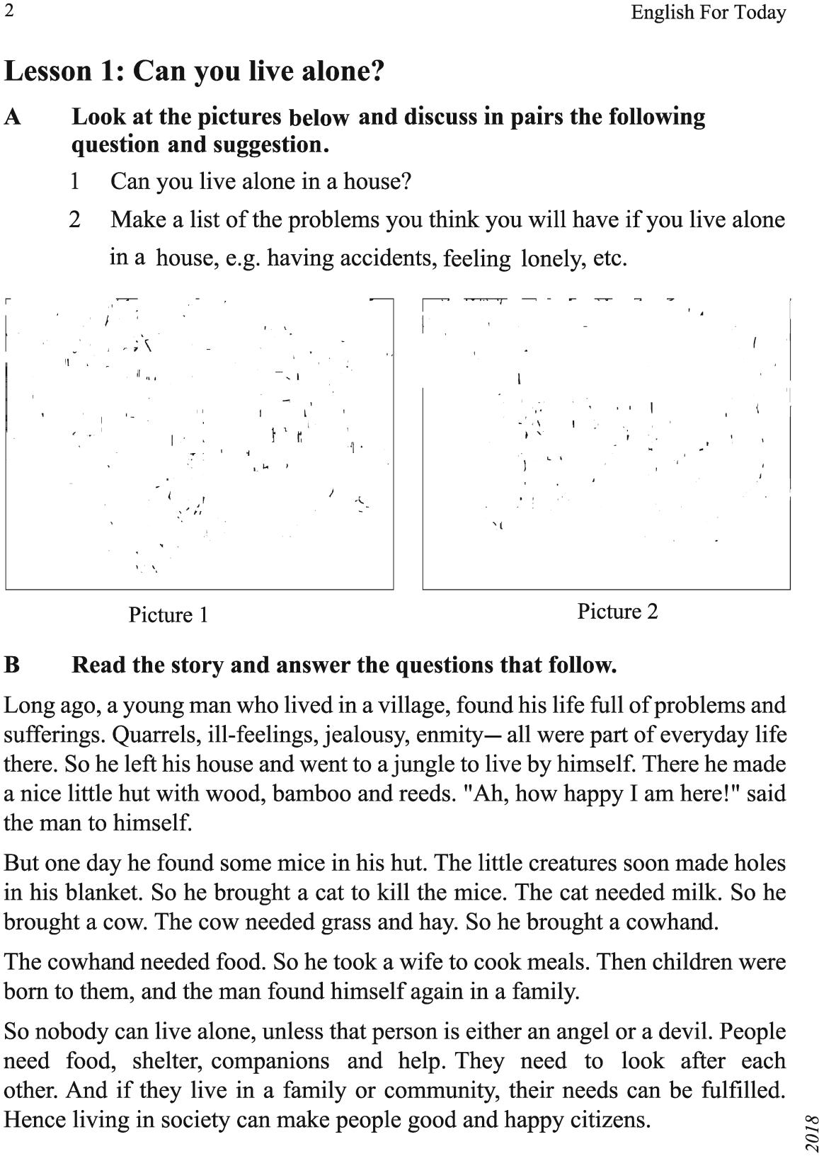

Slide 11
Answer the questions
1/Why did the young man leave his house
Ans-The young man found life in the society full of many problems and suffering. So he left the House.
2/Where did he make a hut
Ans-He made ahut in the jungle.
3/Was the man happy in his hut.
Ans-No the man could not become happy in his hut.
4/Where and how can a person be happy.
Ans-A mancan be happy in the family living with the other people of the society.
5/What is the moral of the story
Ans-The moral of the story is Man cannot live alone orMan is asocial being.

Slide 12
Choose the best answer from the alternatives -
(4)One day the young man found some --- in his hut.
a/Mice b/Snakes c/insects d/rats
(5)Children were born to them. Herethem’ refers to–--.
a/The young man and the cow boy b/the cow and the cat c/the mice and cat d/The young man and his wife
(6)Living in society can make people----.
a/Teachers and professors b/good and peaceful business men c/Farmers and political workers
d/Good and happy citizens

Slide 13

HOME WORK
Write a short summary about good citizen..

Slide 14


