Slide 1
Welcome to Multimedia Class
Teachers information
Mazada Akter
Lecturer (English)
Barabor alim Madrasha
Class : X1
Subject : English Second paper

Slide 2
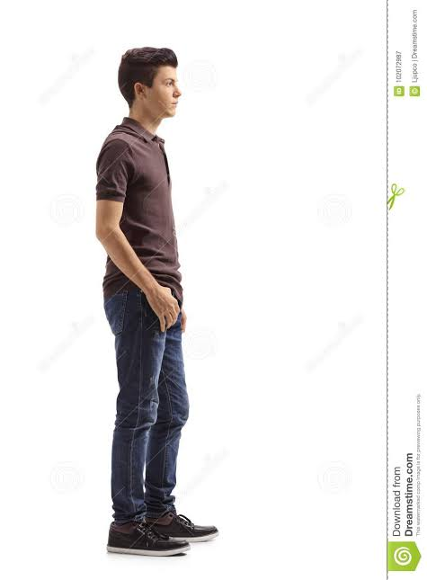
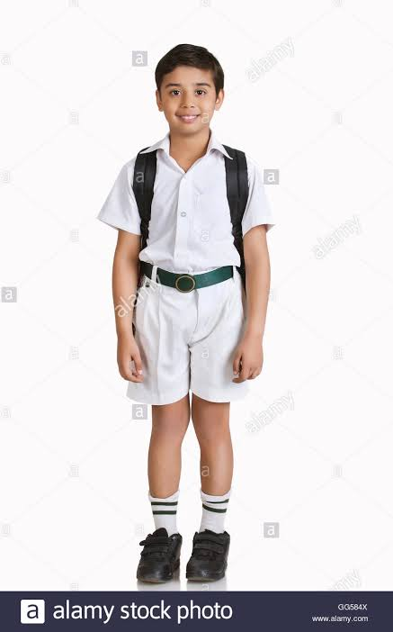
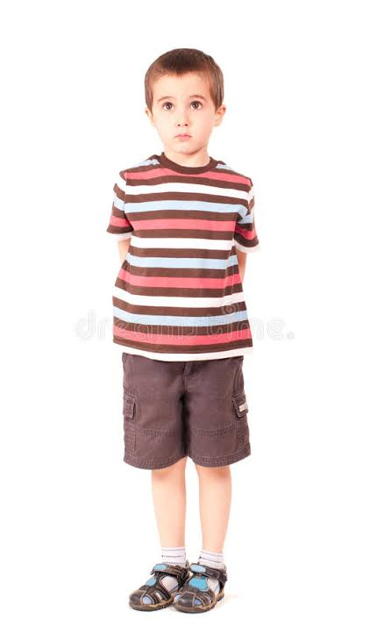
Look at the the following sentences.
tall
taller
tallest

Slide 3
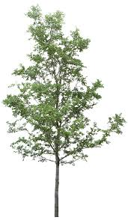
small
smaller
smallest

Slide 4
What can be today's topic?
Can you say?
Degree

Slide 5
So today's topic is
Degree

Slide 6
Learning Outcome
By the end of the lesson,the learner's will be able to-
define degree.
classify degree.
identify degree of adjective.
change Degree .

Slide 7
What is Degree?
Degree is the comparison of adjective/adverb.
Big
Bigger
Biggest

Slide 8
Kinds of Degree
Positive
Comparative
Superlative

Slide 9
Positive
Big
Small
Large
High
Nice
Hot
Good
Comparative
Bigger
Smaller
Larger
Higher
Nicer
Hoter
Better
Superlative
Biggest
Smallest
Largest
Highest
Nicest
Hotest
Best

Slide 10
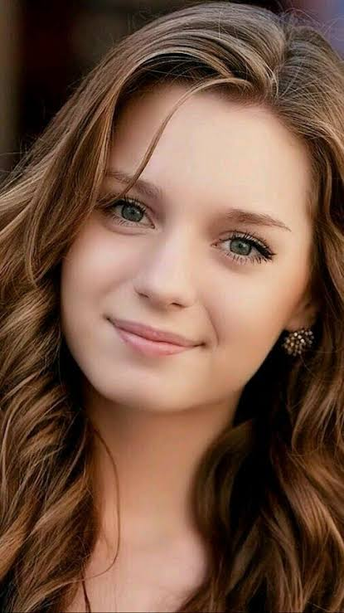
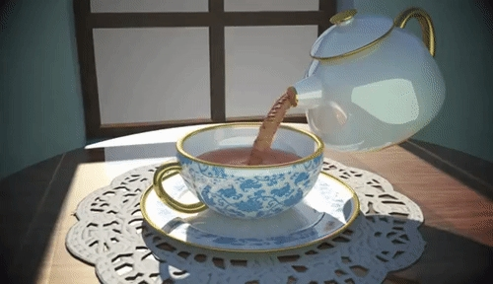
Notice the following sentences
The tea is hot
The girl is beautiful
Here we find two adjectives which simply describe the characteristics of tea and girl.

Slide 11
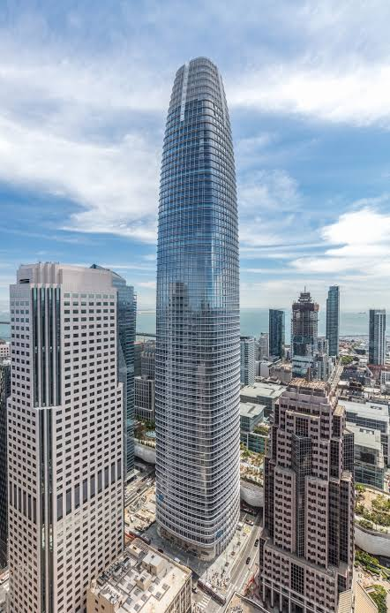
So positive degree is a form of adjective which simply describes a noun or pronoun.
Structure: Subject+verb+adjective+Extension.
Sakib is a famous cricketer
The building is very high

Slide 12
Identify positive adjective from the following text.
Mitu is a student of class Nine.She is very cute.She is the first girl in her class.No other student is as meritorious as she.Her father is an honest government service holder.
honest
cute
meritorious

Slide 13
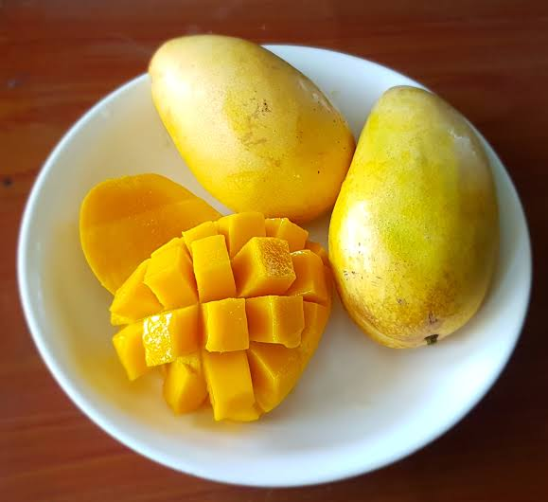
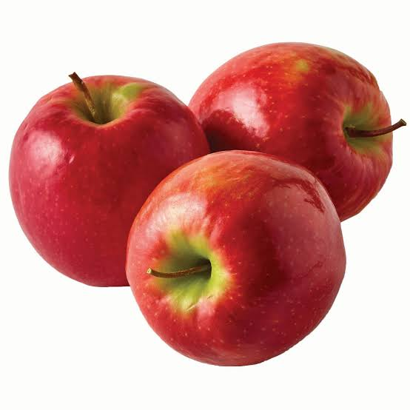
Notice the following sentences
Rakib is taller than Sakib.
Sakib
Rakib
Mango is sweeter than apple.

Slide 14
In these two sentences we get comparison between "Rakib and Sakib".Then,mango and apple.
So these are comparative degree.
Comparative adjectives are used to compare differences between the two objects they modify (larger, smaller, faster, higher). They are used in sentences where two nouns are compared.

Slide 15
Formation of comparative degree
1. Most adjectives of one syllable form the comparative by adding 'er' .
Positive | Comparative
Fast | Faster
Long | Longer
Small | Smaller

Slide 16
2. When an adjective ends in 'e', add 'r' for the comparative.
Positive | Comparative
Fine | Finer
Able | Abler
Simple | Simplest

Slide 17
3. When a one syllable word ends in a consonant-vowel-consonant, add the consonant and 'er' for the comparative form.
Positive | Comparative
Big | Bigger
Fat | Fatter
Mad | Madder

Slide 18
4. When the adjective ends in a 'y' and is preceded by a consonant, change the 'y' into 'i' before adding 'er' for the comparative.
Adjective | Comparative
Busy | Busier
Happy | Happier
Pretty | Prettier

Slide 19
5. When the adjective has two or more syllables, the comparative is formed by using the adverbs 'more' or 'less',
Adjective | Comparative
Important | More important
Difficult | More difficult

Slide 20
Pair work
Transform the adjectives into comparative-
Useful
more useful
Wealthy
wealthier
Courageous
more courageous
Bold
bolder
Proud
prouder

Slide 21
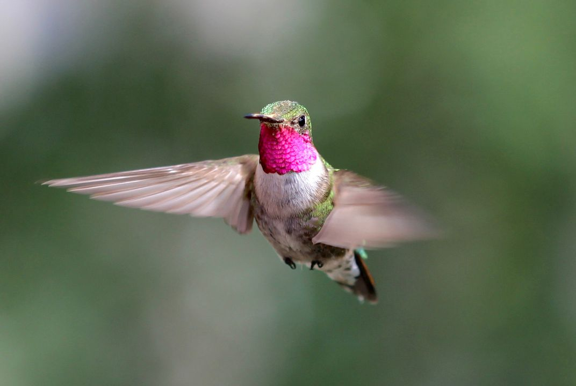
Notice the following sentence
Hamingbird is the smallest bird in the world.
Here we get a comparison of a bird among all birds in the world.So it is superlative Degree.

Slide 22
Superlative Degree
The form of an adjective which is used to compare among many is called Superlative Degree.
Structure: Subject+verb+the/one of the + Superlative form of adjective+Extension.
Example:
1.Jupiter is the biggest planet in our solar system. 2.She is the smartest girl in our class. 3.This is the most interesting book I have ever read. 4.I am the shortest person in my family.
5.Jerry is the least worried about the game.

Slide 23
Formation of Superlative Degree
1. Most adjectives of one syllable form the superlative by adding est.
Positive | Superlative
Fast | Fastest
Long | Longest
Small | Smallest

Slide 24
2. When an adjective ends in 'e', add 'st' for the superlative.
Positive | Superlative
Fine | Finest
Able | Ablest
Simpe | Simplest

Slide 25
3. When a one syllable word ends in a consonant-vowel-consonant, add the consonant and 'est' for the Superlative form.
Positive | Superlative
Big | Biggest
Fat | Fattest
Mad | Maddest

Slide 26
4. When the adjective ends in a 'y' and is preceded by a consonant, change the 'y' into 'i' before adding 'est' for the Superlative.
Adjective | Superlative
Busy | Busiest
Happy | Happiest
Pretty | Prettiest

Slide 27
5. When the adjective has two or more syllables, the Superlative is formed by using the adverbs 'most',
Adjective | Superlative
Important | Most important
Difficult | Most difficult

Slide 28
There are some exceptional adjectives which do not maintain any rules for comparative and superlative.
Adjective | Comparative | Superlative
Good | Better | Best
Far | Further | Furthest
Little | Less | Least

Slide 29
Individual work
Change the following adjective into superlative degree.
Most famous
Famous
Big
Biggest
Dirty
Dirtiest
Most facinating
Facinating

Slide 30
Evaluation
Change the following sentences into comparative and superlative degree.
1.Mitu is a good girl.
Comparative:Mitu is a better girl.
Superlative: Mitu is the best girl.
2.She is a tall girl.
Comparative:She is a taller girl.
Comparative:She is a taller girl.

