Slide 1
welcome

Slide 2
Identity
MD.MONIR HOSSAIN
ASSTS. TEACHER
(ENGLISH)
GHATLAGAG KASURBAG DAKHIL MADRASAH.
CHATKHIL –NOAKHAL
MOB.01816247060
CLASS- EIGHT
ENGLISH 1ST PAPER
UNITE- 2
LESSON-1

Slide 3
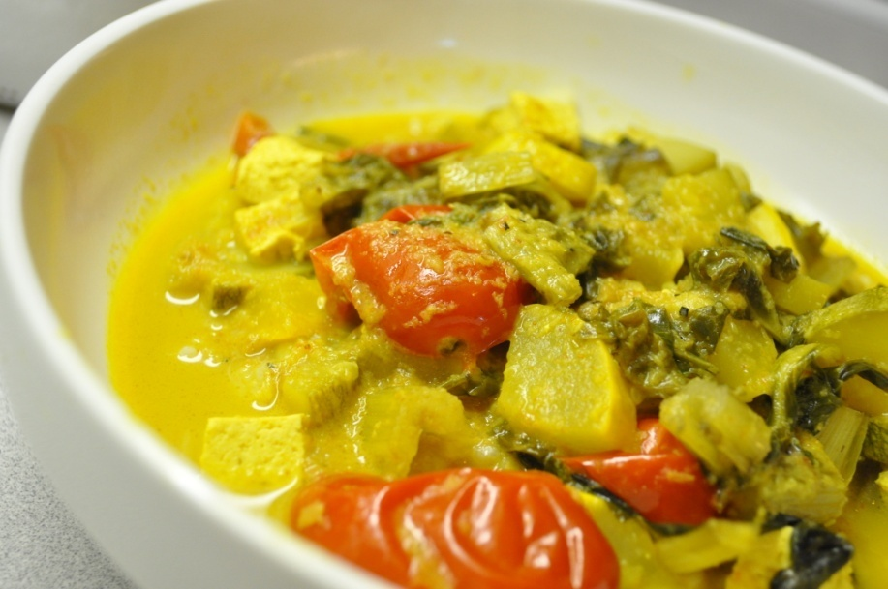
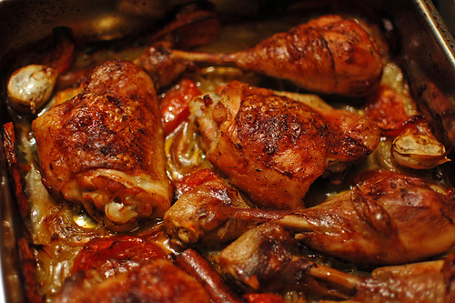
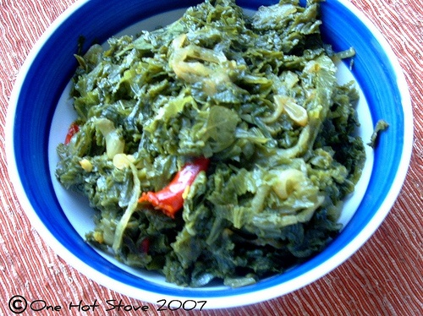
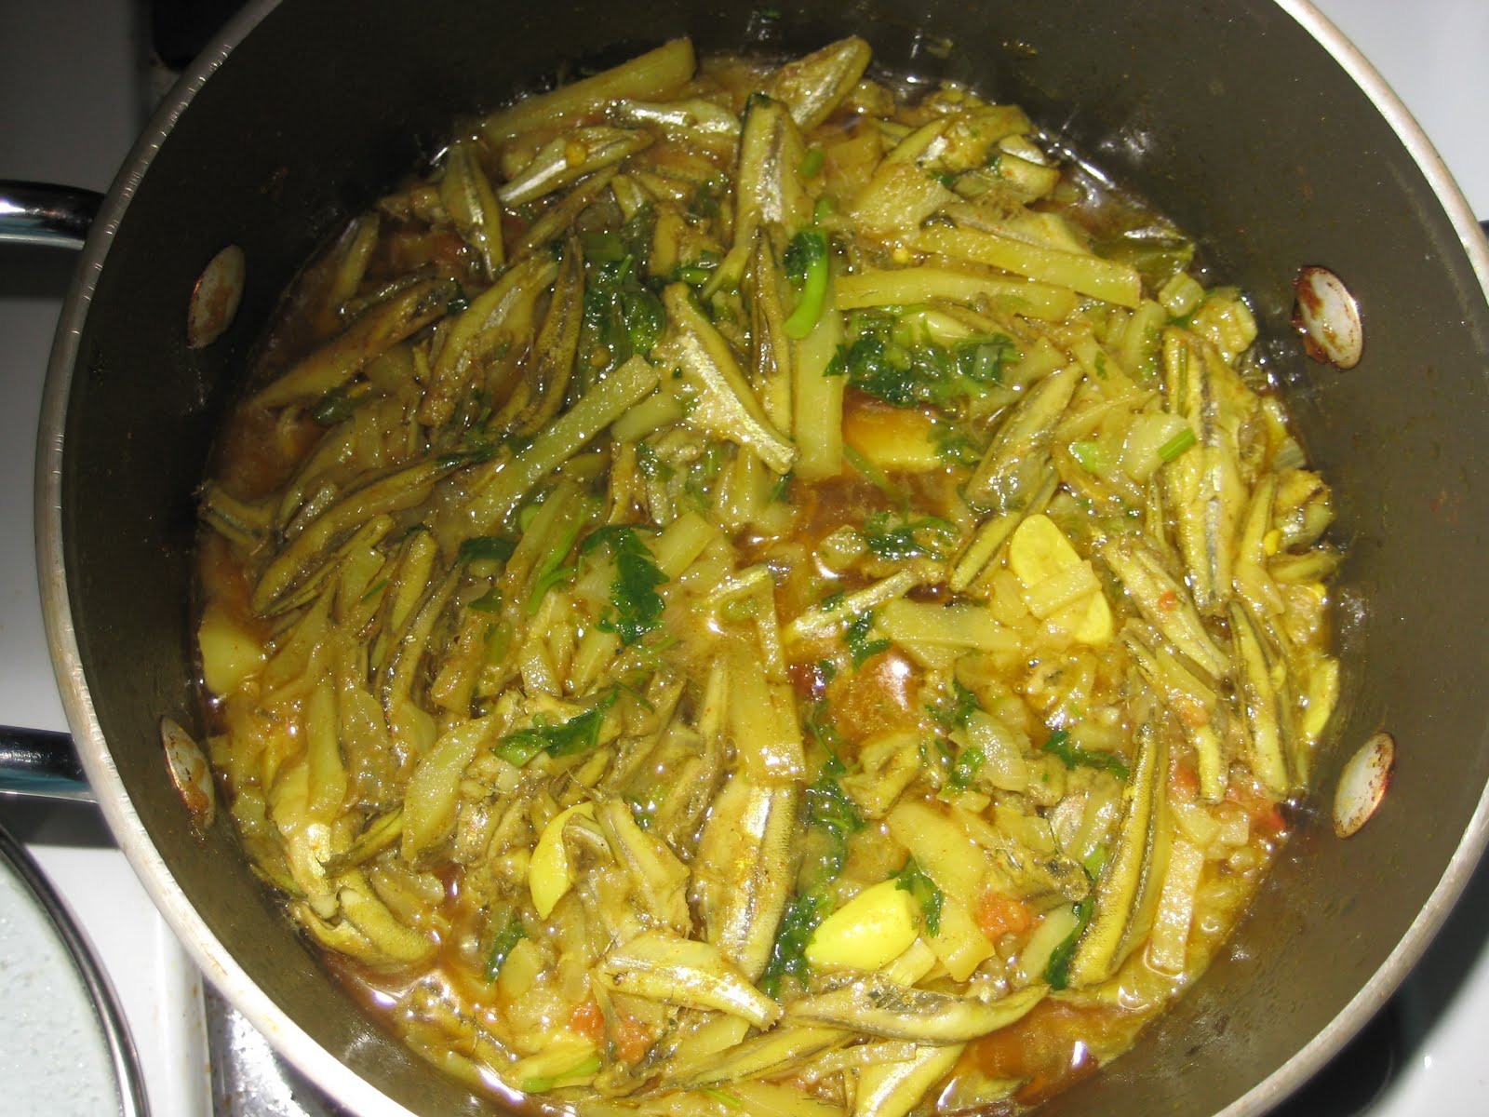
Vegetable curry
Chicken curry
Leafy vegetables curry
Small fish curry

Slide 4
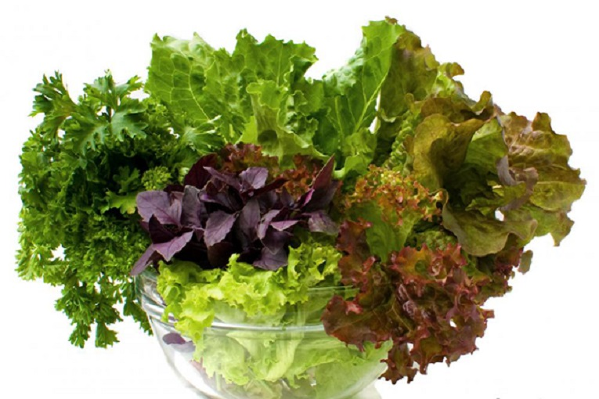
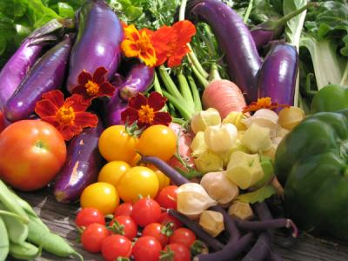
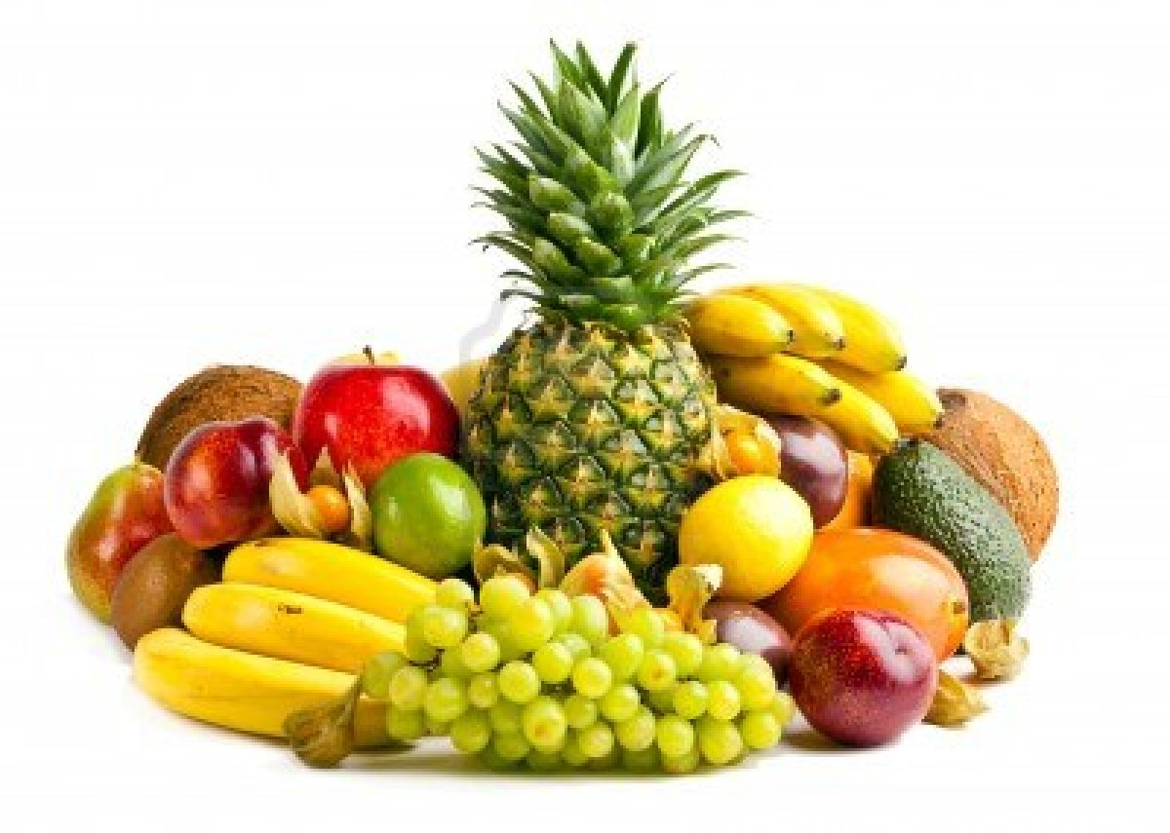
Colorfull vegetable
Leafy vegetable
fruits

Slide 5
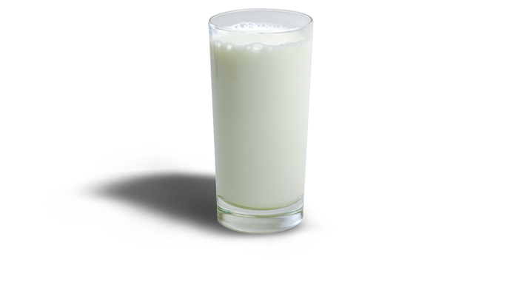
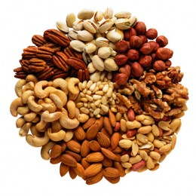
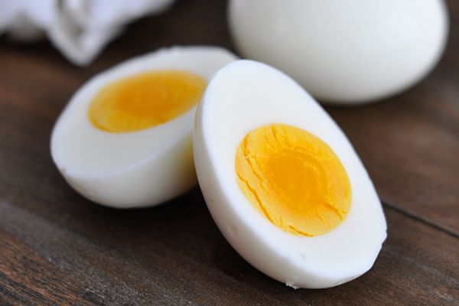
Milk
Nuts
Egg

Slide 6
GOOD FOOD

Slide 7
LEARNING OUTCOMES
AFTER COMPLETE THIS LESSON, STUDENTS WILL BE ABLE TO:-
TALKS ABOUT PICTURE IN ENGLISH
READ TEXT AND ANSWER QUESTIONS
WRITE ANSWER TO QUESTIONS
WRITE A PARAGRAPH ABOUT GOOD FOOD

Slide 8
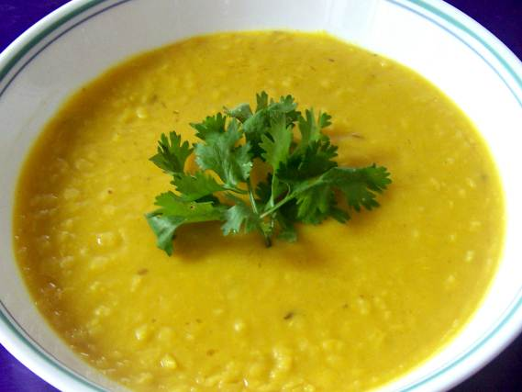
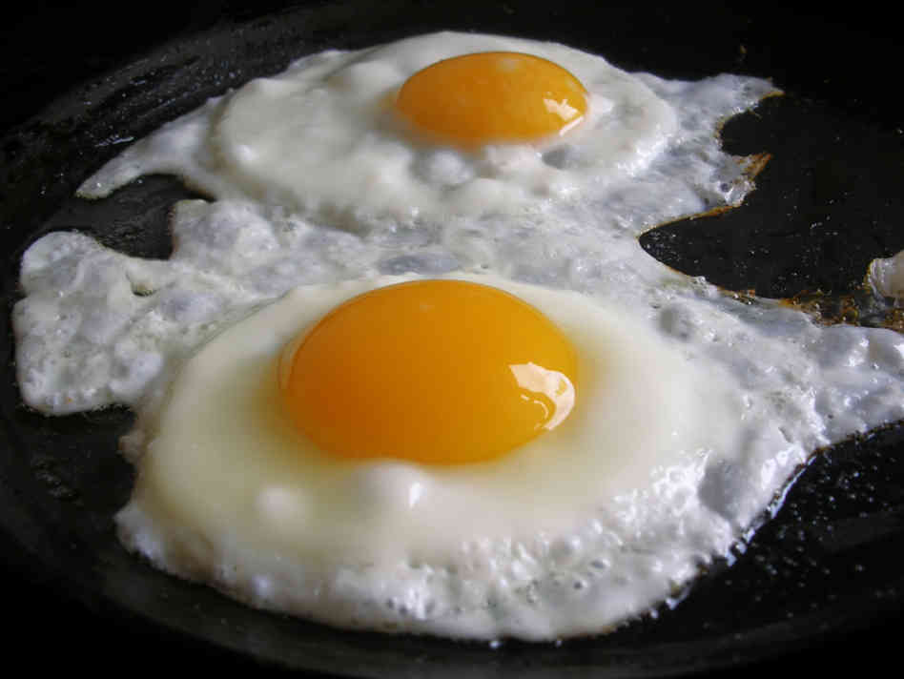
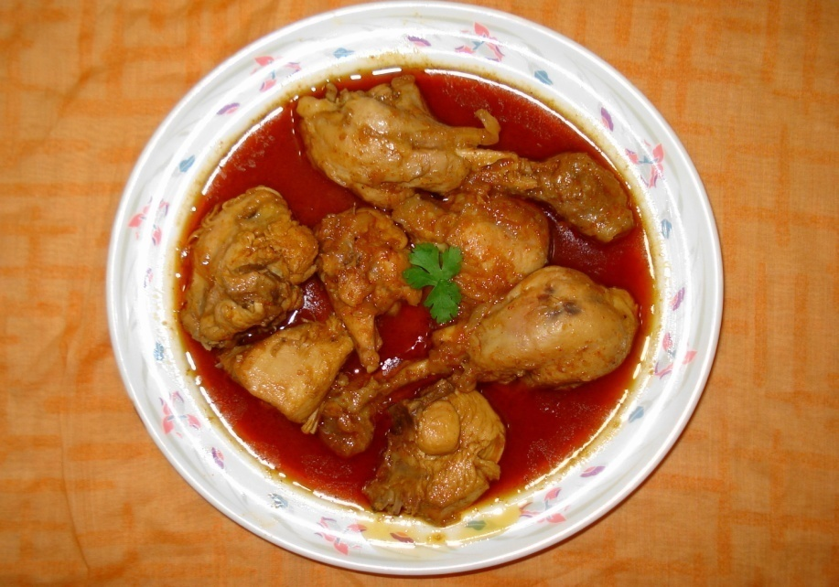
EVERYDAY WE SHOULD EAT CERTAIN AMOUNT OF FOOD

Slide 9
Complete the sentences individually
We should eat good food……………………
We should not eat more then……………..
Eating too much food is……………………….
Good food means ……………………………….

Slide 10
Correct answer
We should eat good food to grow properly.
We should not eat more then though the food is good.
Eating too much food is not good for health.
Good food means the right kind of food.

Slide 11
EVALUATION
What is good food?
Why do we eat food?
What is meant by nutrious food?

Slide 12
HOMEWORK
HOW MUCH FOOD DO YOU NEED A DAY?

