Slide 1
WELCOME

Slide 2
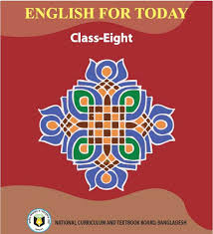
INTRODUCTION
RUBAIYA SULTANA
Assistant Teacher
Hafiz Ahmed High School
Barura, Cumilla.
English For Today
Class - Eight

Slide 3
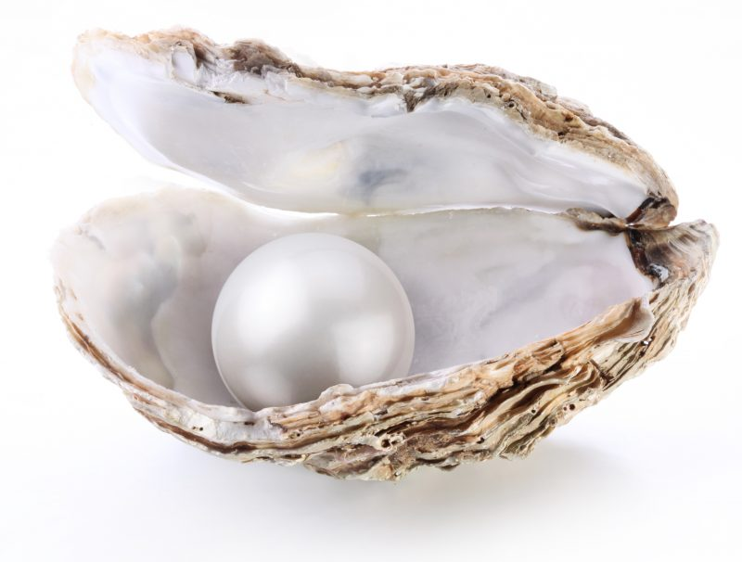
Look at the picture.
Guess what about today’s lesson.

Slide 4
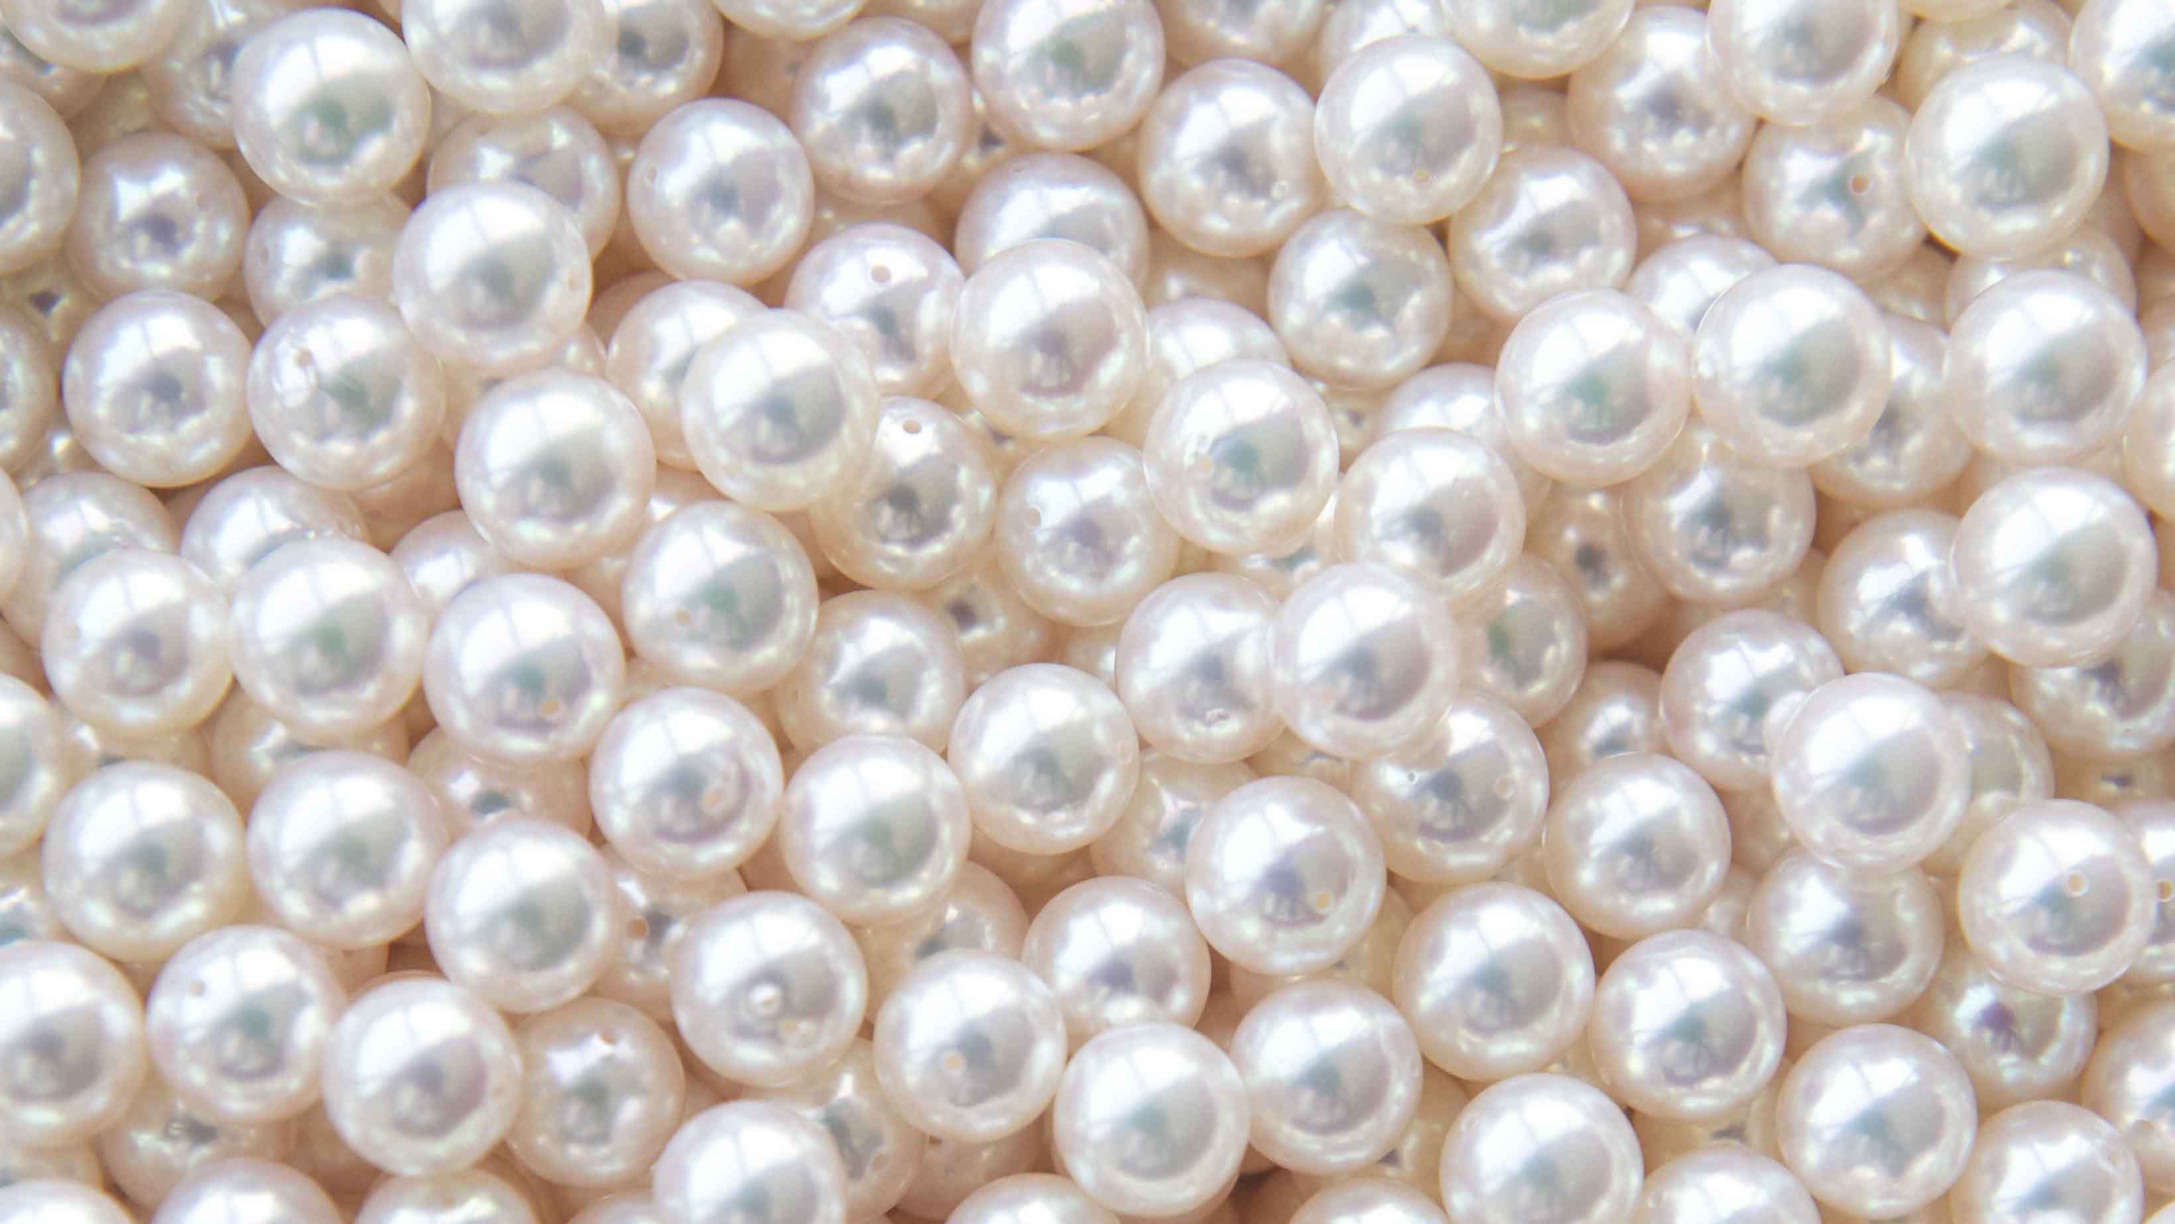
Our Today’s Lesson Is-
Pearls! Pearls! Pearls!
Unit- Seven, Lesson-1

Slide 5
Learning Outcomes
After we have studied this lesson, we will be able to---
read and understand texts
listen for information
Ask and answer questions
write down the main ideas in our own words
write short paragraphs

Slide 7
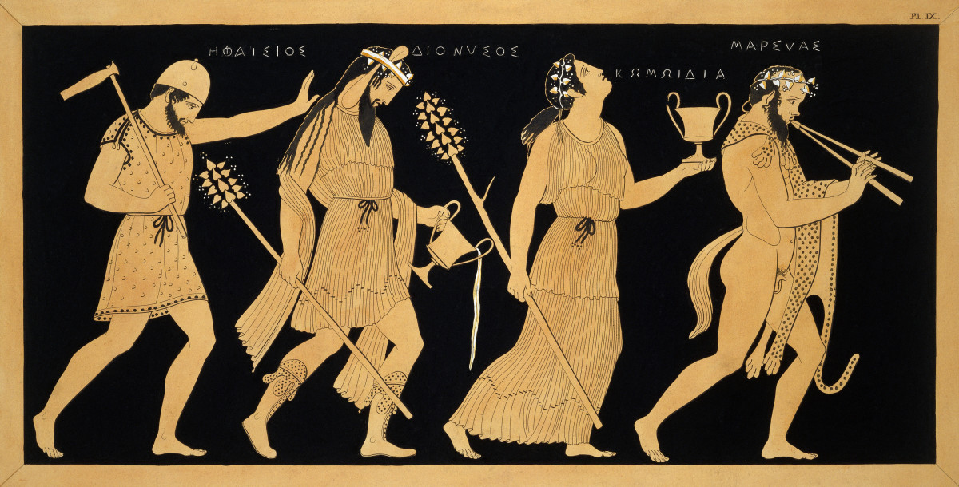
Mythology
Meaning: Tradition, Folklore, Conviction

Slide 8
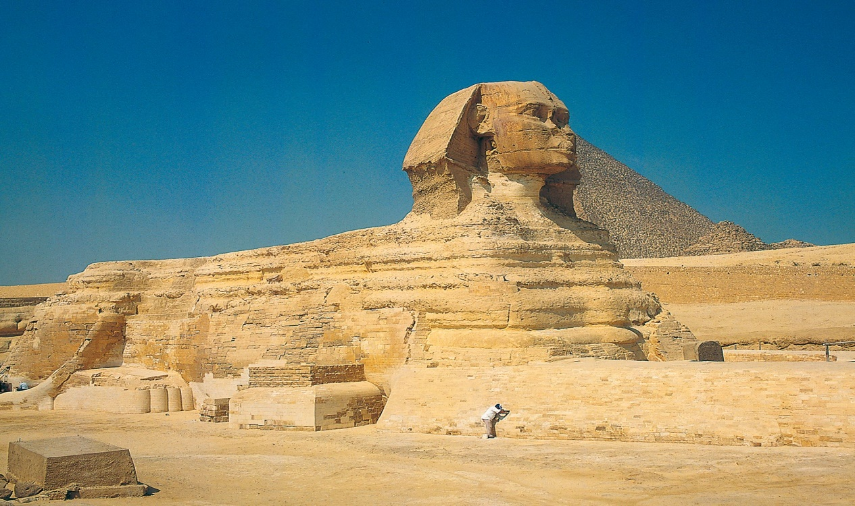
Ancient
Meaning: Antique, Long-ago, Dated

Slide 9
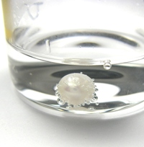
Dissolved
Meaning: Melt, Liquefy, Fuse.

Slide 10
Status
Meaning: Grade, Rank, Position .

Slide 11
Unparalleled
Meaning: Unique, Supreme, Incomparable.

Slide 12
Association
Meaning: Alliance, Connotation .

Slide 13
Delicate
Meaning: Mild, Gentle, Pale .

Slide 14
B.Read the text about Pearls!Pearls!Pearls!
Page no: 79

Slide 15
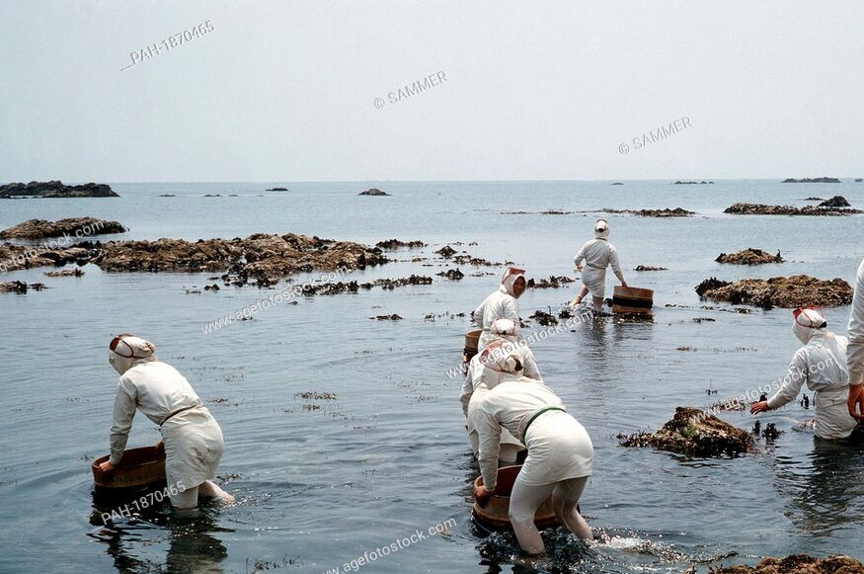
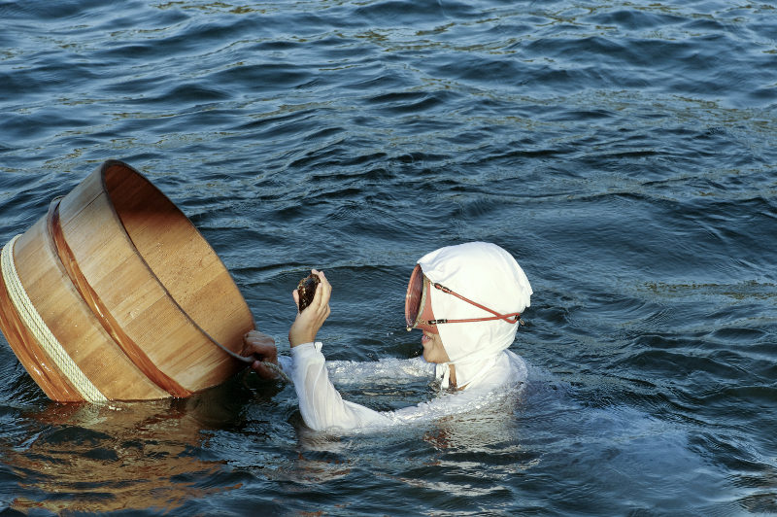
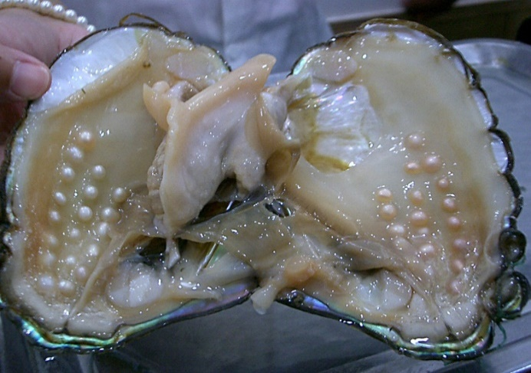
Thousands of years ago, the first pearl was probably discovered while human beings were searching for food at the sea shore. Throughout history, the pearl with its shine has been one of the most highly valued gems.
Pearls have been mentioned many times in religious texts and mythologies from the earliest times

Slide 16
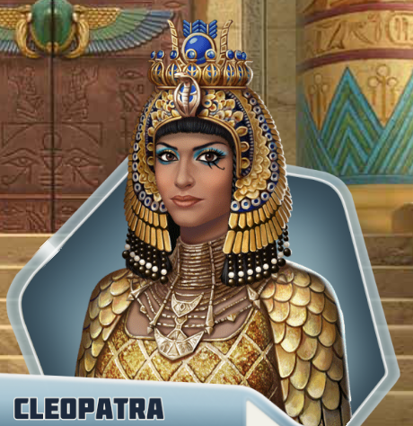
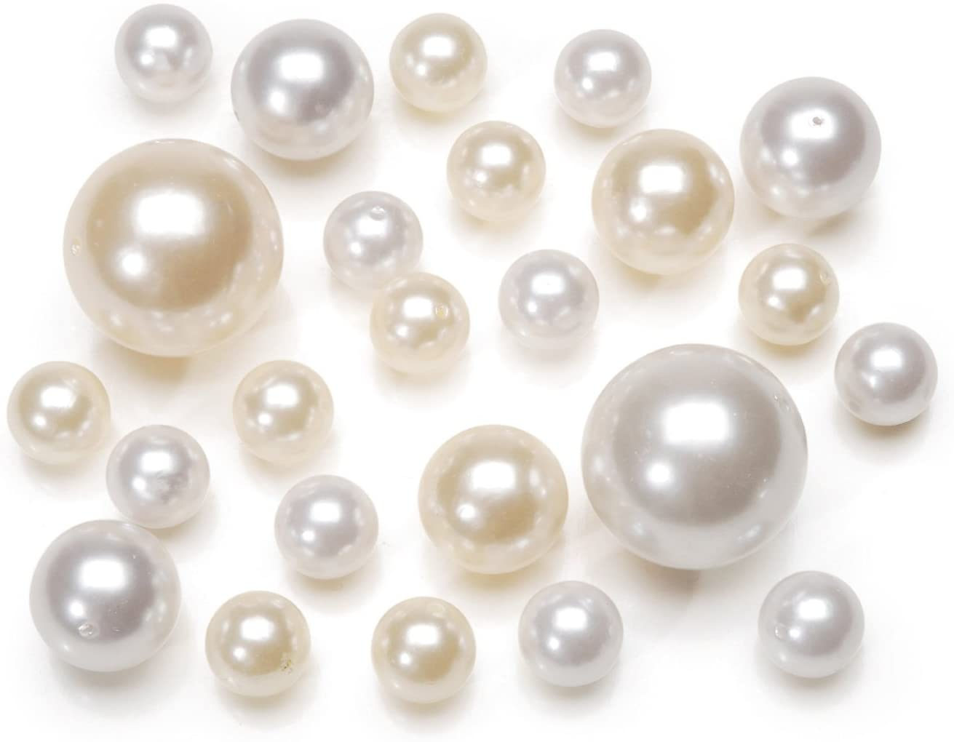
The ancient Egyptians valued pearls so much that they were buried with them. It is said that the famous queen of Egypt Cleopatra would dissolve a pearl in a glass and drink it as a sign of love and respect for the entire nation.
The Greeks thought the pearls as a sign of wealth and social position. The beauty of pearls was associated with love and marriage.

Slide 17
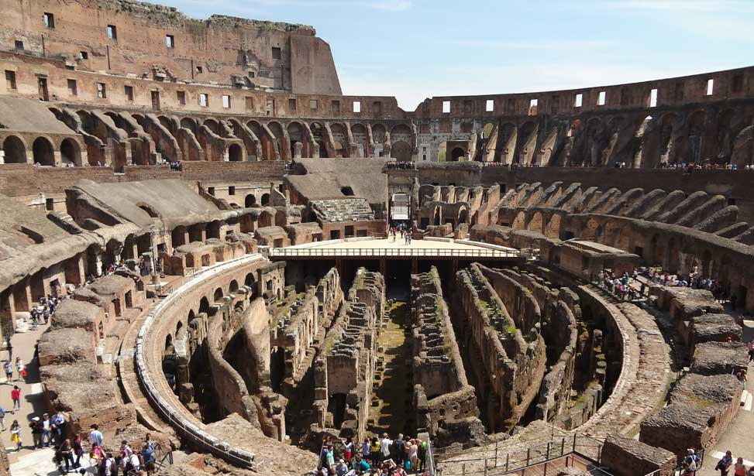
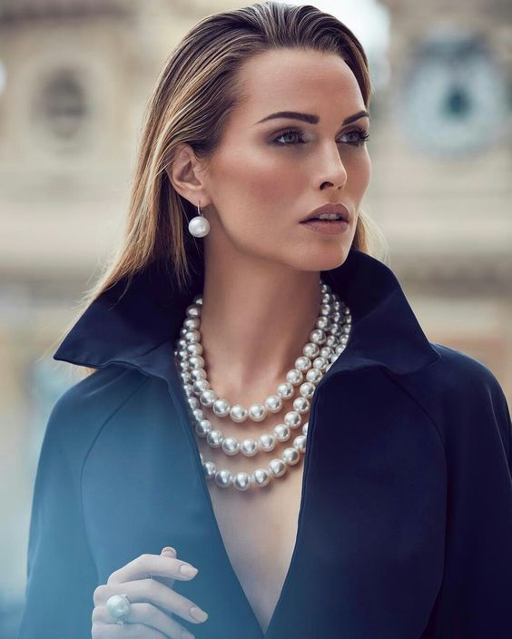
In ancient Rome, pearls were considered the greatest sign of wealth and social status. At that time the young women of noble families loved to wear beautiful pearl necklaces.

Slide 18
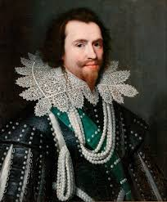
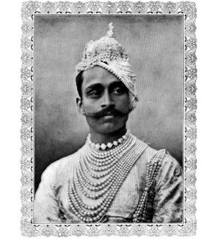
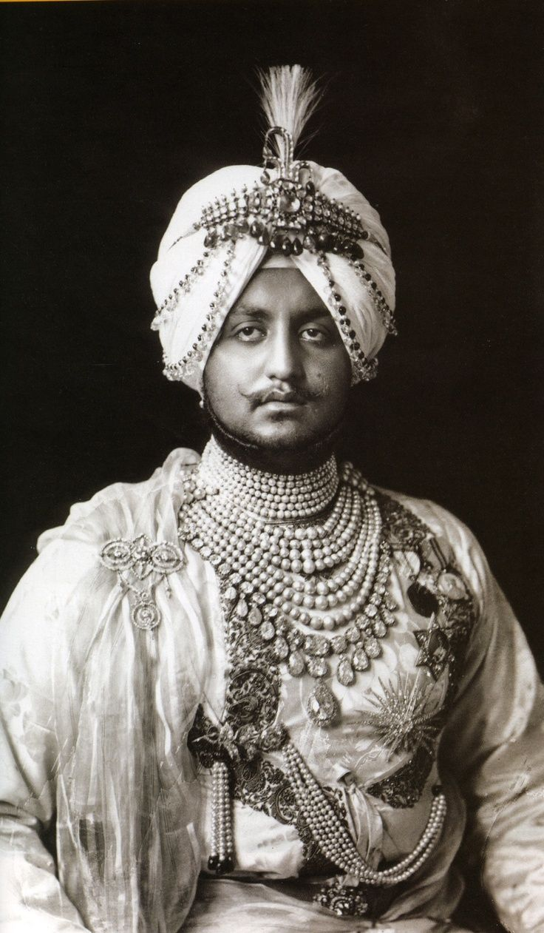
The brave knights used to wear them in the battles for good luck.

Slide 19
p
Pair work
Answer the following questions-
1.Do you think “pearls” were discovered by accident? Why?
Ans: Yes, I think “pearls” were discovered by accident. I think so because no one knew about the existance or it’s quality before to search for this.
2.Why do you think pearls were valued so much in the past?
Ans: . I think pearls were valued so much in the past because these have been mentioned many times in religious scriptures and mythologioes. Moreover, many historical events also prove this.
3.What good luck the knights thought would pearls bring them?
Ans: The knights thought the pearls would bring them victory as good luck.

Slide 20
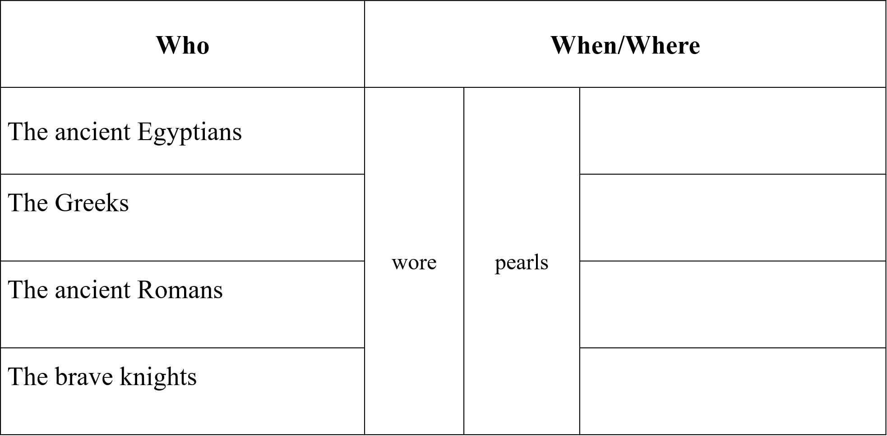
Evaluation
C. Read the text in B again and write the information in the table.
when they were buried.
in the time of love and marriage.
in social gathering.
in the battle ground.

Slide 21
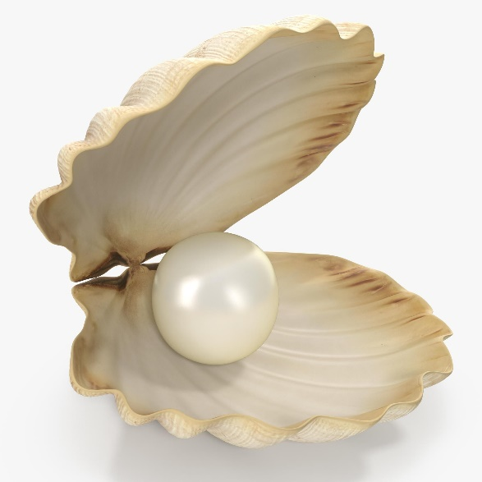
Home Work
Write short paragraph about pearls.

