Slide 1
Welcome to Multimedia Class

Slide 2
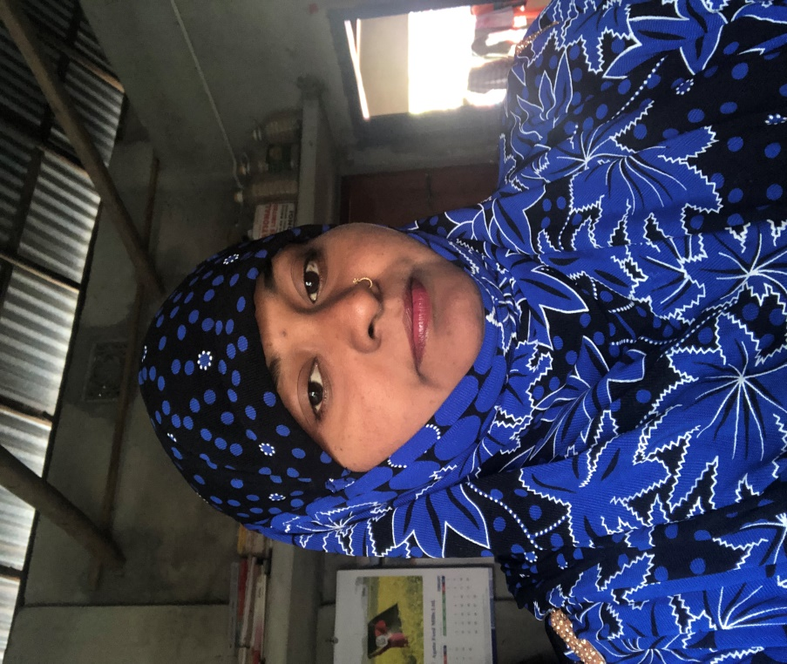
Teachers information
Mazada Akter
Lecturer (English)
Barabor alim Madrasha
Class IX-X
Subject : English Second paper

Slide 3
Our today’s lesson is--
Transformation
Superlative
to
positive degree

Slide 4
How to change superlative (with one of the) into positive
Very few
+
portion after superlative degree
are/were
so/as
+
+
positive form of adjective
+
as
+
subject (word before verb
Dhaka is one of the biggest cities in Bangladesh.
Subject
verb
portion after superlative
degree
Superlative degree
Very few
cities in Bangladesh
big
Dhaka.
are
as
as

Slide 5
Change the sentences into positive degree
Hazrat Omar was one of the greatest caliphs of Islam.
He was one of the most obedient followers of prophet Muhammad (Sm).
He ruled one of the biggest peninsulas in the world.
He was considered one of the noblest rulers in Islamic world.
He is one of the best models for all rulers.

Slide 6
Assignment at home.
He is the best boy in the class.
Akbar was one of the greatest kings of India.
The Padma is the biggest river in Bangladesh.
Cox’s Bazar is one of the largest sea beaches in the world.
My country is the most beautiful country in South Asia.

Slide 7
Thanks Every body No more today, See you next time.

