Slide 3
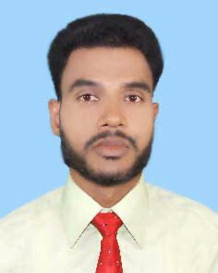
Presented by:
Mohammed Abu Noman
Assistant Teacher Of
Batakhali Nuria Dakhil Madrasah,
Chakaria.Purasava

Slide 4
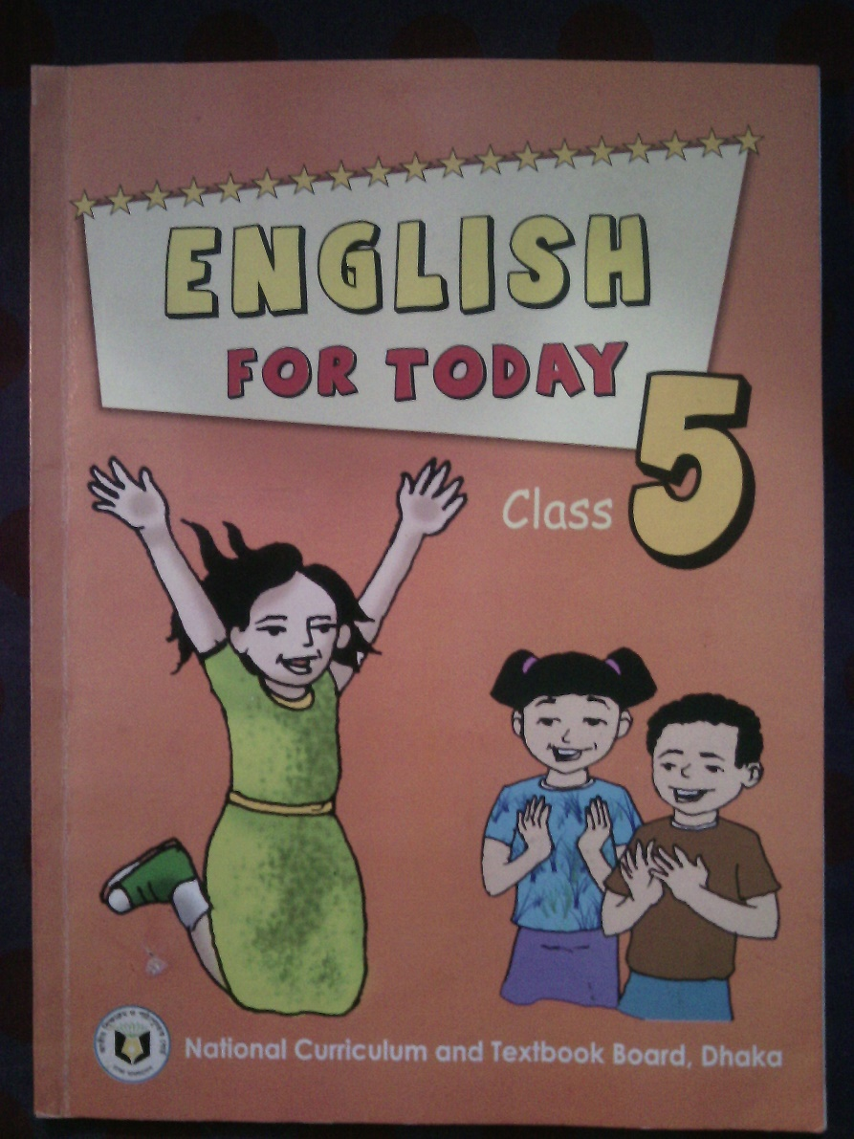
Class: Five
Sub: English

Slide 5
Today’s lesson:-
Unit-3: Saikat’s Family
Subtitle: Saikat Islam lives …… …… …… …… … …… …… …… ….. ….. ….. especially tigers and lions.

Slide 6
Learning Outcomes
At the end of the lesson, students will be able to.........
Read the text with proper pronunciation.
Know some new words.
Make sentence using new words.
4. Learn about their family.

Slide 7
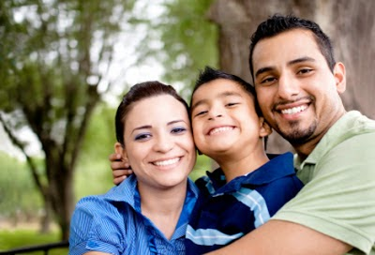
Family

Slide 8
His name is Saikat Islam.
Do you know? What’s his name?

Slide 9
Today we will learn about Saikat’s family.

Slide 10
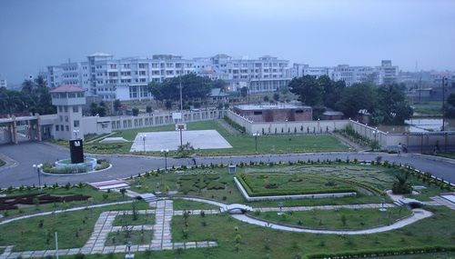
Bogra City
Saikat Islam lives with his parents in a flat in Bogra.

Slide 11
What does he do?
He is a banker.
His name is Rashidul Islam.
What’s his name ?

Slide 12
He is Saikat Islam’s father.

Slide 13
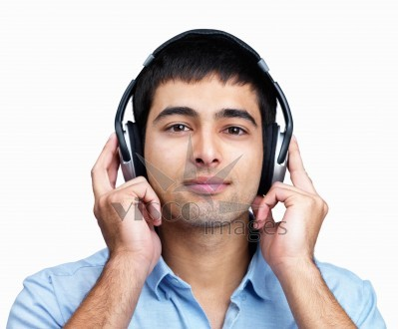
In his free time Mr. Islam writes stories and listens to music.

Slide 14
She is Mrs. Monwara Islam. She is Saikat Islam’s mother.

Slide 15
She is a housewife.

Slide 16
In her free time she enjoys sewing.
She makes dresses.

Slide 17
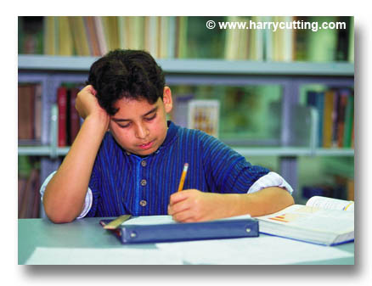
Saikat is in class 5. He is a good student. He wants to improve his English.

Slide 18
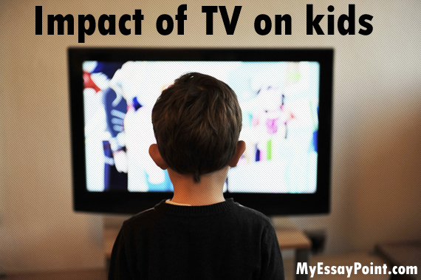
So he watches cartoons on TV every day.

Slide 19
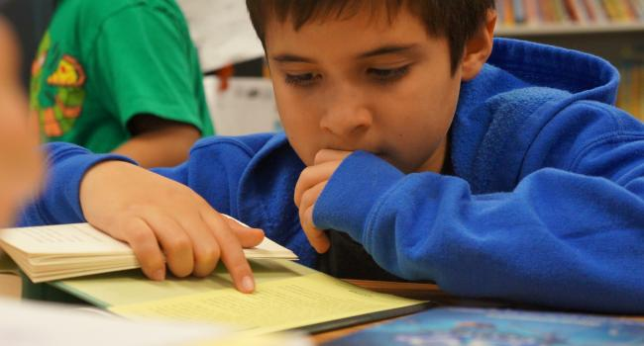
He also reads English books. He likes books about animals.

Slide 20
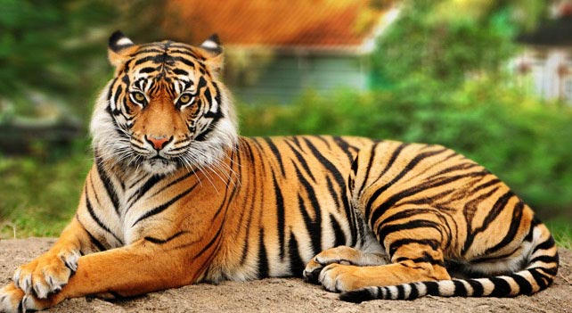
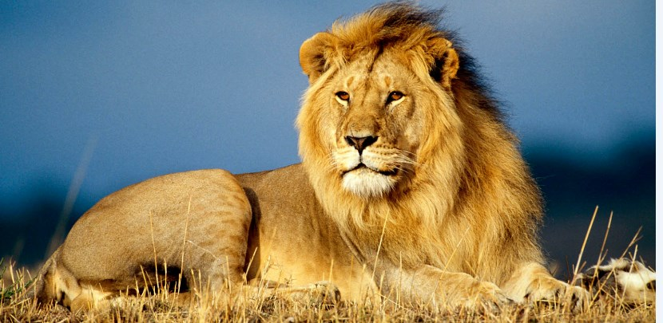
especially
tigers
And
lions.

Slide 21
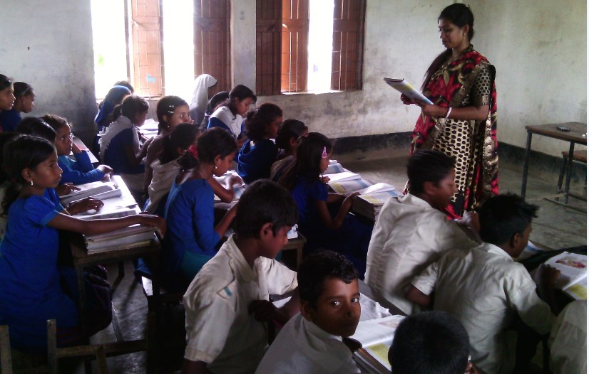
Teacher’s Reading

Slide 22
Find out new words-
Saikat Islam lives with his parents in a flat in Bogra. His father Mr. Rashidul Islam is a banker. But in his free time Mr. Islam writes stories and listens to music. Saikat’s mother is Mrs. Monwara Islam. She is a housewife. In her free time she enjoys sewing. She makes dresses. She often gets orders from her friends and neighbours.
Saikat is in class 5. he is a good student. He wants to improve his English, so he watches cartoons on TV every day. He also reads English books. He likes books about animals, especially tigers and lions.
parents
stories
housewife
sewing
neighbours
improve
watches
animals

Slide 23
Groupwork
1. What is Saikat’s father’s name?
2. What class does Saikat read in?
3. What does Saikat’s father do in
his free time?

Slide 24
Small Group Work(SGW)
Make sentence-
Parents
I love my parents very much.
Banker
Saikat’s father is a banker.
Make
Monwara Islam makes dresses.
Student
Saikat is a good student.
watch
Saikat watches cartoons every day.

Slide 25
1. What is Saikat’s mother’s name?
2. What does his mother do in her free
time?
3. What does Saikat do in his free
time?
4. What kind of books does Saikat like?

Slide 26
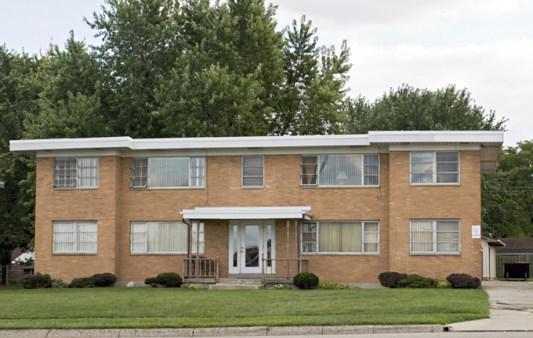
You will write five sentences about your family.

Slide 27
