Slide 1
Welcome

Slide 2
Presented PppppppppppppppP
Presented By
Mohammad Azizul Hoque
Assistant Teacher
Alinapara Government Primary School.
Sherpur Sadar, Sherpur.

Slide 3
Lesson Identity
Subject : English
Class : Four
Topics Name : Traffic rules
Lesson : 1-2
Time : 40 Minutes
Date: 23.01.21

Slide 4
Learning outcomes
By the end of the lesson students will be able to….
Listening:
1.1.1 Recognize sound differences in the context of words.
Speaking:
1.1.1 Repeat after the teacher and say words,phrases and sentences with proper sounds ,stress and intotation.
Reading:
1.4.1 Read words ,phrases and sentences in the text.
Writing:
3.1.1 Write words, phrases and sentences using non cursive capital and small letters.

Slide 5
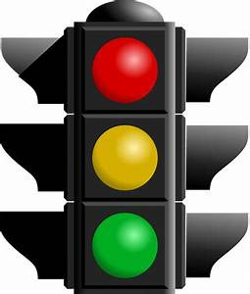
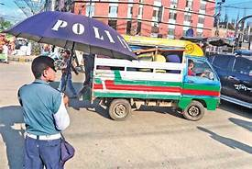
What have you seen the picture?

Slide 6
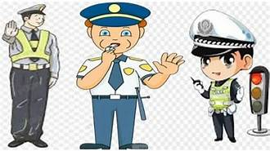
Lesson Declaration
Traffic Rules

Slide 7
No Horn

Slide 8
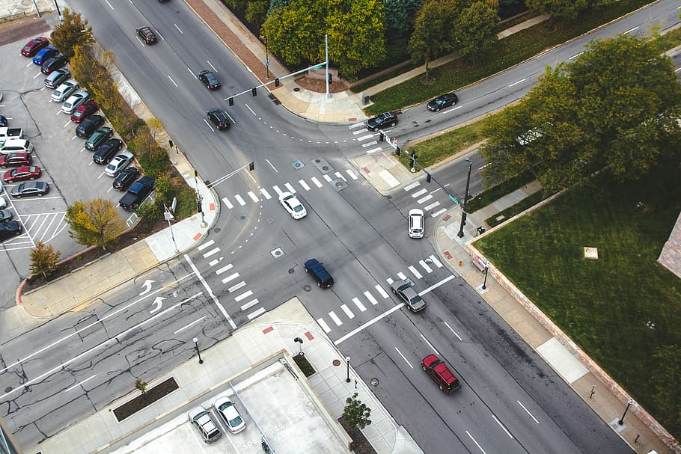
Intersection

Slide 9
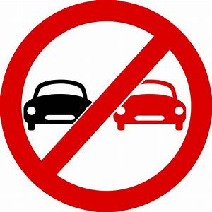
No overtaking

Slide 10
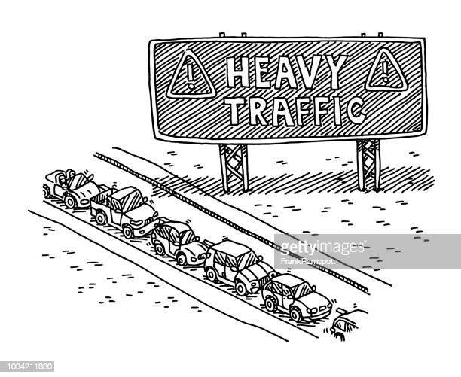
Heavy Taffic

Slide 11
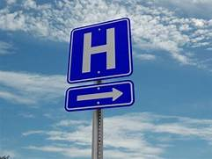
Hospital

Slide 12
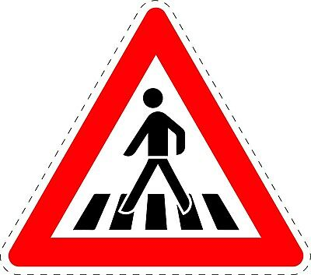
Zebra Crossing

Slide 13
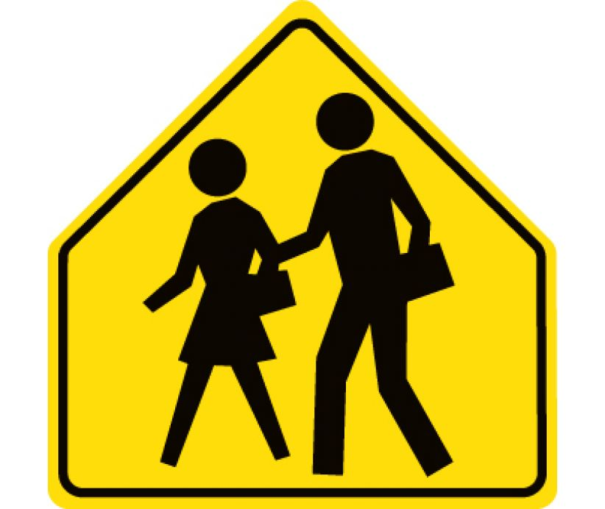
School

Slide 14
Traffic ights

Slide 15
Group Work
GREEN
RED
Blue
Each Group discuss about Traffic rules.

Slide 16
Evaluation
Now check your Answer
Zebra Crossing
No overtaking
No Horn
Intersection

Slide 17
Home Work
students learn five types of this Traffic rules.

Slide 18
Thanks to All

