Slide 1
welcome

Slide 2
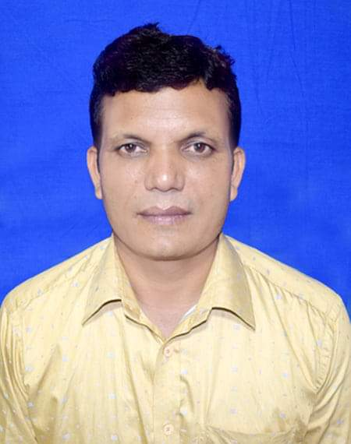
Presented by
A F M Saiful Islam
Head Teacher
Musrat Madati GPS
Kaligonj, Lalmonirhat.

Slide 3
Sub: English
Class: 4
Lesson : Unit 3
Title : Family

Slide 4
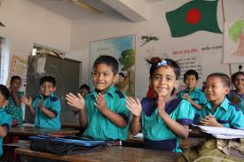
Let’s sing a song

Slide 5
Learning outcomes
Listening :
3.1.1 understand questions about family and friends.
Speaking:
3.1.1 Ask and answer. Wh question.
Reading :
1.4.1 read the words , phrases and sentences in the text.
5.1.1 read silently with understand paragraphs ,stories and other text.

Slide 6
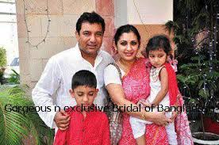
Look at the picture .
Think and discuss in pair .
What can you see in the picture ?
Picture of a family

Slide 7
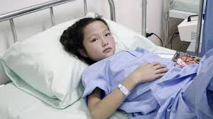
New words
patient
A person receiving medical treatment.

Slide 8
Pilot
A person who operate the flying control of an aircraft.

Slide 9
Take care
Be careful.

Slide 10
Today we are going to read about -
Family
Please open at page -6

Slide 11
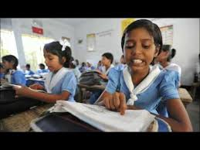
Listen the audio and read
loudly

Slide 12
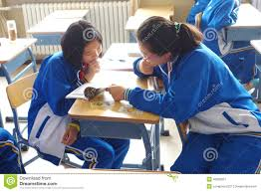
Let’s read in Pair

Slide 13
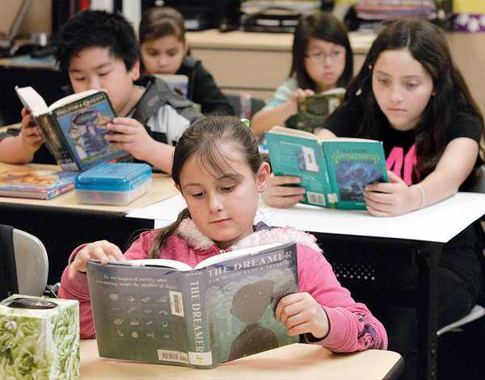
Silent reading

Slide 14
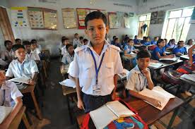
Individual reading

Slide 15
Read the text again and answer the questions
Where does Farzana live ?
Farzna lives in Kushtia .
What does Rehana Pervin do ?
She takes care of many patients .

Slide 16
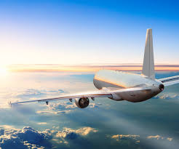
Match picture with word
patient
fly
Take care

Slide 17
Read and complete the chart
name | age | job | waorkplace
Farzana | 9 | Student | Chachua GPS
Jamil
Rehana Parvin
Aziz ahamed
Aitaf Uddin
Jahanara Begum
Student Chachua GPS
Doctor hospital
Pilot Biman Bangladesh
does not work No
64 Home maker at home

Slide 18
HOME WORK
Complete the chart with information about your family
name | Age | job | workplace

Slide 19
Write about your family at least 5 sentences. Use the information in activity B.

Slide 20
Thanks a lot

