Slide 1

Welcome to all

Slide 2
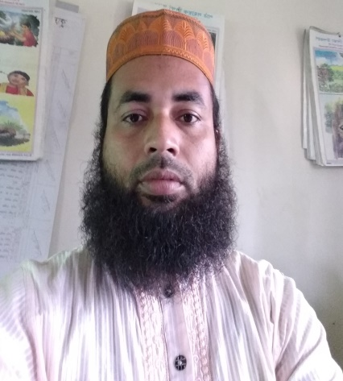
Teacher’s identity
Md.Afzal Hossain
Assistant teacher
Kuralia Govt. Primary School
Madhupur, Tangail

Slide 3
Lesson’s identity
Subject: English
Class: Five
Unit: 9
Lesson: 1-2
Title of the unit: Occupations
Date: 25-01-2021

Slide 4
Learning outcomes:
The students will be able to-
Listening
1.1.1-recognize sound differences in the context of word.
3.4.1-understand statements made by teacher and students.
4.2.1-understand and enjoy simple stories.
Speaking
1.1.1-repeat after the teacher and say words, phrases and sentences with proper sounds and stress.
Reading
1.5.1-read words phrases and sentences in the text with proper pronunciation, stress and intonation.
1.7.1- read simple paragraphs, dialogues and simple letters.
7.1.1-recognize punctuation marks and read accordingly.

Slide 5
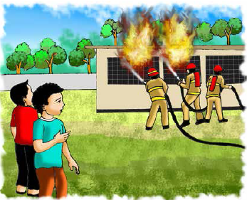

Let’s see some pictures
A fire in the school building
A firefighter

Slide 6
Today’s lesson
Occupations (A firefighter)

Slide 7
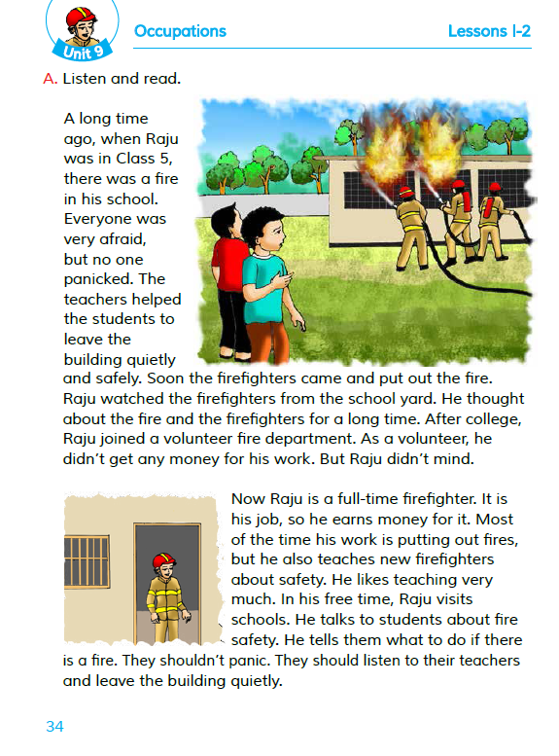
Now, open your book at page 34

Slide 8
Let’s see some new words
ago
before the present time
afraid
filled with fear
panic
sudden fright
quietly
silently
safely
without any danger

Slide 9
a person who puts out fires
firefighter
put out
to extinguish
one who works without money
volunteer
department
a part
free time
leisure time

Slide 10
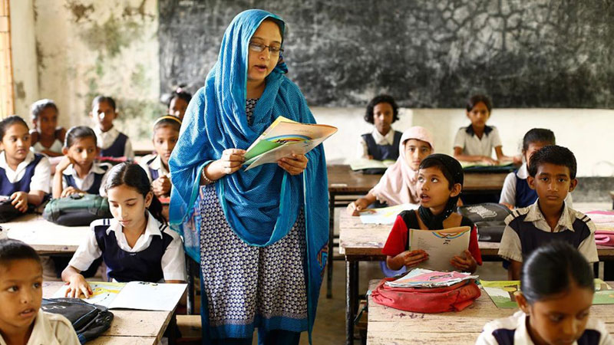
Teacher’s loud reading
W.C.W

Slide 11
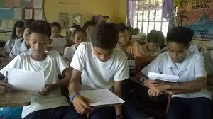
Student’s silent reading
I.W

Slide 12
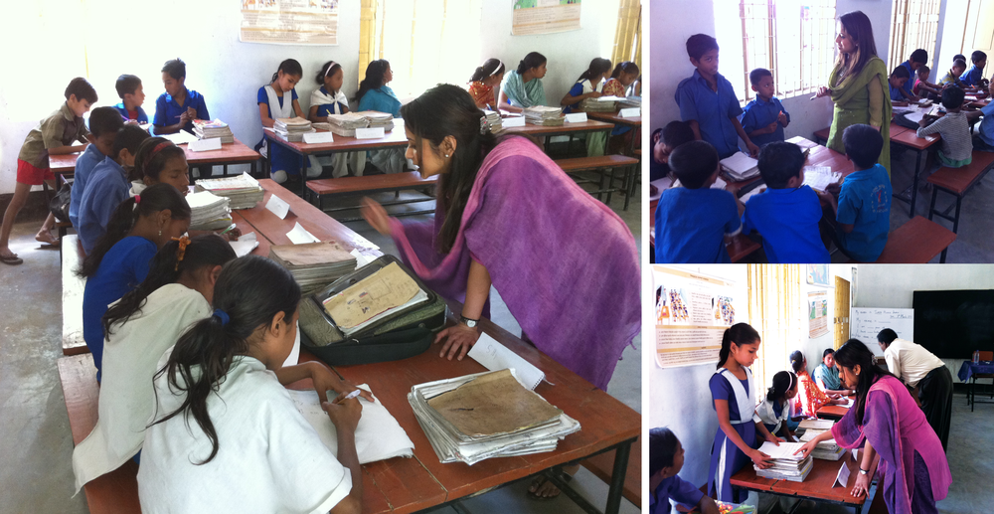
Match the words with their meanings
Column A | Column B
a)firefighter | i)silently
b)panic | ii)extinguish
c)quietly | iii)who puts out fires
d)put out | iv)who works without money
e)volunteer | v) sudden fright
G.W

Slide 13
Now, check your group work activity
firefighter - who puts out fires
panic - sudden fright
quietly - silently
put out - extinguish
volunteer - who works without money

Slide 14
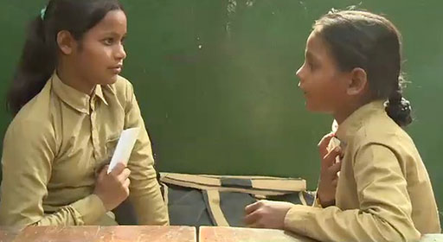
Answer the following questions (say and write)
P.W
a) What is Raju ?
b) Who helped the students to leave the building ?
c) When did Raju join a volunteer fire department ?
I.W
d) What is Raju’s main duty ?
e) How does afire fighter help us ?
f) Write your feelings about a firefighter ?

Slide 15

I.W
Home work
Write five sentences about a fire fighter.

Slide 16

Good bye
Bye
Bye

