Slide 1





WEL COME

Slide 2

TEACHER INTRODUCING
ABDUL ALIM
ASSISTANT TEACHER
LOKKHONKHOLA GOVT PRIMARY SCHOOL
MEGHNA, CUMILLA.

Slide 3
LESSON -INTRODUCING
SUBJECT –ENGLISH
CLASS-ONE
UNIT:10
TIME-40 M.

Slide 5
Lesson declaration
Alphabet
Page:21

Slide 6
Learning Outcome
Student will be able to
Listening:
1.1.1:Become familiar with english sounds by listening to common english word.
Speaking
1.1.1:Repeat after the teacher simple words.
Reading
1.2.1 recognize and read the alphabet both small and capital.
Writing
1.1.1 to practice letter shapes/simple writig patterns, etc.

Slide 7
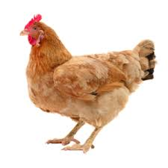
What’s this ?
Hen
hen

Slide 10
Say and read. Trace and write
Capital Letter

Slide 11
Say and read. Trace and write
Small Letter

Slide 12
Group Work
Write and trace

Slide 13
Say, trace and write
h e n
e n
h
e
n
h

Slide 14

Home Work
Say, trace and write: Activity B & C

Slide 15

Evaluation
h e n

Slide 16
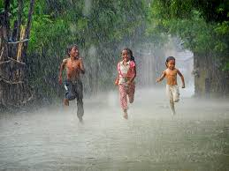
Thank You

