Slide 2
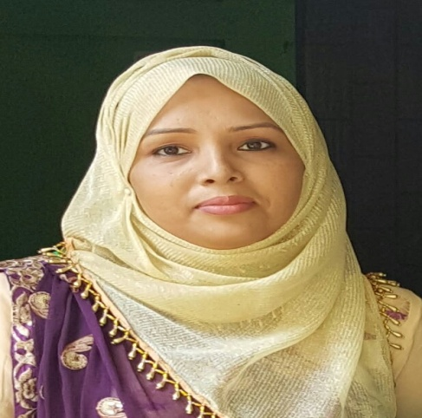
INTRODUCTION
Achia Begum
Head Teacher
Uttarsur
K.C GPS
Sreemangal,
Moulvibazar.
English For
Today
Class:5

Slide 3
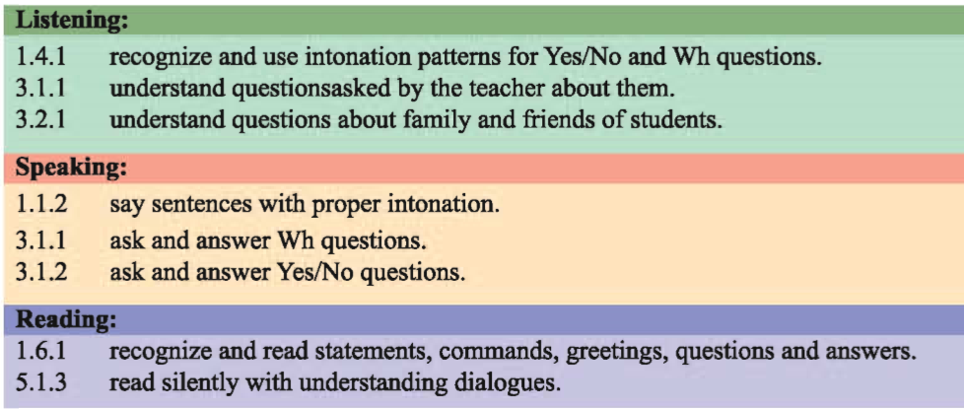
Learning outcomes:
students will be able to -

Slide 4
Good morning. Let’s sing a new year song.

Slide 5
What is this?
This is our ‘English for today’ textbook.

Slide 6
Key words
Introduce
make (someone)known by name to another in person , especially formally.

Slide 7
really
truly
holiday
break

Slide 8
meeting
gathering
leaving
go away from

Slide 9
Today’s topic is-
Hello!
Unit:1
Lesson 1
pg:2

Slide 10
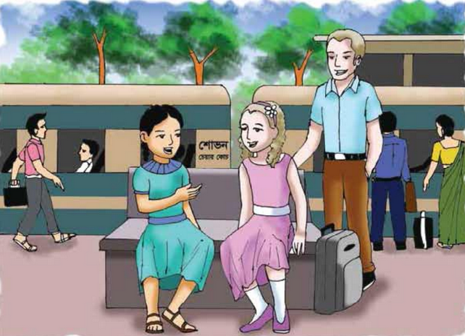
What do you see in the picture?
Describe, Where are they and What are they doing?

Slide 11
Listen to the audio carefully.
Open your book and put your finger under the line.

Slide 12
Silent reading
Students will read the text silently.

Slide 13
Group work
Where is Jessica going?
Where is Jessica from?
Where is Sima going?
Is Sima from Dhaka?
Where are Sima and Jessica ?

Slide 14
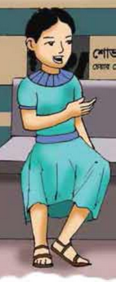
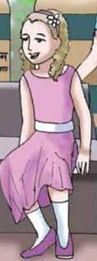
Pair work
Every pair will read. Teacher will try to see the reading of each pair. Everyone has to make sure to read.
Sima
Jessica
One will act as Sima and other will Jessica.

Slide 15
Individual work
How do we introduce ourselves? What do we say at the starting of a conversation?
“Hi! I’m………../Hello! I’m………and I am from……..”

Slide 16
Individual work
What do we say at the end of a conversation or at the time of leaving?
“Bye! Nice meeting you, Take care, See you”

Slide 17
Evaluation
I’ll call two students to the front and ask them to show us how to introduce themselves.

Slide 18
Useful expressions
At the beginning of a conversation : May I introduce myself ? I’m……
At the end of a conversation: Nice meeting you. See you. See you later.

Slide 19
Write a paragraph introducing yourself . Use the useful expressions discussed in the class.

