Slide 1
Welcome

Slide 2
Introduction
Amena Ferdosi(Nizum)
Assistant Teacher(English)
Bhimpur High School Chatkhil,Noakhali.
CLASS: NINE-TEN
SUBJECT: ENGLISH 1ST PAPER

Slide 3
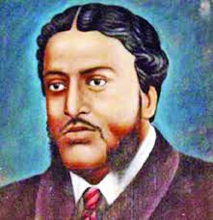
Do you know him?

Slide 4
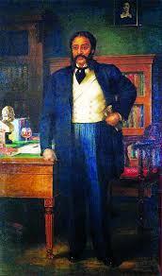
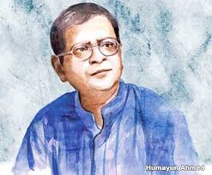
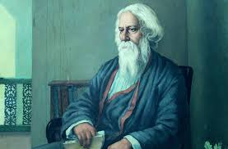
Who is the sonnet writer out of them?
Michael Madhusudan Dutt

Slide 5
Learning Outcomes
After this lesson the students will be able to-
1. talk about the pictures.
2. listen for specific information.
3. read and a text and find out information.
4. make WH questions.
5. infer the word meaning from the text.

Slide 6
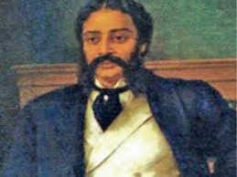
Today our lesson topic is….
The return of the native
Unit12, Lesson:3

Slide 7
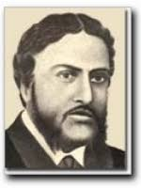
Michael Madhusudan Dutt was a popular 19th –century Bengali poet and dramatist.

Slide 8
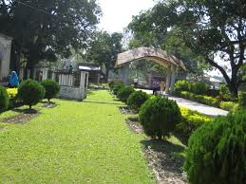
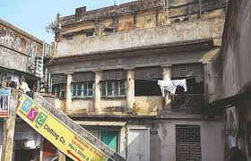
He was born in Sagordari on the bank of the Kopotahsho River, a village of Keshobpur Upozila under Jossore district.

Slide 9
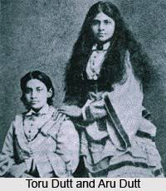
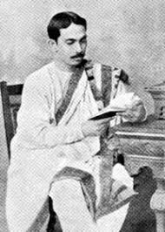
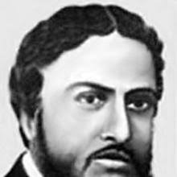
Though he was born in a sophisticated Hindu family , he took Christianity as young man ,much to the ire of a family , he adopted the first name Michael.

Slide 10
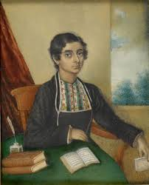
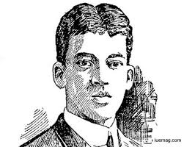
In his childhood, he was recognized by his teachers as a precious child with gift of literary talent.

Slide 11
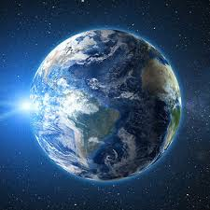
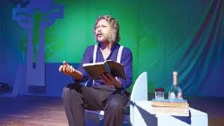
Since his adolescence he started to believing that he was born on the wrong side og the planet, and that his society was unable to appreciate his intellect.

Slide 12
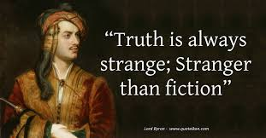
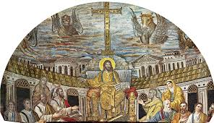
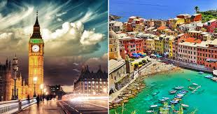
Michael was ardent follower of the famous English poet lord Byron. So after adopting Christianity, he went to Europe and started composing poetry and drama almost entirely English.

Slide 13
However, he failed to gain the appreciation.

Slide 14
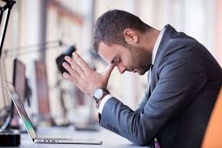
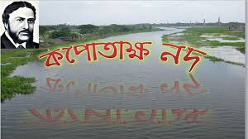
Out of his frustration, he composed a sonnet in Bangla “Kopotasksha Nad” which earned him huge reputation in Bangla.

Slide 15
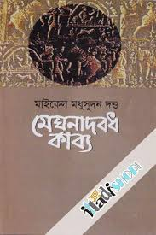
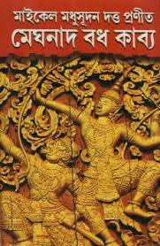
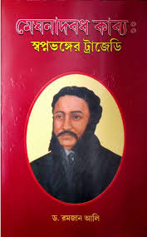
He is the poet to write the first Bangla epic Meghnad Badh Kabya.

Slide 16
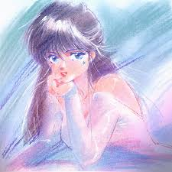
Let us know some key words.
Aspire
Wish for/Desire/Want

Slide 17
Ire
Anger

Slide 18
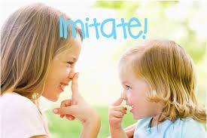
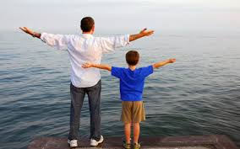
Imitate
The action of using someone or something as a model

Slide 19
Adolescence
Teenage years

Slide 20
Read the text in the book and write the answers of the following questions.
Q 1. How was the reaction of Michael Madhusudan Dutt’s family when he took Christianity?
Q 2. What was his attitude to his root in his adolescence?
Q 3. Why did he compose “Kopotaksha Nad”?

Slide 21
Home work
How the story of Michael is related to the unit theme Roots.

Slide 22
Thank You

