Slide 1
Welcome to our online class.

Slide 2
Introduction
Runa Begum
(Assistant Teacher)
Nandia Sangun Ideal Dakhil Madrasah.
Sreepur,Gazipur .
Subject -English 1st.
Class -5
Lesson -4-5,
unit-6

Slide 3
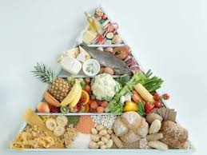
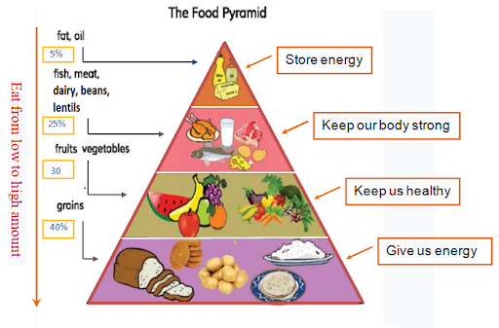
Let’s see some picture
Can you guess our todays lesson?

Slide 4
Todays Topic
The food pyramid.

Slide 5
Learning outcomes
After Completing the lesson Students will be able to---------
Ask & answer questions,
Practise vocabulary,
Write short paragraph.

Slide 6
Word MEANING
Orange =
Ice cream =
Egg =
Chips =
Papaya =
Milk =
Grains =
কমলালেবু।
আইস-ক্রীম।
ডিম।
ভাজা-পোরা।
পেপে।
দুধ।
শস্য জাতীয় খাবার।

Slide 7
MORE WORD MEANING
Chocolate =
Fish =
Lettuce =
Rice =
Fruits =
Vegetables =
Fries =
চকোলেট।
মাছ।
এক প্রকার সবজি।
ভাত।
ফলমূল।
শাকসবজি।
ভাজা জাতীয় খাবার।

Slide 8
Read the passage.
What food is good food? Sometimes the food we like to eat isn’t the healthiest food for us. The Food Pyramid helps us to understand the different food groups, and it tells us how much of each food group we should eat.

Slide 9
Look at the picture of the food Pyramid. We eat more of the foods at the bottom of the Pyramid .what foods do you see at the bottom? These are things made from grain, for example, rice, ruti and bread. Potatoes are not grains, but they are similar grains give us energy.

Slide 10
Fruit and vegetables are in the next level of the Pyramid. These are also very important for us. They have vitamins. They help our eyes and our health.
On the next level, there are fish, meat, dairy products, beans and lentils. Meat, fish and chicken have protein. Beans and lentils do, too!

Slide 11
Dairy products are things like milk and eggs. They help our teeth and bones. Protein and dairy make us strong.
Fat and oil are at the top of the Food Pyramid. These make food delicious, but our body does not need very much of them.

Slide 12
Sometimes we can’t get food from all the different food groups. But when we have choice about food, we need to make good choices.

Slide 13
True or false and give the correct answer.
A. Grains give us energy.
B. A food pyramid is a chart to shw the nine graups of food.
C. The food pyramid helps us giving idea about food habit.
D. Our body meeds a good mix of food.
E. Dairy products help our teeth and bones.

Slide 14
Answer the true or false
A. True.
B. False.
correct answer- A food pyramid is a chart to show the four groups of foods.
C. True.
D. True.
E. True.

Slide 15
Answering the following questions…
A. Which are the most important for teeth and bones?
B. What is a food pyramid?
C. What foods should be taken moderately?
D. What is the benefit of eating a healthy breakfast of food pyramid?
E. A food pyramid is----- ?

Slide 16
Answering questions……..
Ans.(a)Dairy products are the most important for teeth and bones.
Ans.(b) A food pyramid is a chart to show the five groups of foods .
Ans.(c)We should eat the dairy products as well meat, fish, bean and nuts moderately.

Slide 17
Ans.(d)If we eat a healthy breakfast before leaving the madrasah we will feel strong and active the whole day
Ans.(e) A food pyramid is a chart of foods.

Slide 18
HOME WORK
Write 5 sentence to the food pyramid.

Slide 19
Thank you everyone

