Slide 1
Welcome to our online class

Slide 2
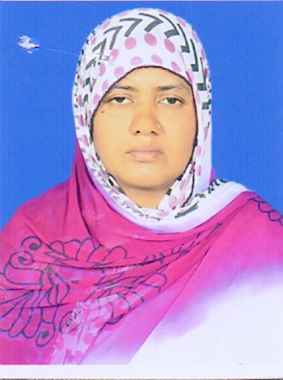
Runa bugum
(Assistant Teacher)
Nandia Sangun Ideal Dakhil Madrasah.
Sreepur,gazipur .
CLASS: 09-10
SUBJECT: ENGLISH 1ST PAPER
UNIT: 03
LESSON: 02

Slide 3
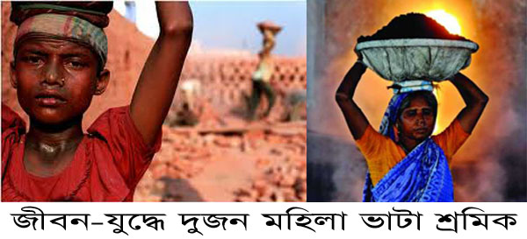
Let’s see some pictures
Two labours work in a brick field.

Slide 4
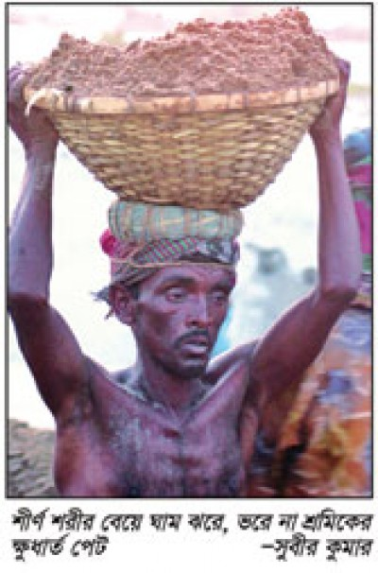
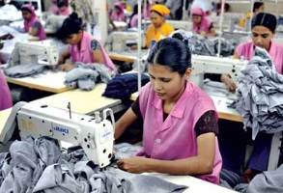
A day labour working hard
Some garment workers working

Slide 5
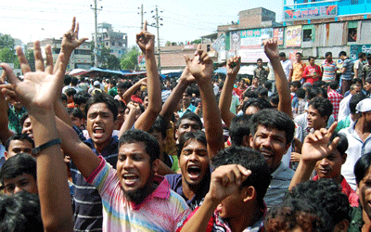
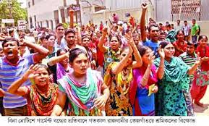
Is their salary sufficient?
Movement
Movement

Slide 6
Look At the picture and talk about it.
What do you see in the picture?
Can you relate any historical event in this picture?
What happened on this day?

Slide 7
Today’s Topic-
May day

Slide 8
Learning outcomes
We will learn about the importance of may day.
We will able to identify the reasons of industrial revolution.
We will know the meaning of new words.
We will able to develop four skills.

Slide 9
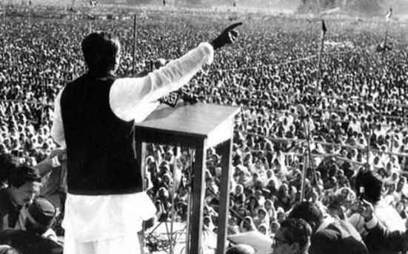
Word meaning
connected with history or past events
Historical
Sheikh Mujib made a historical speech.

Slide 10
Commemorate
Recall and show respect for someone or something
Struggle --- a forceful effort to get free.
Demand---- to ask for something forcefully.
Instantly --- at once.

Slide 11
Read the passage about may day .

Slide 12
May Day or International Workers Day is observed on May 1 all over the world today to commemorate the historical struggle and sacrifices of the working people to establish an eight-hour workday. It is a public holiday in almost all the countries of the world,Since the Industrial Revolution in the 18th and 19th centuries in Europe and the US, the workers in mills and factories had been working a long shift, fourteen or even more hours a day.

Slide 13
On May 1 st in 1886 , inspired by the trade unions ,half of the workers at the McCormic Harvester Company in Chicago went on strike demanding an eight-hour workday.Two days later,a workers rally was held near the McCornic Hervester Company and about 6000 workers had joined it.

Slide 14
The rally was addressed by the labour leaders.They urged the workers to stand together,to go on with their struggle and not to give in to their bosses.Just at this moment some strike breakers started leaving the meeting place.The strikers went down the street to bring them back.

Slide 15
Suddenly about 200 policemen attacked them with clubs and revolvers.One striker was killed instantly,five or six others were seriously wounded and many of them were badly injured,The events of May 1,1886 is a reminder that workers will continue to be exploited until they stand up and speak out to gain better working conditions , better pay and better lives .

Slide 16
B. Read the text and answer the questions.
1.What does May Day refer to?
2. How long did the workers have to work a day before the May 1 strike?
3.How many workers were victimised for taking part in the strike?
4.How did the workers in Chicago go on astrikes?

Slide 17
Evaluation
1.Do you think Tania’s monthly salary is enough for her work?
2.How many time does Tania work?
3.Does Tania live in a hygienic place?

Slide 18
Home work
Write a paragraph about May Day.

Slide 19
Thanks

