Slide 1
Lesson’s Identity
Class: Nine
Subject: English 1st Paper
Unit: Two
Lesson: 01 (C)
Title: Have You Any Favourite Pastime?

Slide 2
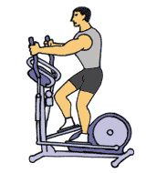
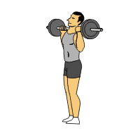
Look at The Pictures

Slide 3
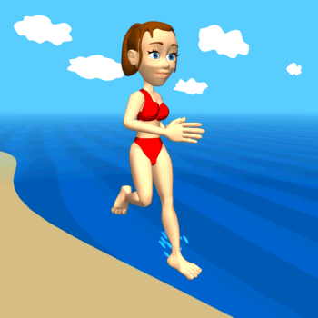
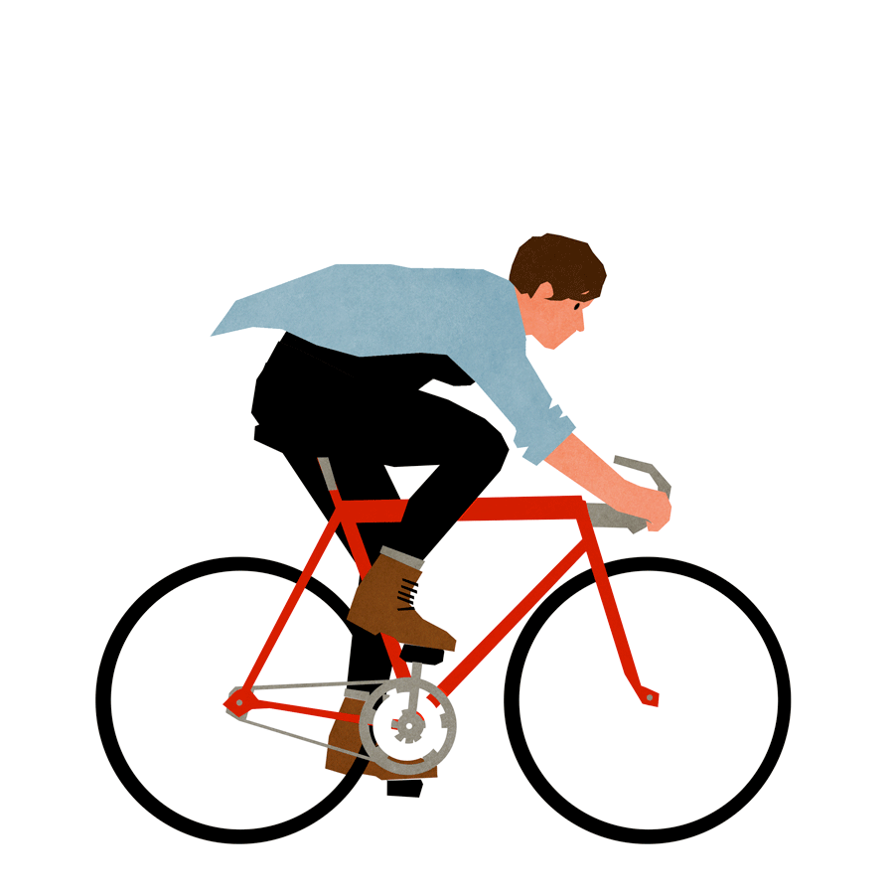
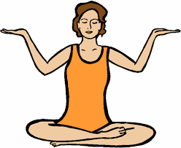

Slide 4
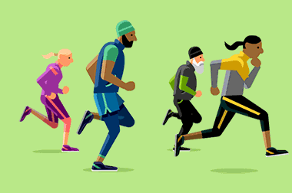

Slide 5
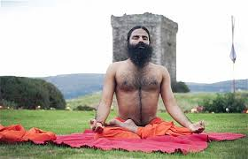
Our Today’s Topic
Yoga

Slide 6
Vocabulary
Position in which you hold your body when standing or sitting.
Posture

Slide 7
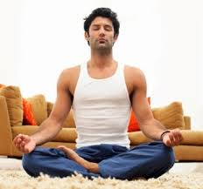
Contemplation.
Meditation

Slide 8
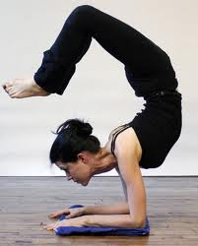
The quality of bending easily without breaking; Elasticity.
Flexibility

Slide 9
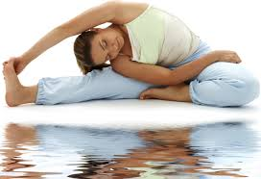
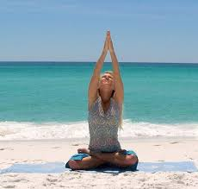
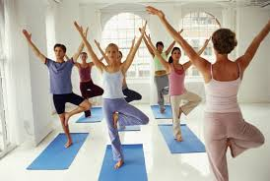
Movements
An act of changing physical location or position.

Slide 10
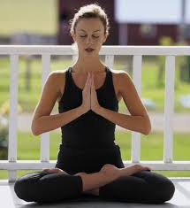
Look at the pictures
A traditional yoga

Slide 11
Precise movements.

Slide 12
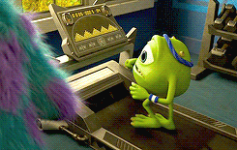
Improved balance

Slide 13
A variety of movements.

Slide 14
Pair Work:
Write five short notes about these four pictures.

Slide 15
Group Work
Write ten sentences about the health benefits of yoga.

Slide 16
:
Home Work
Write a paragraph on Your Favourite Pastime.

