Slide 1
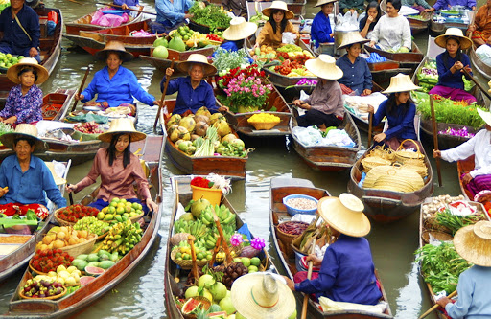
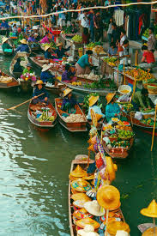
Look at the picture and talk about it.
Can you guess what this could be?
Where do you think this place is?

Slide 2
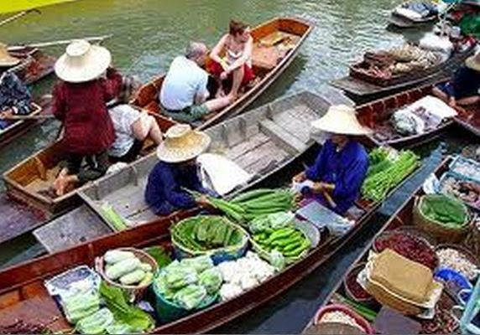
Today’s Lesson
The Tha Kha floating market

Slide 3
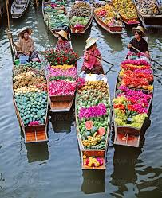
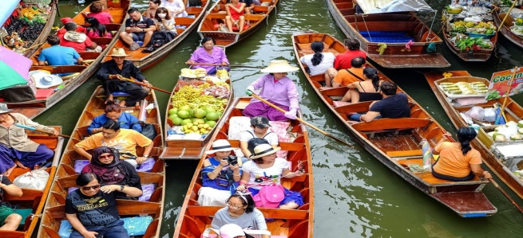
Key Words presentation
Words
Meanings
Heavily loaded with something.
Laden (adj)
Syn. Full, loaded
Ant. unladen, unloaded
The boats were laden with lotus flowers, farm-fresh coconuts, vegetables tec.
Conversation about things that are not important
Chitchat (n)
Syn. Idle talk
Ant. Serious talk
Mita and Zara made a little chitchat at the time of buying and selling.

Slide 4
Natives (n)
Person who were born in a particular country or area
Syn. Aboriginals, locals
Ant. outsiders
Most of the buyers and seller are native of the market.
To put something in a place where people can see it easily.
Display (v)
Syn. show, exhibit
Ant. hide
They displayed the products beautifully for the buyers.

Slide 5
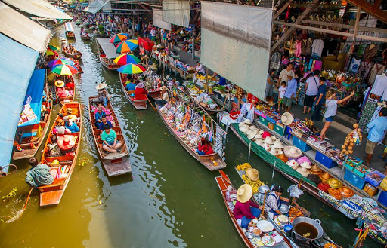
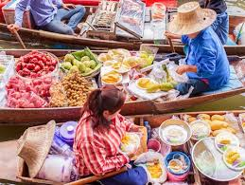
Row (v)
To run a boat
Syn. oar
Thy move here and there in rows
Used as a polite word for ‘old’
Elderly (adj)
Syn. Aged, older
Ant. young
Most of the buyers are elderly Thi women

Slide 6
Read the text and answer the questions.
It was Sunday. Mita, Zara, Jhuma Islam and Mazharul Islam woke up very early. They quickly got ready and started for Tha Kha floating market. They planned to have breakfast at the market. They reached the market place sharp at 7. The canals were surrounded with coconut palm trees. They hired a boat. The boatman started to row slowly taking them to the centre of the market.
There were boats everywhere .The sellers were mainly elderly Thai women. Their small boats were laden with bundles of lotus flowers, farm-fresh coconuts, fruits, vegetables, local food and delicious sweets. The sellers and buyers rowed their boats slowly. The sellers and buyers rowed their boats slowly. The sellers displayed their goods for sale and the buyers chose their pick. They could have a little chit-chat as buying and selling was going on.

Slide 7
Write the answer of the following questions
Individual Work
What kind of market was it?
2. Why did the boatmen row slowly?
3. Who were selling goods? How were they selling g their goods?
4. What were they selling?
Ans. It was a floating market.
Ans. The boatmen rowed the boat slowly because the goods needed to be seen by the buyers.
Ans. The Thai elderly women mainly were selling goods.
Ans. They were selling bundles of lotus flowers, farm-fresh coconuts, fruits,. Vegetables, local food and delicious sweets, etc.

Slide 8
Again read the text silently and give the answers of the following question.
The Tha Kha floating market is more traditional with a few tourists visitng that other floating markets. Originally, the Tha kha floating market used to sit only six or seven days a month depending on the phase of the moon. Nowadays, the trade takes place on Fridays, Saturdays and Sundays, too. The main buyers here are the Tha kha natives, People seem to know each other very well. Everyone was seen smiling and calling each other by name. The locals did not notice Mita and others much. They were all busy buying and selling.

Slide 9
Pair Work
True or false? If false, give the correct information.
The Tha Kha floating maket is a tourist place.
2. It sits only six or seven days a month.
3. The buyers and sellers are the local people living near The Tha Klha river.
4. They all knew each other.
Ans. False: corr. Info. The Tha Kha floating market is a traditional market.
Ans. True.
Ans. True.
Ans. True.

Slide 10
Read the text further and write the answer to the following questions.
Why is Tha Kha floating market ‘traditional’?
2. How many days a week does the market sit?
3. Why do you think people at the floating market know each other so well?
Ans. The Tha Kha floating market is traditional as it used to sit only six or seven days a month depending on the phase of the moon.
Ans. The market sits three days a week. The days are Friday, Saturday and Sunday.
Ans. I think people at the floating market know each other so well because they were seen smiling and calling each other by name. Besides, they live in the same place

Slide 11
Group Work
Fill in the gaps with suitable words.
The Tha Kha people are simple and easy going. They are not (a) and (b) at all. They do not understand © or any other language. Yet they have a way of (d) with Mita and others. After seeing a traditional Tahi floating market, Mita became (e) .
unfriendly
impolite
English
communicating
Delighted/ happy

Slide 12
Evaluation
Describe a nearby bazar/market in your locality by answering the following questions.
What is the market called?
When does the market sit?
What can you buy at the market?
Do you like going to the market? If you do, write why?

Slide 13
Home Work
Write a short paragraph on ‘The Tha Kha floating market’.

Slide 14
Thank you everybody, Have a nice day.
See you again in the next class.

