Slide 2
You are welcome.

Slide 3
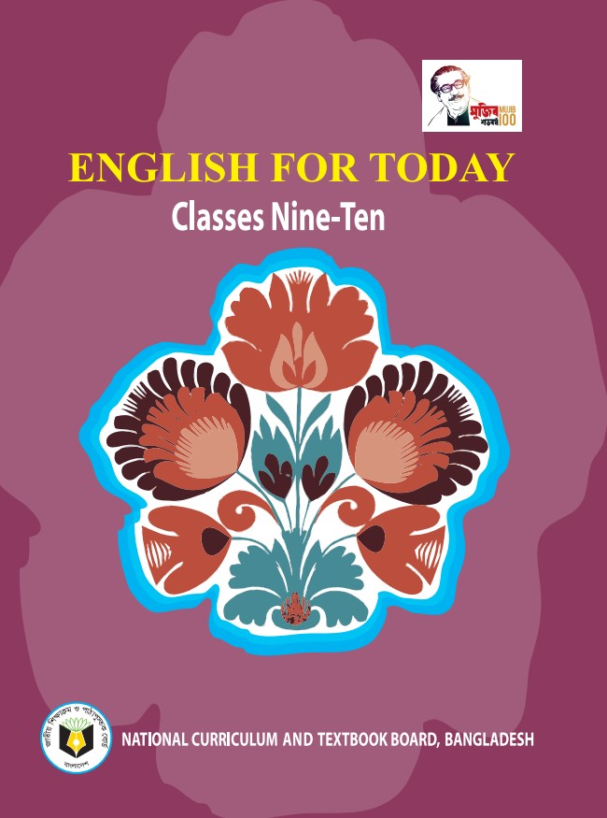
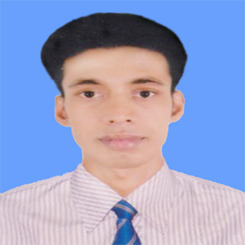
My identity
Swandip Banerjee
Assistant Teacher (English)
Pallimangal Secondary School, Khulna.
E-mail: swandipb1@gmail.com
Mobile: 01718503573

Slide 4
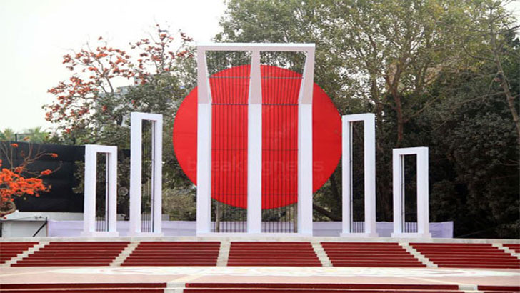
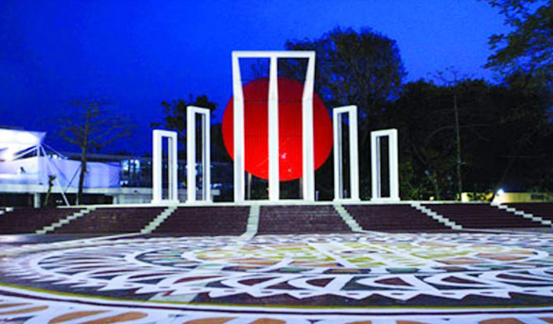
A: Look at these pictures and discuss the following questions.
1. When did the International Mother Language Day celebration begin?
2. What does the abbreviation UNESCO stand for?
3. What is the other name of 21 February?

Slide 5
Our today’s topic of the class is……?
International Mother Language Day-2
Unit : 03
[Events and Festivals]
Lesson : 04

Slide 6
Learning outcomes
After we have studied this lesson, we will be able to …….
talk about events and festivals,
ask and answer questions and give opinions in a logical sequence,
infer meanings from the context.

Slide 7
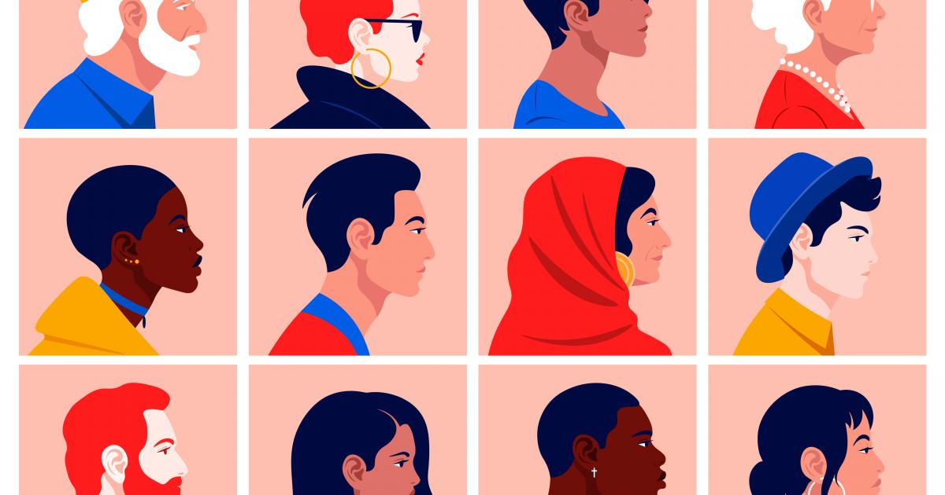
New word
Diversity
A range of many people or things that are very different from one another.
Synonym: difference, variety.

Slide 8
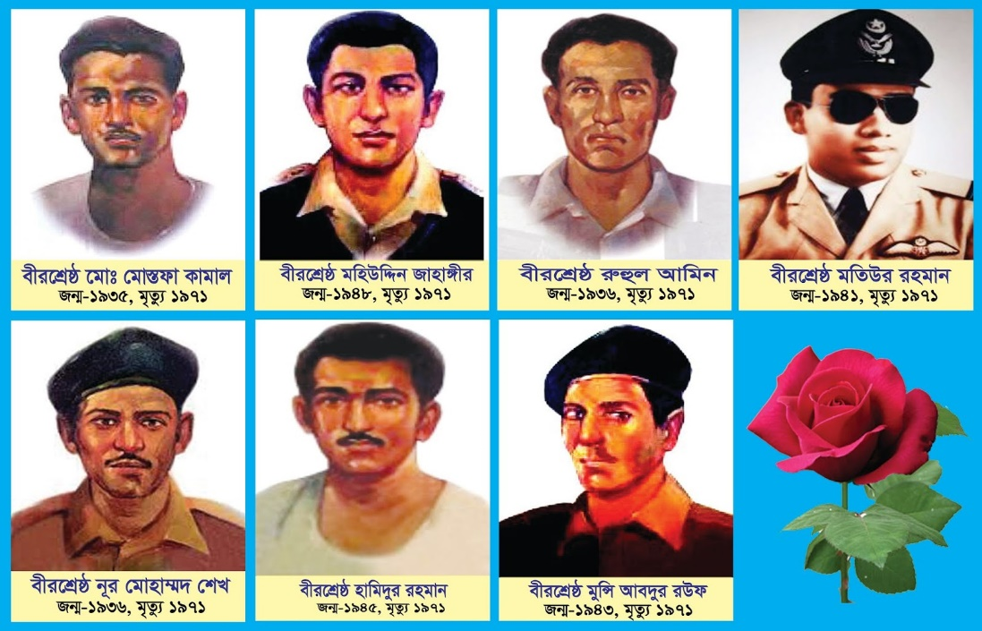
New word
Martyr
A person who is killed because of religious or political beliefs.
Synonym: hero,

Slide 9
New word
Mourning
The expression of deep sorrow for someone who has died, typically involving following certain conventions such as wearing black clothes or badges.
Synonym: grief, lamentation

Slide 10
New word
Expatriate
a person living in a country that is not his own.
Synonym: immigrant

Slide 11
B. Open at page no. 38 from your textbook and read more about International Mother Language day-2.
TEXT

Slide 12
21 February is observed as Shaheed Dibosh every year throughout the country in remembrance of the martyrs of language movement of 1952. The commmemoration begins at the early hours of the day with mourning songs that recall the supreme sacrifices of our language martyrs. People wear black badges and go to the Shaheed Minar in barefoot processions, singing mourning songs. They place wreaths at the Minar. Many of them visit the graves of the martyrs at Azimpur graveyard and pray for them. They also attend various programmes organised in remembrance of the language martyrs.

Slide 13
The UNESCO (United Nations Educational, Scientific and Cultural Organisation) on 17 November in 1999 proclaimed February 21 as the International Mother Language Day in recognition of the sacrifices of the martyrs for the rightful place of Bangla. Two Bangladeshi expatriates living in Vancouver in Canada, Rafiqul Islam and Abdus Salam, sent a proposal to Kofi Anan, the then secretary General of United Nations. They requested him to declare 21 February as the International Mother Language Day. They added that the decision will honour and save all extinct languages of the world. As per their logical expectations Prime Minister Sheikh Hasina then took prompt initiative by sending formal proposal to UNESCO. Finally, on 17 November 1999, UNESCO declared 21st February as the International Mother Language Day. The day is now annually observed worldwide to promote awareness of linguistic and cultural diversity and multilingualism.
Question

Slide 14
C. Match the words/phrases in the table with their meanings.
Words/phrases | Meanings
wreath | encourage
in remembrance of | in appreciation of
proclaim | practice of using several languages
promote | an arrangement of flowers in the shape of a circle
diversity | declare
multilingualism | in memory of
in recognition of | variety
an arrangement of flowers in the shape of a circle
in memory of
declare
encourage
variety
practice of using several languages
in appreciation of

Slide 15
D. Read the text in B again and answer these questions.
TEXT
Why is 21 February called Shaheed Dibosh?
Why do people go to the Shaheed Minar? How do they go there?
3. Why is 21 February now observed throughout the world every year?

Slide 16
E. Complete the passage with suitable words.
blood
On 21 February 1952 _______ was shed at a place between Dhaka Medical College and Dhaka University _______ to establish Bangla as a state_________ of Pakistan.
All subsequent movements ___ the struggles for independence had their origin in the historic language _________. Shaheed Minar is the ______ of the supreme sacrifice ____ the mother tongue.
campus
language
and
movement
symbol
for

Slide 17
Evaluation
What does ‘UNESCO’ stand for?
How are the martyrs remembered?
When does the occasion of the day begin?
What does the Shaheed Minar signify?
How do you feel for 21 February?

Slide 18
Home work
F. Write briefly how you observed this year’s 21 February at your school.

Slide 19
Thank you all.

