Slide 1
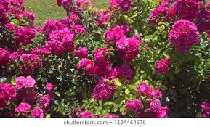
Welcome to Multimedia Class

Slide 2

Teacher’s Identity:
Mazada Akter
Lecturer (English)
Barabor alim Madrasha
Class :IX-X
Subject : English 1st
paper

Slide 3
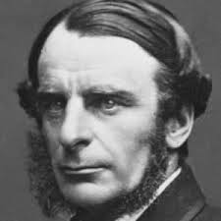
NAME
  Charles Kingsley
OCCUPATION
  Priest, Writer
BIRTH DATE
  June 12, 1819
DEATH DATE
  January 23, 1875
EDUCATION
  University of Cambridge, Magdalene College, King's College London,
  Helston Grammar School
PLACE OF BIRTH
  Devon, England, United Kingdom
PLACE OF DEATH
  Eversley, England, United Kingdom
Charles Kingsley, a 19th century priest and writer who worked under Queen Victoria, is known for novels like Yeast, Alton Locke and Hypatia. A poet and children's author who loved nature, Kingsley died in Eversley, England, on January 23, 1875.
Poet’s introduction

Slide 4
Today’s lesson is--
“The Sands of Dee”
Unit-14 lesson-3

Slide 5
Learning outcomes -
At end of the lesson, students will be able to –
Discuss about pictures;
Recognize and use English sounds, stress, and intonation;
Understand and enjoy poem;
Interpret, evaluate and summarise literary texts;

Slide 6

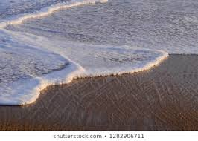
New words
creep
crawl
To move slowly and carefully to avoid being noticed

Slide 7
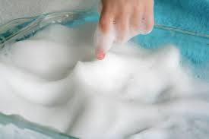
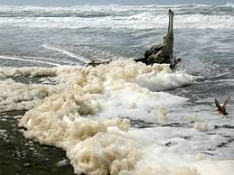
New words
foam
spume
foam of soap
Foam of wave
A mass of very small bubbles formed on the surface of a liquid

Slide 8
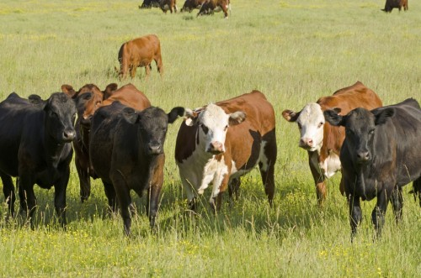
Kew words
cattle
livestock
Domestic animals such as cows ,oxen etc.

Slide 9

The Sands of Dee
“O Mary, go and call the cattle home,
And call the cattle home,
And call the cattle home,
Across the sands of Dee!”
The western wind was wild and dank with foam,
And all alone went she.
The western tide crept up along the sand,
And o’er and o’er the sand,
And round and round the sand,
As far as eye could see.
The rolling mist came down and hid the land
And never came home she.
“Oh! Is it weed, or fish, or floating hair—
A tress of golden hair,
A drowned maiden’s hair,
Above the nets at sea?
Was never salmon yet that shone so fair
Among the stakes of Dee.’
They rowed her in across the rolling foam.
The cruel, crawling foam,
The cruel, hungry foam,
To her grave beside the sea:
But still the boatman hear her call the cattle home
Across the sands of Dee.
- Charles Kingsley
Listen to the poem

Slide 10
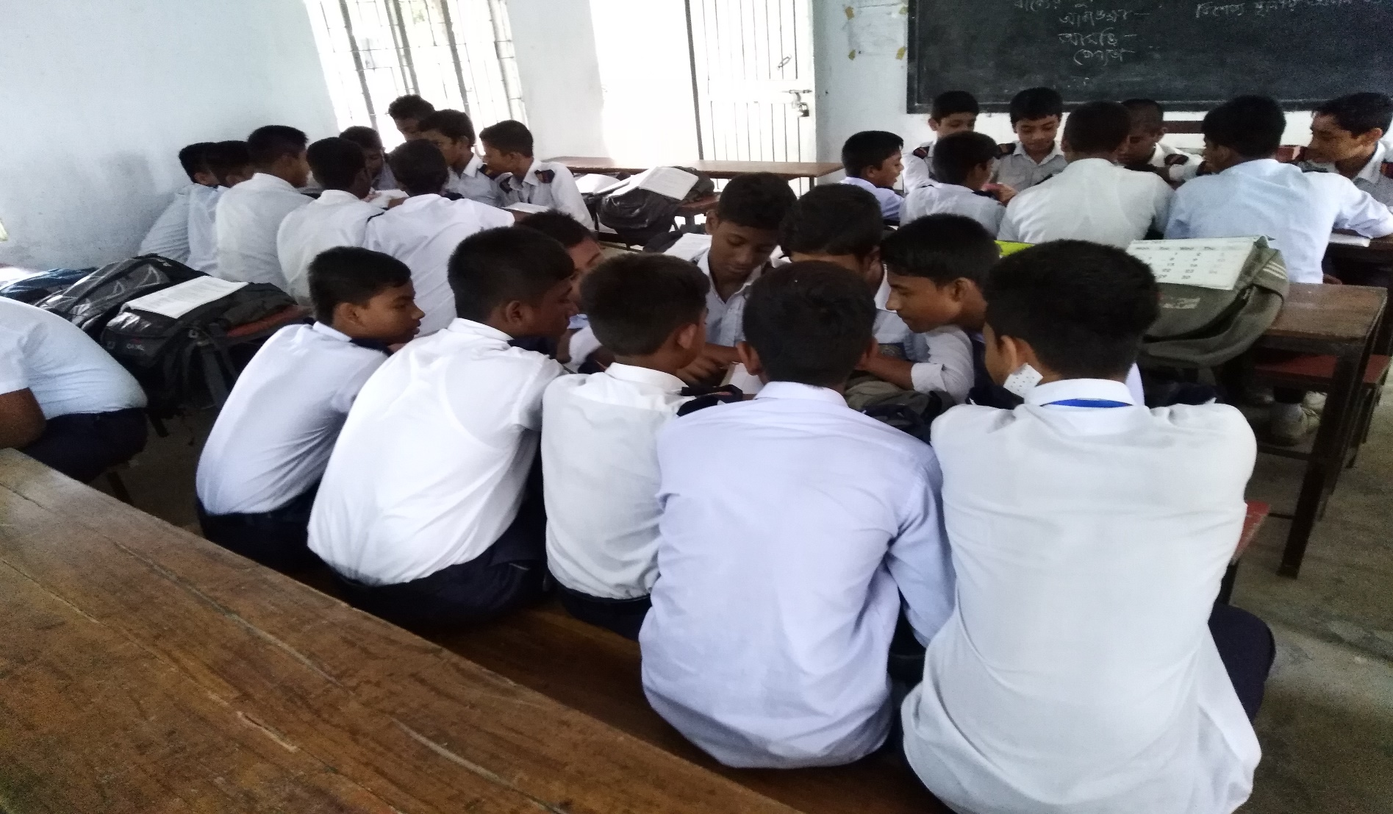
Read the poem aloud in groups

Slide 11
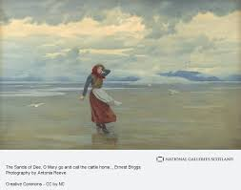
“O Mary, go and call the cattle home,
And call the cattle home,
And call the cattle home,
Across the sands of Dee!”

Slide 12
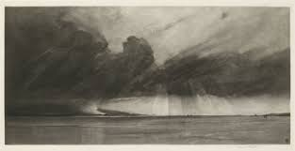
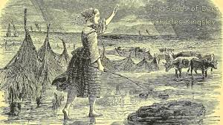
The western wind was wild and dank with foam,
And all alone went she.

Slide 13
The western tide crept up along the sand,
And o’er and o’er the sand,
And round and round the sand,
As far as eye could see.
The rolling mist came down and hid the land
And never came home she.

Slide 14
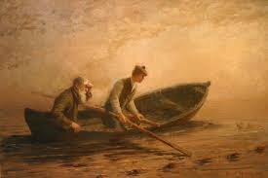

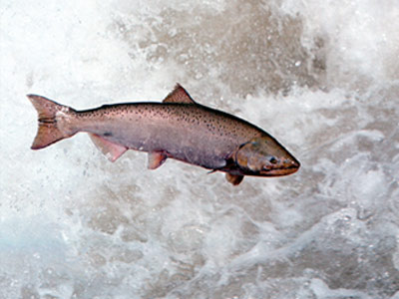
“Oh! Is it weed, or fish, or floating hair—
A tress of golden hair,
A drowned maiden’s hair,
Above the nets at sea?
Was never salmon yet that shone so fair
Among the stakes of Dee.’

Slide 15
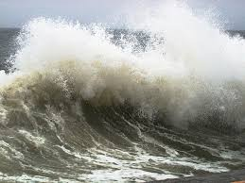
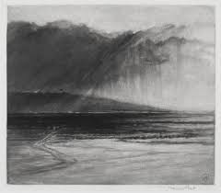
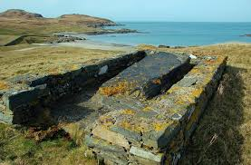
They rowed her in across the rolling foam.
The cruel, crawling foam,
The cruel, hungry foam,
To her grave beside the sea:

Slide 16
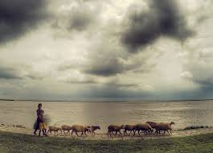
But still the boatmen hear her call the cattle home
Across the sands of Dee!”

Slide 17
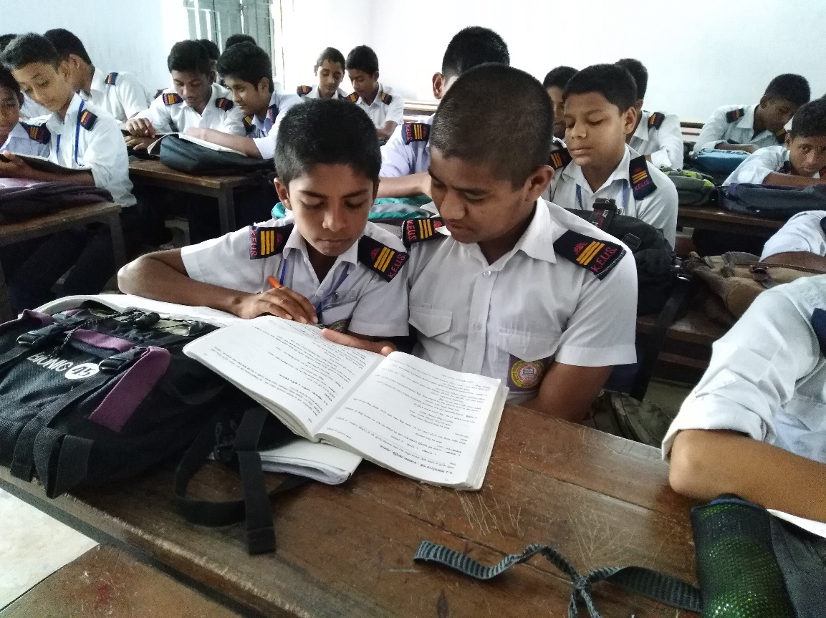
Pair work
2. Look at some words, phrases and sentences that have been repeated several times. Explain why the poet has done that.

Slide 18
1. What was the weather like when Mary went to bring the cattle home?
When Mary went to bring the cattle home, the weather was very adverse, for the example there were wild western wind, foam in the sea, mist in the air and above all a tide in the sea.

Slide 19
2. How has the poet described the sea?
To describe the sea, the poet has personified it. He has used words like ‘cruel’, ‘crawling foam’ ‘hungry’ etc to express the movement of the sea.

Slide 20

Homework
Summarise the poem in your own words.

Slide 21

Thank You All

