Slide 1
Welcome to Multimedia Class

Slide 2
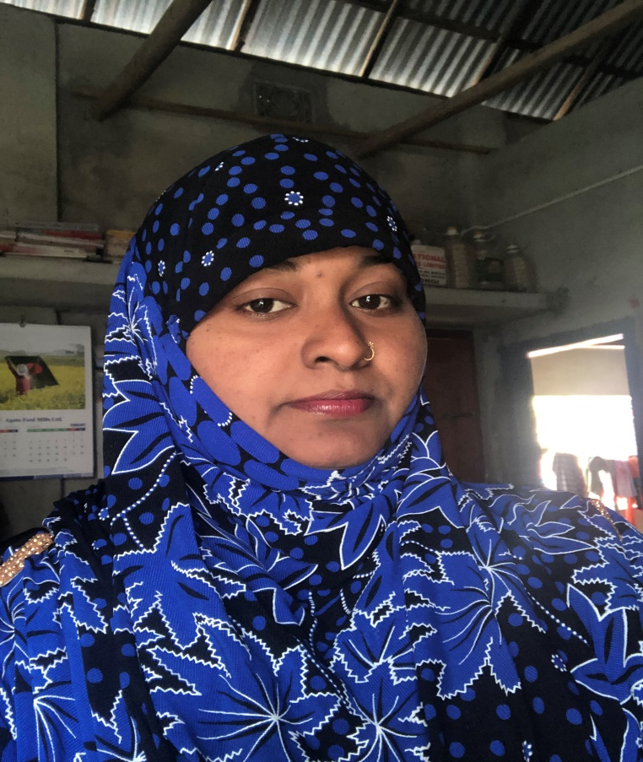
Teacher’s Identity:
Mazada Akter
Lecturer (English)
Barabor alim Madrasha
Class :IX-X
Subject : English Second
paper

Slide 3
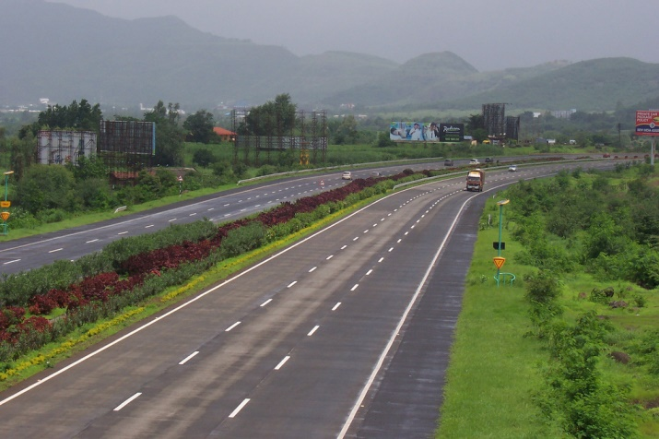
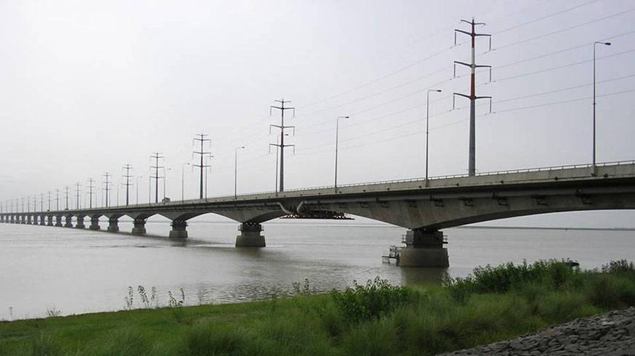
What do you see in the pictures?
If you want to cross a river
you need to use a bridge.

Slide 4
TODAY’S TOPIC
SENTENCE CONNECTORS
(LINKERS)

Slide 5
Learning outcomes
By the end of the lesson the learners will be able to
*make sentences using sentence connectors ( linkers)
*use sentence connectors in a passage listening to a text.
* develop a paragraph using sentence connectors.

Slide 6
When it is spring , colourful flowers bloom.

Slide 7
Are you okay ? I am deeply concerned about you. You have been depressed since you missed the new job interview.
. In addition to , you have lost the former one.

Slide 9
The launch was over crowded .
As a result, it may sink.

Slide 10
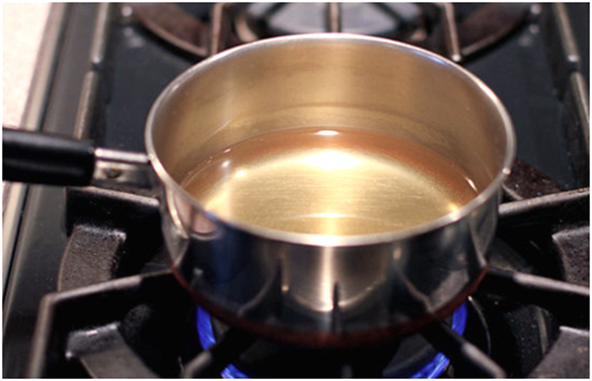
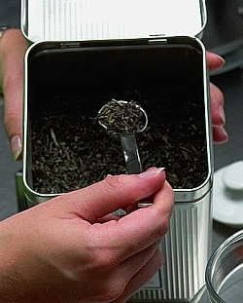
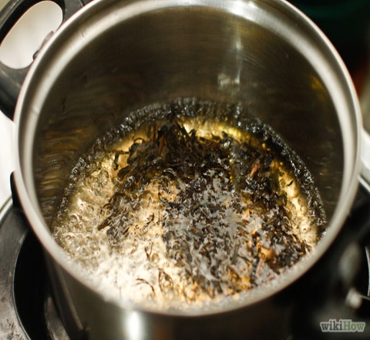
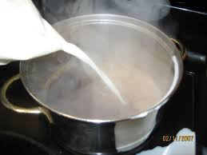
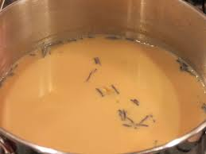
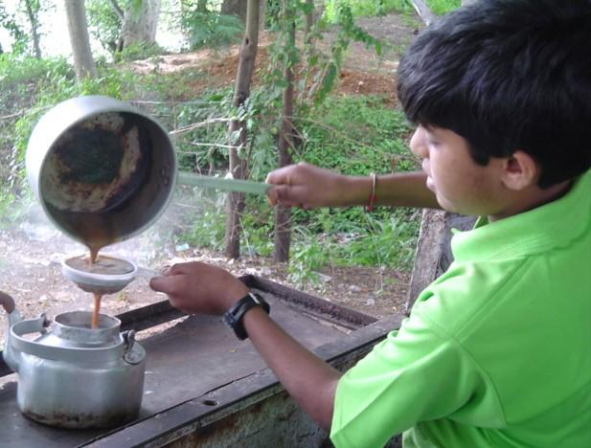
Discuss the pictures in pairs . Then develop a paragraph using the given clues.
Clues: At first, Then, After that,
Next, Afterward, later ,Finally

Slide 11
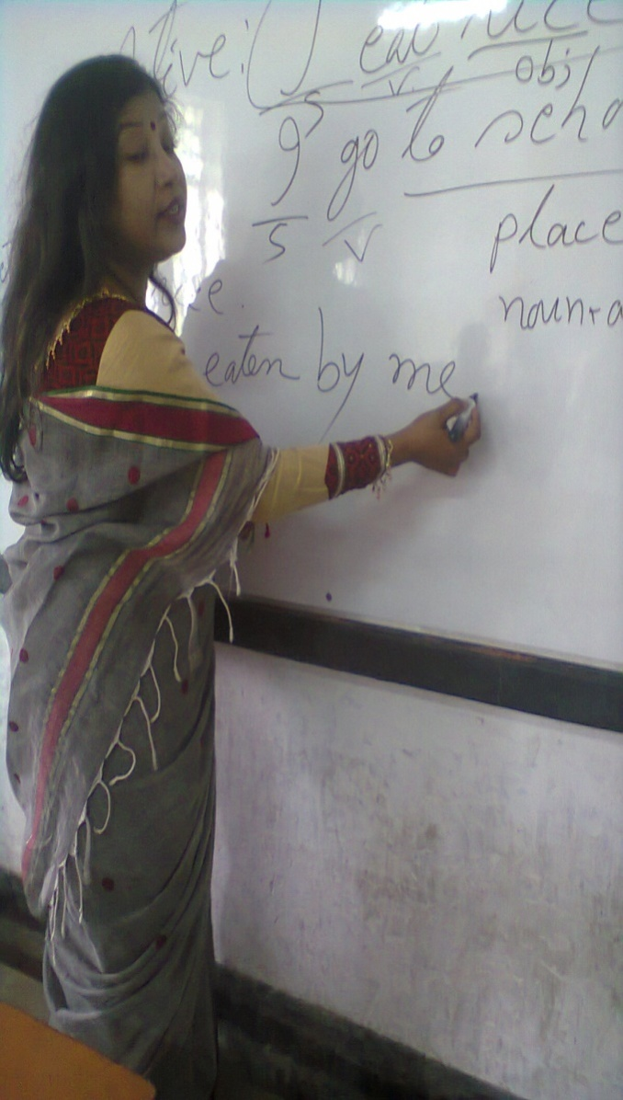
I couldn’t get my head around the Passive Voice. Anyway, I don’t think it’s important to use it all the time.

Slide 12
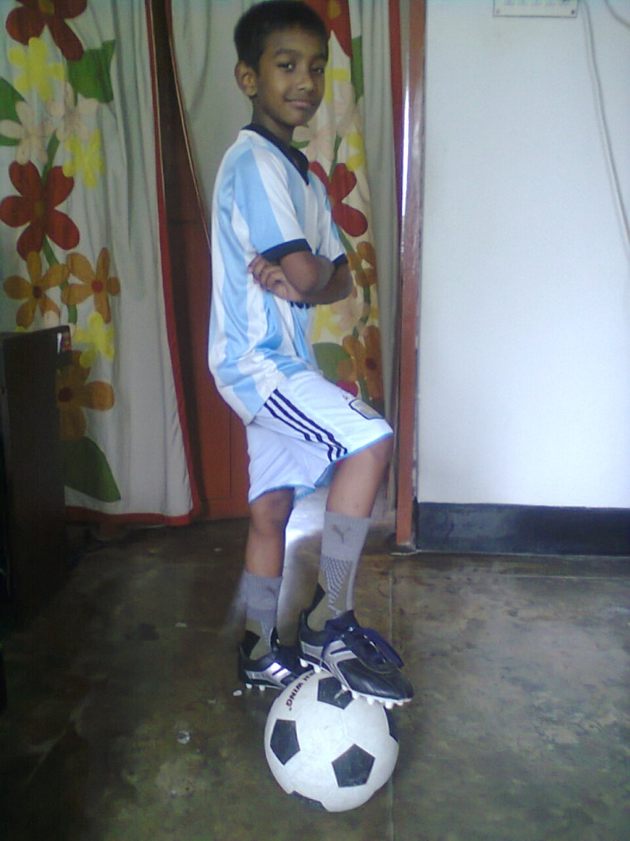
Nitol was in so much pain . He didn’t want to get up in the morning to go to school. Nevertheless, now he is ready to go to football practice as usual.

Slide 13
Yesterday I appeared at a sudden class test.The test was ridiculously easy ! I didn’t even study ,
but I will get a high score.

Slide 14
At first The bees collect honey from flowers.
After that they store them in the beehive.

Slide 15
Mr. Hasan didn’t want to take a side in the argument. Instead, he put his headphones on and listened to some smooth Rabindra Sangeets.

Slide 16
At a glance Sentence Connectors:
‘Connectors’ are used to link large groups of words: phrases and sentences. You can also use them to connect paragraphs to give them coherence.
Sentence connectors are usually placed at the beginning of a sentence and may be categorized as follows:
Contrast, Similarity, Result, Sequence, Dismissal and order of Importance

Slide 17
HOME WORK
Write a paragraph on
“How to open a Bank Account.”

