Slide 1
Notes:
Notes for the teachers.

Slide 2
Bogula online school & college.
Welcome
To
Online class.

Slide 3
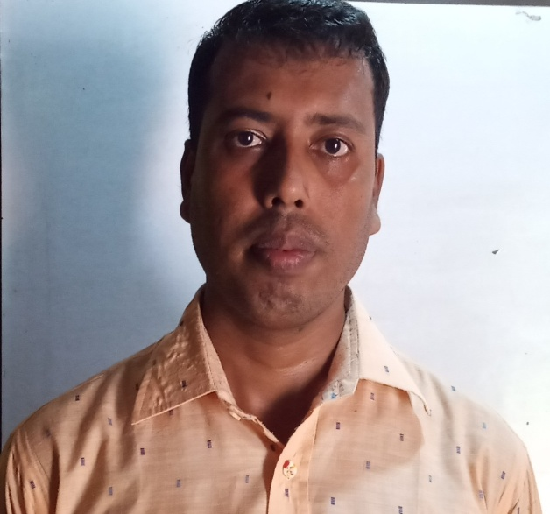
Bogula online school & college.
Identity
Md. Uzzol Rahman
Assistant Teacher.
Bogula Rusmot Ali Ramsundar School & college.
Dowarabazar, Sunamgonj.
Mobile : 01775369356
Class: Nine
Sub: English 2nd paper.
Notes:
Identity of teacher and class.

Slide 4
Bag
Tag
A bag with a tag.
Notes:
To show actual meaning of Tag (Tag means to add something with other thing).

Slide 5
Question Tag.
He is a student,
isn’t he?
What is this?
Notes:
Suspension to take out tag question from the students.

Slide 6
Our Today’s Class is on
Tag question
Notes:
Lesson declaration.

Slide 7
Learning Outcomes
After completing this lesson, the students will be able to-
define question tag
identify tag operators/auxiliary verb
apply tag
different use of tag

Slide 8
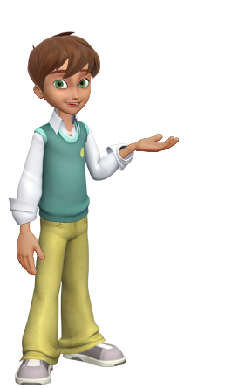
You are Tamim, aren’t you?
Tag
Adding something with other
A tag question is a question that is used at the end of a statement to get the support from the listener.
Notes:
Definition of tag question.

Slide 9
A computer operator.
Am, is, are, was, were
Tag question operators/Auxiliary verbs.
have, has, had,
shall, should, will , would, can, could, may, might, must, ought, dare, need.
Do, does & did (Used in action verbs)
Notes:
This slide is to teach the operators of tag questions to the students.

Slide 10
Tag question basic/contraction form of the operators.
Am not = aren’t
Is not = isn’t
Are not = aren’t
Was not = wasn’t
Were not = weren’t
Will not = won’t
Shall not = shan’t
Can not = can’t
Could not = couldn’t
May not = mayn’t
Might not = mightn’t
Must not = mustn’t
Has not = hasn’t
Have not = haven’t
Had not = hadn’t
Do not = don’t
Does not = doesn’t
Did not = didn’t
Ought not = oughtn’t
Dare not = daren’t
Need not = needn’t
Notes:
Tag or contraction forms of the operators.

Slide 11
Tamim was my best friend,
wasn’t he?
Notes:
First teacher may show the picture and sentence to ask tag to the students then he can show the answer to check.

Slide 12
How to form a tag question?
1. Direction for positive statement
Statement + , + Auxiliary verb +n’t+ subject (pronoun) +?
Mamun is a truthful boy,
isn’t he?
2. Direction for negative statement
Statement + , + Auxiliary verb + subject (pronoun) +?
is she?
She is not my mother,
Notes:
The rules are mentioned here how to add tag to the statements.

Slide 13
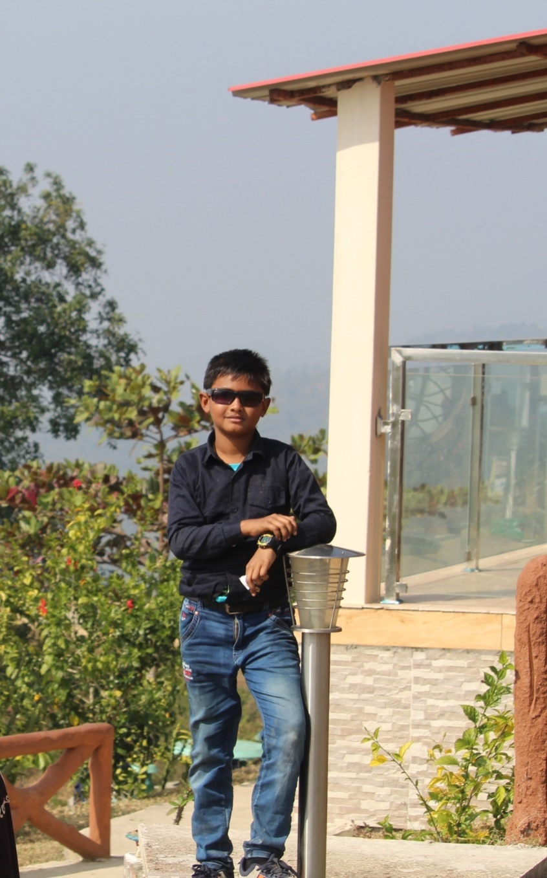
Rana is a smart boy,
isn’t he?
Notes:
Teacher may show the picture and sentence to ask tag to the students then he can show the answer to check.

Slide 14
Add tag to the following
1. Ranu was a brilliant student, __________?
wasn’t she
2. You were not a player,__________?
were you
aren’t they
3. They are playing football,_____________?
4. We cannot do this now,_________?
can we
5. He may come tomorrow,__________?
mayn’t he
Notes:
Teacher may ask orally or written to get answers from the learners as class activities.

Slide 15
Without Operator we have to follow this
My mother cooks very well,
doesn’t she?
don’t we?
We play football regularly,
He went to market yesterday,
didn’t he?
Notes
If there is V₁ with ‘s/es’, add tag with doesn’t.
2. If you find V₁ without ‘s/es’, add tag with ‘don’t.
3. If you find V₂ , add tag with ‘didn’t as operator.
Notes:
How to add tags to the action verb sentences are shown in this page.

Slide 16
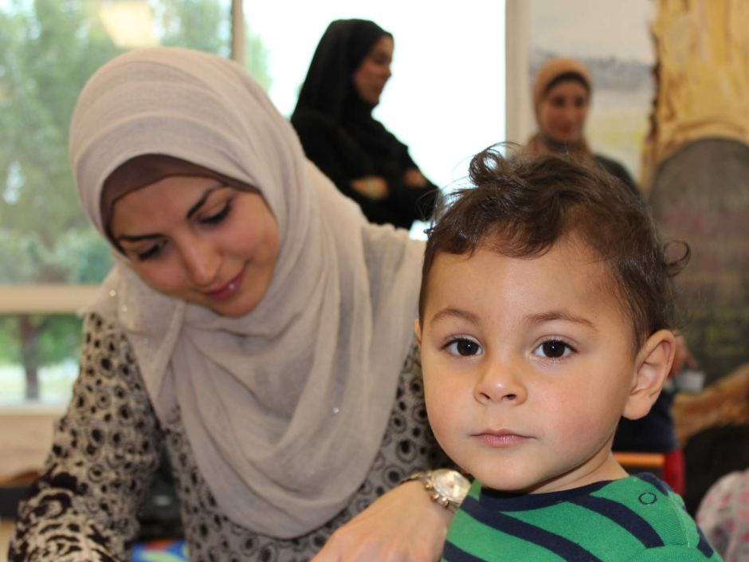
Every mother loves her child,
don’t they?
Notes:
Exceptional use f tag begins from here.

Slide 17
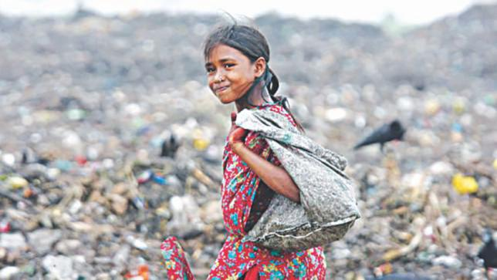
Nobody helps poor,
do they?
Notes:
Exceptional use of tag question.

Slide 18
Exceptions
If you find ‘s/es after everybody, everyone, nobody, no one, somebody, some one, one, none, the above rules will not be effective. In that place you have to add ‘don’t they/do they’
Everyone respects him,
don’t they?
Nobody likes a man of bad temper,
do they?
Notes:
The rules of exceptional use of tag question are shown here. Teacher may explain it if necessary.

Slide 19
(never, rarely, seldom, hardly, barely, few, little and scarcely are negative word although they seem positive)
Notice carefully
 | Positive tag
He never played cricket, | did he?
She can rarely come these days, | can she?
You hardly ever came late, | did you?
I barely know you, | do I?
You would scarcely expect her to go, | would you?
Notes:
There are some words which seem to be affirmative but in tag question they are treated negatives. Teacher may explain it clearly.

Slide 20
More exceptions
a few, a little = Affirmative
don’t I/haven’t I ?
I have a few friends,
I have few money,
do I/ have I?
few, little = Negative
There is a little water in the jar,
isn’t there?
There is little water in the jar,
is there?
Notes:
Difference between a few, few, a little, little and something like this are shown in this slide.

Slide 21
Action /do verb
don’t/doesn’t +?
I need your help,
don’t I?
She needs a pen,
doesn’t she?
But
You need not worry,
need you?
I need not go there,
need I?
Modal verb
need + Sub(pronoun) +?
Notes:
‘Need’ is used as action verb but ‘need not’ is used as modal verb.

Slide 22
I’d visit you, wouldn’t I?
Last year I’d visited London,
hadn’t I?
Follow
I’d visit = I would+ v₁
I’d visited = I had+ v₃
Notes:
If there is a complex sentence, students will have to follow the verb of principal clause. Teacher may make it clear to the students with the example above.

Slide 23
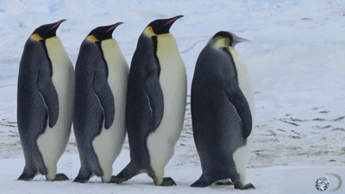
Tag question in imperative sentence
will you?
Take a picture of these birds,
Notes:
While adding tag with an imperative sentence, it indicates simple future . So ‘will you/won’t you’ is suggested to use.

Slide 24
Let me write a letter,
will you?
Let him go,
will you?
Let them enjoy the game,
will you?
But
Let us play football,
shall we?
shall we?
Let’s go out for a walk,
Notes:
The differences between let me, let him, let them and let us are shown here. Teacher may explain it if necessary.

Slide 25
Good bye (I bide good bye),
don’t I?
Hasan, (He is Hasan),
isn’t he?
Who cares (Nobody cares),
do they?
isn’t it?
Yes, (Yes, it is)
is it?
No, (No, it is not)
Good morning, good afternoon, good evening, good night, thank you, ( I bide / wish / say…) don’t I?
Notes:
Actually these are not tag related statements but recently these are shown according to modern English. In the recent curriculum we have got conversation style in tag question.

Slide 26
Tips for easy way
1. Selet the sentence negative or affirmative.
2.Find out the operator/auxiliary verb.
3.Use do/does/did if there is no operator.
4.Seach negative word.
5.Use a operator with not or without no and a
pronoun and put a ? As a ans.
isn’t he?
I barely know you,
He is my teacher,
do I?
Operator
Negetive
Notes:
Actually these are not tag related statements but recently these are shown according to modern English. In the recent curriculum we have got conversation style in tag question.

Slide 27
Pair Work
Add tag in every sentence of the following passage.
He is my friend, …….? Sumon tells a story, …….? He wanted to be a good teacher, ……? let us discuss about this matter, …….? Nobody called me, .…..? Every rose has a throne, …….? None could do this, ……..?
Notes:
Teacher may make some pairs to conduct this session .

Slide 28
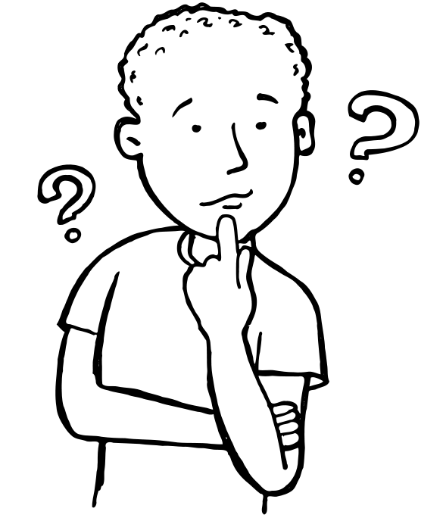
Home Work
Write a short paragraph about your school in 5/6 sentences in different tenses. Then add tag to each sentence with be, modal, let, action verb and exceptional use of tags.
Notes:
Creative assignment at home for the next class.

Slide 29
Bogula online school & college.
..GOODBYE..
Notes:
Ending greeting.

Slide 30
Acknowledgement
We would like to express our cordial gratitude to the Ministry of Education, Directorate of Secondary & Higher Education, NCTB, A2i and the panel of honorable editors ( Md. Jahangir Hasan, Assistant Professor (English) TTC, Rangpur, Ranjit Poddar, Associate Professor (English) TTC, Dhaka, and Urmila Khaled, Assistant Professor (English) TTC, Dhaka, to enrich the contents.

