Slide 2
You are welcome

Slide 3
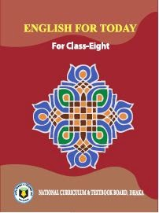
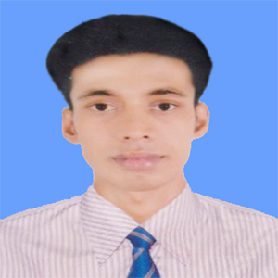
Introduction
Swandip Banerjee
Assistant Teacher English
Pallimangal Secondary School, Khulna
E-mail. swandipb1@gmail.com
Mobile: 01718503573

Slide 4
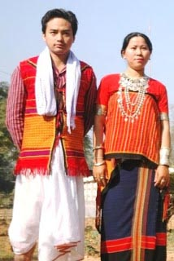
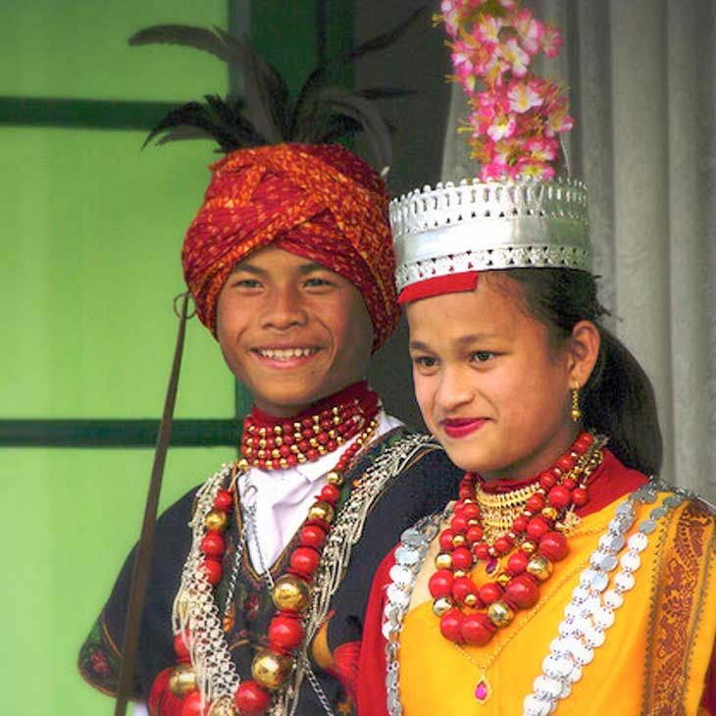
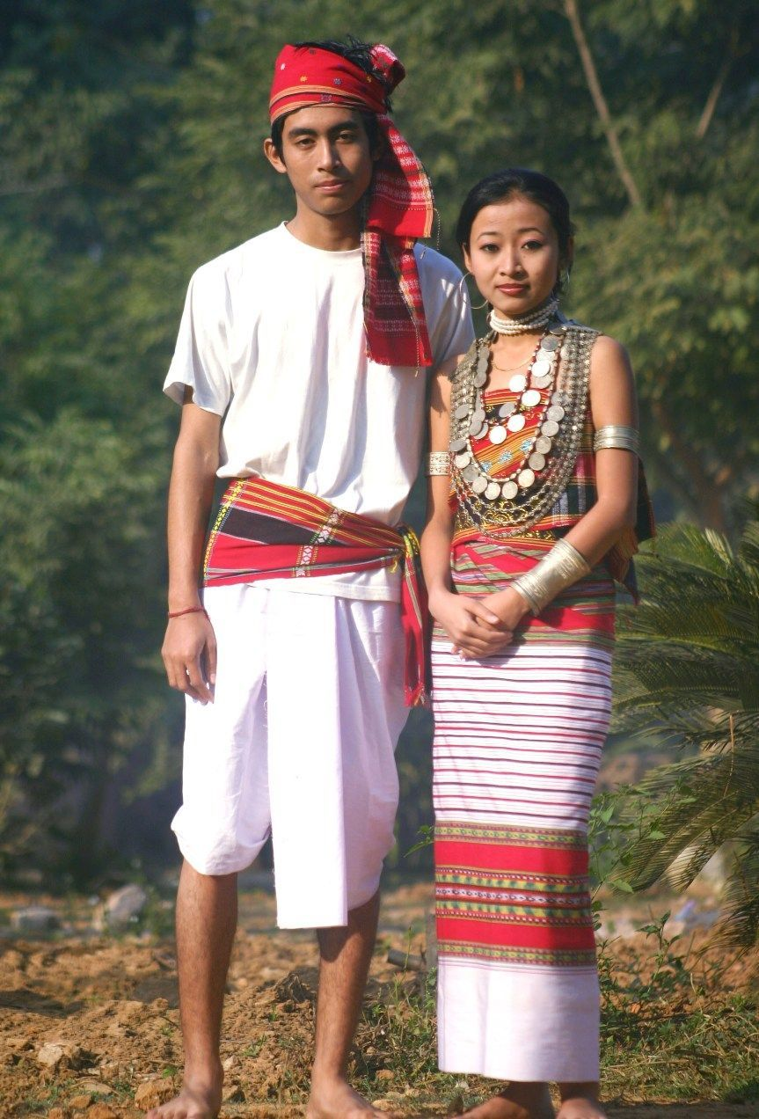
Look at the following pictures.
Chakma
Khasia
Tippera

Slide 5
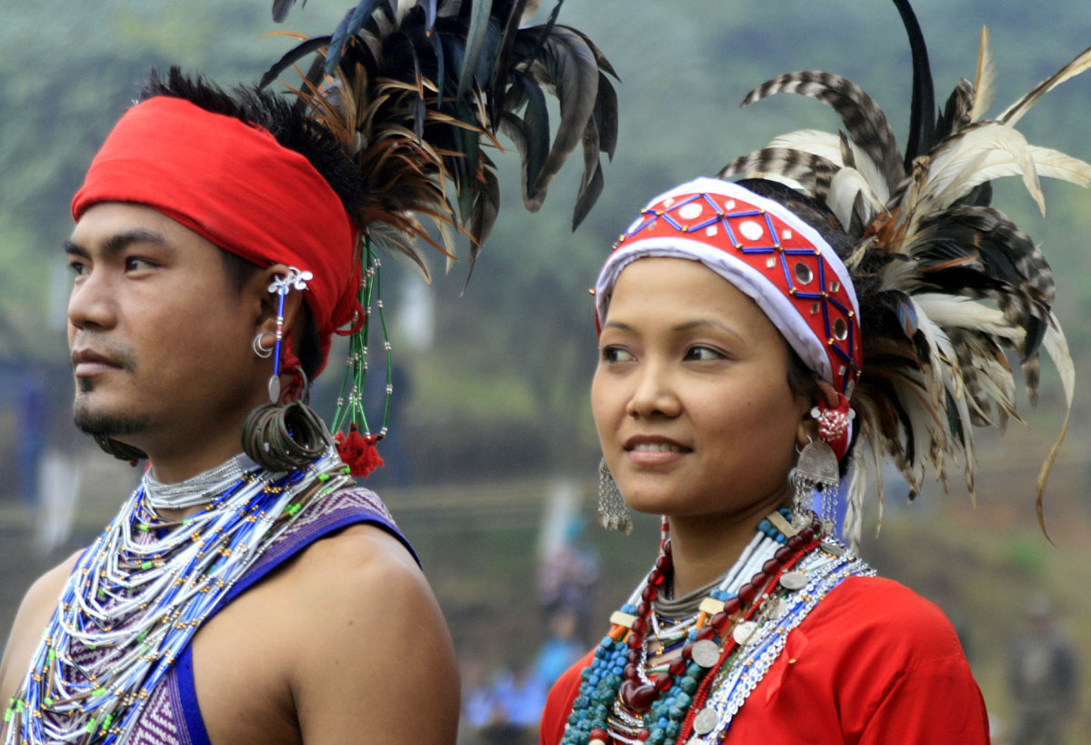
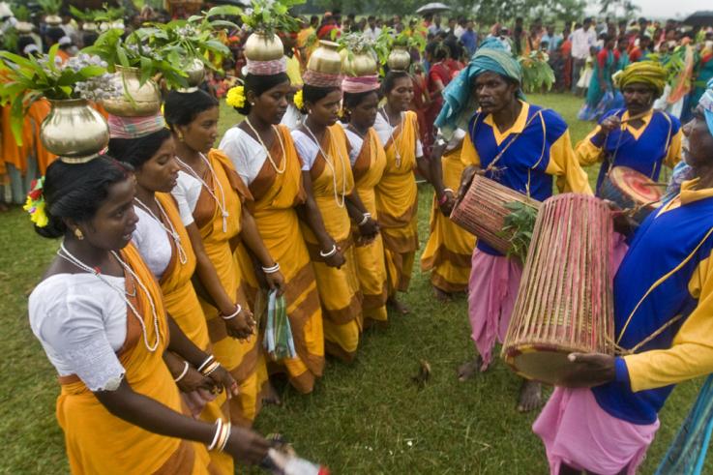
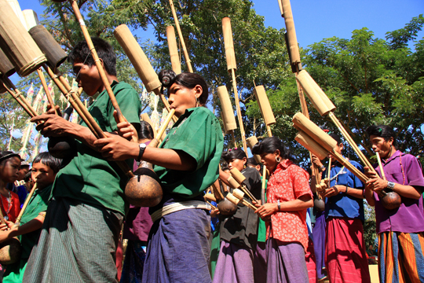
Look at the following pictures.
Garo
Santal
Moorang

Slide 6
Our today’s lesson is….
Our ethnic friends (1)
Unit: 01
[A glimpse of our culture]
Lesson: 03

Slide 7
Learning outcomes
After we have studied this lesson, we will be able to…
read and understand texts through silent reading.
infer meaning from context.
ask and answer questions.
write answer to questions .

Slide 8
New word
Ethnic
connected with or belonging to a nation or people that shares a cultural tradition
Syn.: racial, tribal
Notes:
At first teacher will show the words then ask his/her students to tell the meaning and making sentences. If they fail teacher will show the picture again. For feedback click on meaning button.

Slide 9
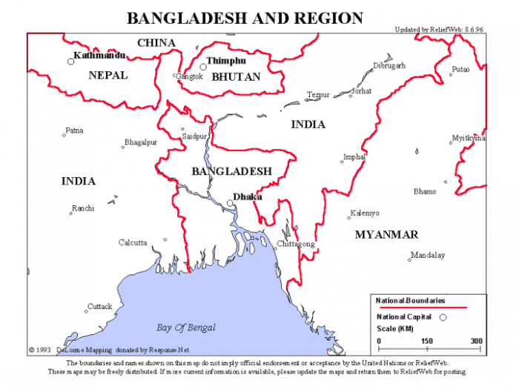
New word
Region
a large area of land, usually without exact limits or borders
Syn.: area, arena
Notes:
At first teacher will show the words then ask his/her students to tell the meaning and making sentences. If they fail teacher will show the picture again. For feedback click on meaning button.

Slide 10
New word
Majority
the largest part of a group of people or things
Syn.: greater number
Notes:
At first teacher will show the words then ask his/her students to tell the meaning and making sentences. If they fail teacher will show the picture again. For feedback click on meaning button.

Slide 11
A. Look at the questions following and discuss in groups.
Have you heard the word ‘ethnic people’? Can you tell what it means?

Slide 12
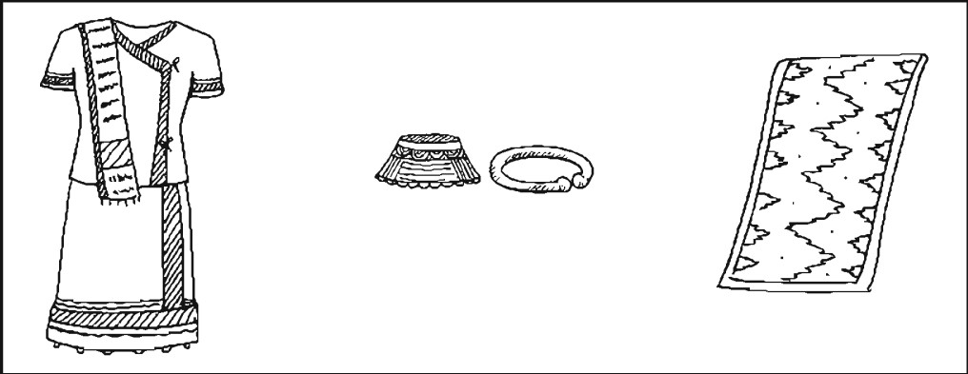
Now, look at the pictures. Then discuss the following questions.
Do you know where the ethnic people live in Bangladesh?
What are they called?

Slide 13
B. Now read the text.
C
D
The ethnic people in Bangladesh hold a very important place in the culture of the country. The majority of these people live in the Chattogram Hill Tracts. The others live in the regions of Mymensingh, Rajshahi and Sylhet. They live in forest areas, in the hills and rural areas. They do Jhum cultivation. For this work they clear a piece of land in the forest, prepare it and sow seeds in it. They are mostly farmers. By religion they are Hindus, Christians or Buddhists. They speak their own mother tongues. Some of them are the Chakmas, the Marmans, the Tipperas and the Moorangs who live in the Hill Tracts. The Santals live in Rajshahi. The Khasias and the Monipuries, live in Sylhet and the Hajangs and the Garos in Mymensingh.

Slide 14
C. True or false. If false, give the correct answer.
Text
1. All the ethnic people of our country live in Chattogram Hill Tracts.
1. False. The majority of the ethnic people live in the Chattogram Hill Tracts.
2. True.
2. Most of them are farmers.
False. By religion they are Hindus, Christians or Buddhists.
3. By religion all of them are Buddhists.
4. The Moorangs are an ethnic group.
4. True.
5. They practice Jhum cultivation.
5. True.

Slide 15
D. Ask and answer the questions in pairs.
1. Where do you find the Marmans?
2. What language do they speak at home?
3. Where and how do they do the Jhum cultivation?
Text

Slide 16
Name of some ethnic in Bangladesh
Chakma
Marma
Tippera
Moorang
Santal
Khasia
Monipuri
Hajang
Garo

Slide 17
Religion of ethnic people
Religion
Buddhists
Christians
Hindus

Slide 18
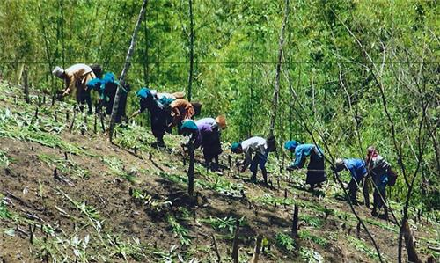
Profession
They are mostly farmers.
They do Jhum cultivation.

Slide 19
Living places of the ethnic people of Bangladesh
Ethnic people
Sylhet
Rajshahi
Mymensingh
Chattogram

Slide 20
Evaluation
Where do most of the ethnic people live in Bangladesh?
How do they enjoy their past times?
Which religions do the ethnic people follow in Bangladesh?
What is their main occupation?

Slide 21
Home work
Write the summary of the text B in your own words (around 50 words).

Slide 22
Thank you all.

