Slide 1
Welcome
to All
to Enjoy
Digital Class

Slide 2
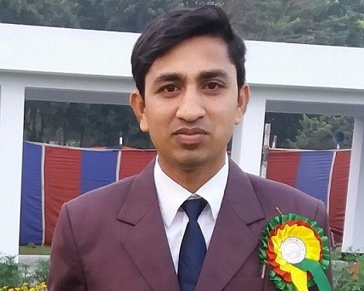
Identity
ABUL KASHEM
BA(Hons) & MA in English, B.Ed.
Asst. Teacher(English)
Pabna Cadet Collegiate School
kashemsir87@gmail.com
Class : Eight
Subject : English 1st paper
Unit : Five
Lesson : Three

Slide 3
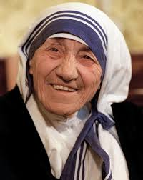
Who is the woman?
Why is she famous in the world?

Slide 4
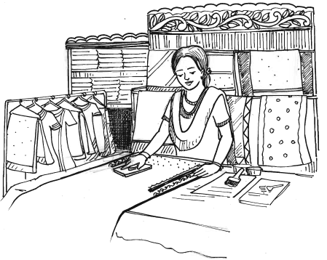
Lesson Declaration
Ever Beautiful Shamima
Unit-5, Lesson-3

Slide 5
Learning Outcomes
After this lesson the students will be able to-
1. read and understand text through silent reading.
2. infer word meaning from the context.
3. choose the best answers from the alternatives.
4. practice fill in the gaps with suitable words.
5. ask and answer questions.

Slide 6
Word meaning

Slide 7
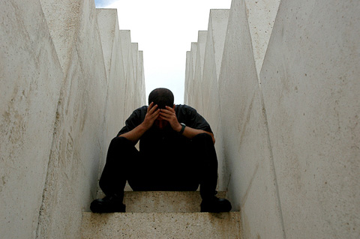
Misery
Meaning : sorrow, grief
Shamima’s misery started after her marriage.

Slide 8
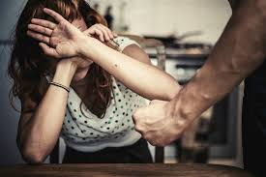
Abuse
Meaning : misuse, maltreat
Shamima’s husband abused her verbally.

Slide 9
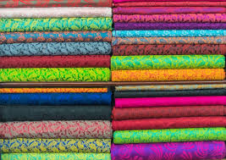
Fabric
Meaning : cloth, textile
She designs fabrics.

Slide 10
Provide
Meaning : supply, deliver.
Shamima provided the ill- fated with work.

Slide 11
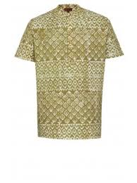
Fatuas
Meaning : A kind of shirt worn by man.
She made fatuas for man.

Slide 12
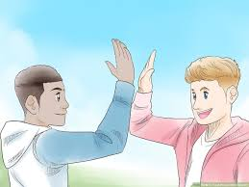
Dignity
Meaning : honour, respect
They could live with self respect and dignity.

Slide 13
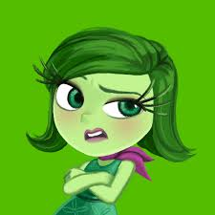
Grudge
Meaning : envy, resent
Now, Shamima has no grudge.

Slide 14
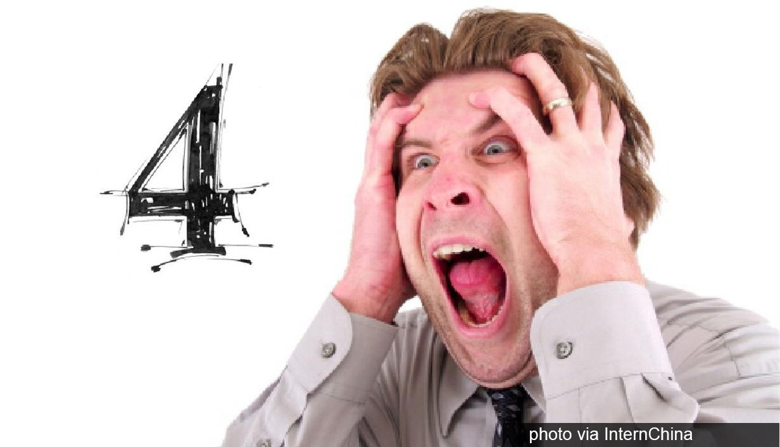
Unfortunate
Meaning : unlucky, ill-fated
Shamima brought smile for the women who are unfortunate.

Slide 15
Let’s read the text.

Slide 16
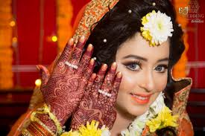
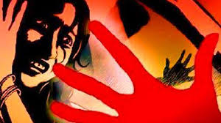
Shamima’s misery started the day she was married. Her husband was a greedy person and he used to abuse her verbally and physically. Within a few months into her marriage she had to leave her husband Kamal Uddin Joarder.

Slide 17
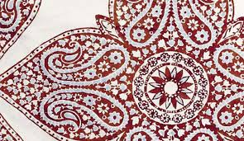
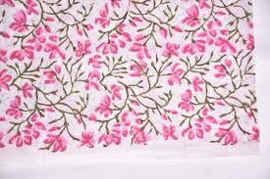
Now Shamima vows to work with women, who are ill-fated like her. She has 43 female members in her organisation working for her. She herself trains the members and then provides them with work. She designs fabrics, makes block-print, brush-paint and hand-embroidered saris.

Slide 18
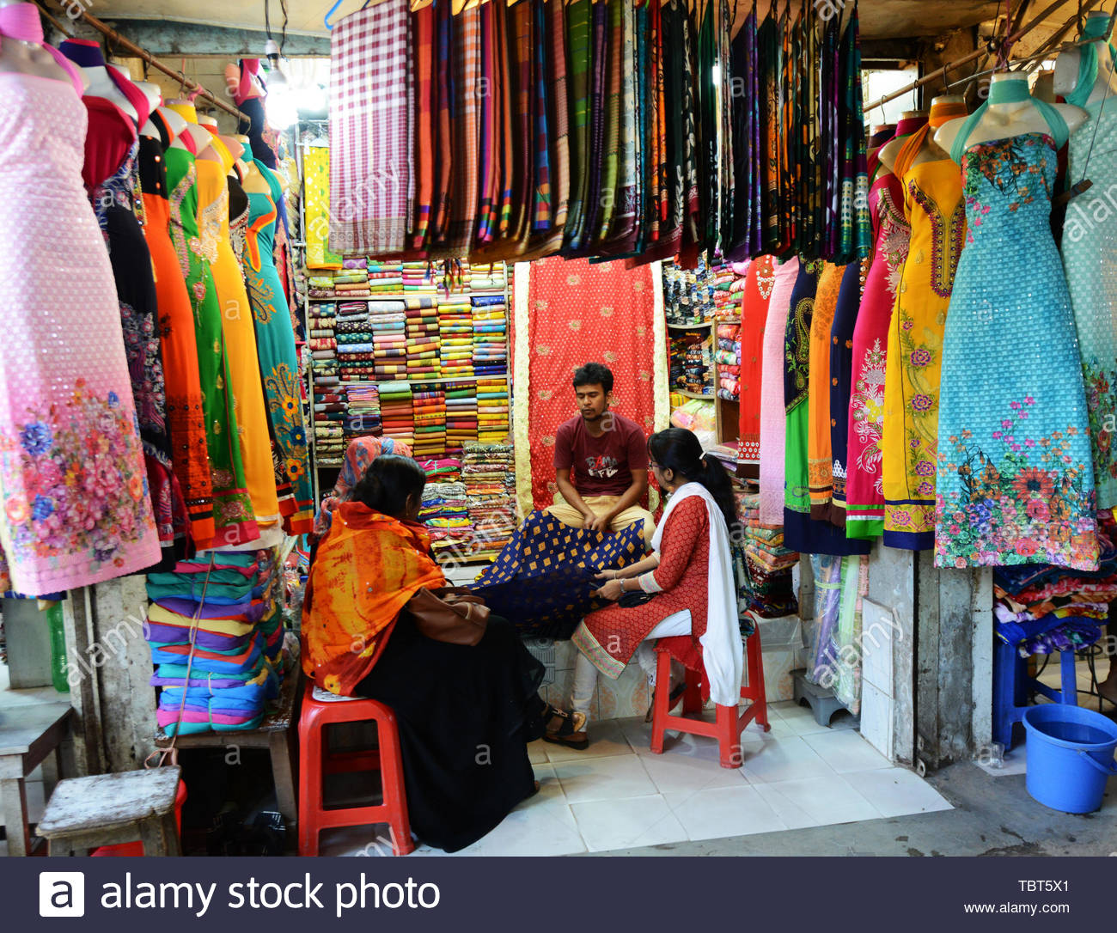
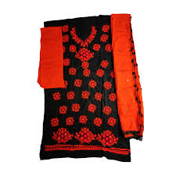
She also makes three-piece dresses for women, and fatuas for men. She sells these products in her shop and supplies them outside.

Slide 19
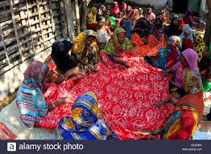
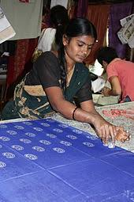
Shamima has a dream now, a dream to do something for the helpless people. She wants them to feel useful. They can live with self-respect and dignity. With this in view, she goes out looking for such people.

Slide 20
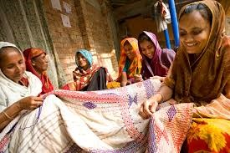
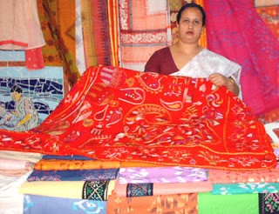
Shamima finished her story with a smile. Shamima has no complaints, no regrets, no grudges. All she wants to do is to bring a smile on the faces of those women who are unfortunate. Shamima wants to become a famous designer.

Slide 21
Pair work
Fill in the blanks with suitable words.
Shamima has a dream now, a dream to do something for the (a) ______ people. She wants them to feel (b) _____. They can live with self respect and (c) ______. With this in view, she goes out looking for such people. Shamima finished her (d) _____ with a smile. Shamima has no (e) _________, no regrets, no grudges.
helpless
useful
dignity
story
complaints

Slide 22
Group work
1. How has she become an entrepreneur?
2. Why did she leave her husband?
3. Why did Shamima search for the helpless people?
4. Where does she sell her product?
5. How did she finish her story?

Slide 23
Home work
Write a paragraph about a woman in your locality who has changed her condition by hard work.

Slide 24
Thanks to All

