Slide 1
W
E
L
C
o
M
E

Slide 2
Md . Saifuddin khan
Lecturer in English ,
Hajee GoyesUddin Mohila Fajil Madrasah , Bhangura , Pabna.
Mobile number: 01710449379
Email :skhan84bd@gmail.com

Slide 3
Learning outcomes
Afrer reading the text ss will be able to
1.Tell the meaning of some new words.
2.Write the name of pesticides used in food.
3.Describe about “Food Adulteration” in Bangladesh.

Slide 4
Word | Meaning
Survey | Investigation
Sample | Example
Acquire | Obtain
Banned | Forbidden
Contaminate | Pollute
Analyse | Examine
Fatal | Deadly
Swallow | Consume
Inhale | Breath
Detect | Identify
Mandatory | Obligatory
Co-ordinated | Harmonozed

Slide 5
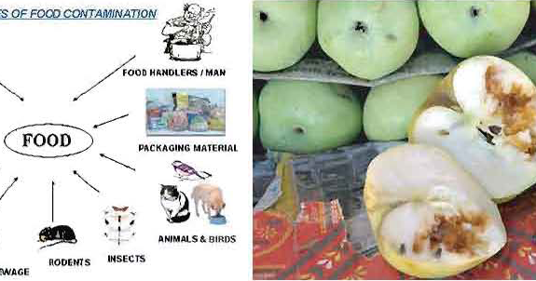
Look at the picture and imagine about it.

Slide 6
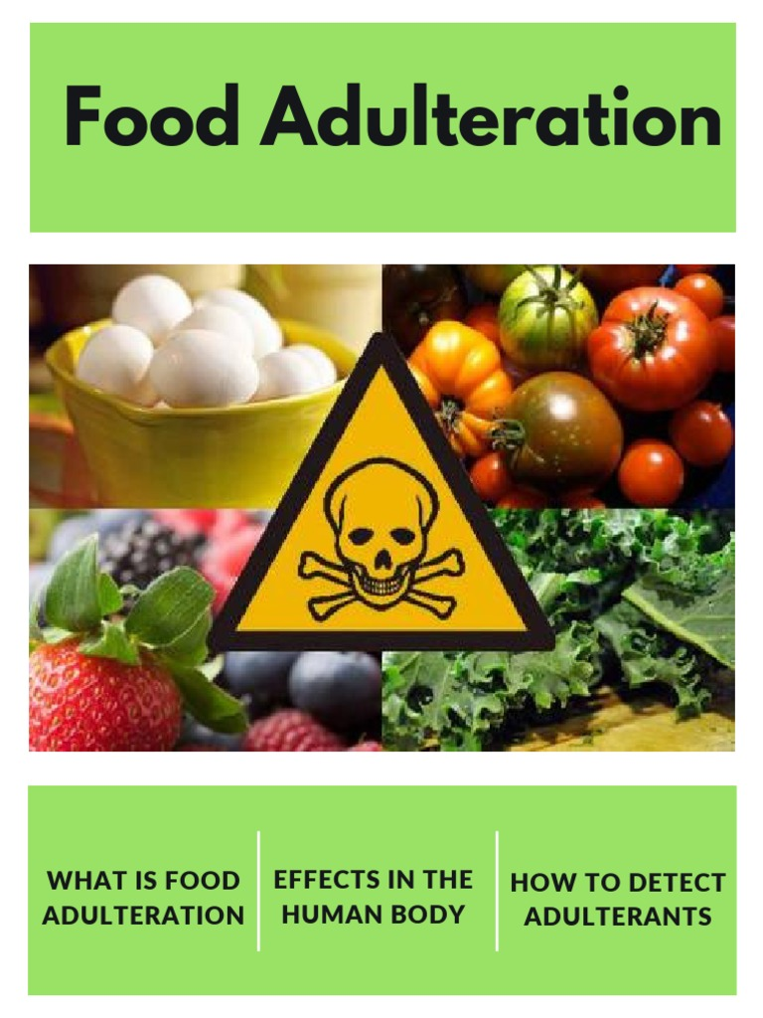
Our today’s topic is
A
L
I
M
1st
Y
E
A
R
U
N
I
T : 5
L
E
S
S
O
N: 1
English for today

Slide 8
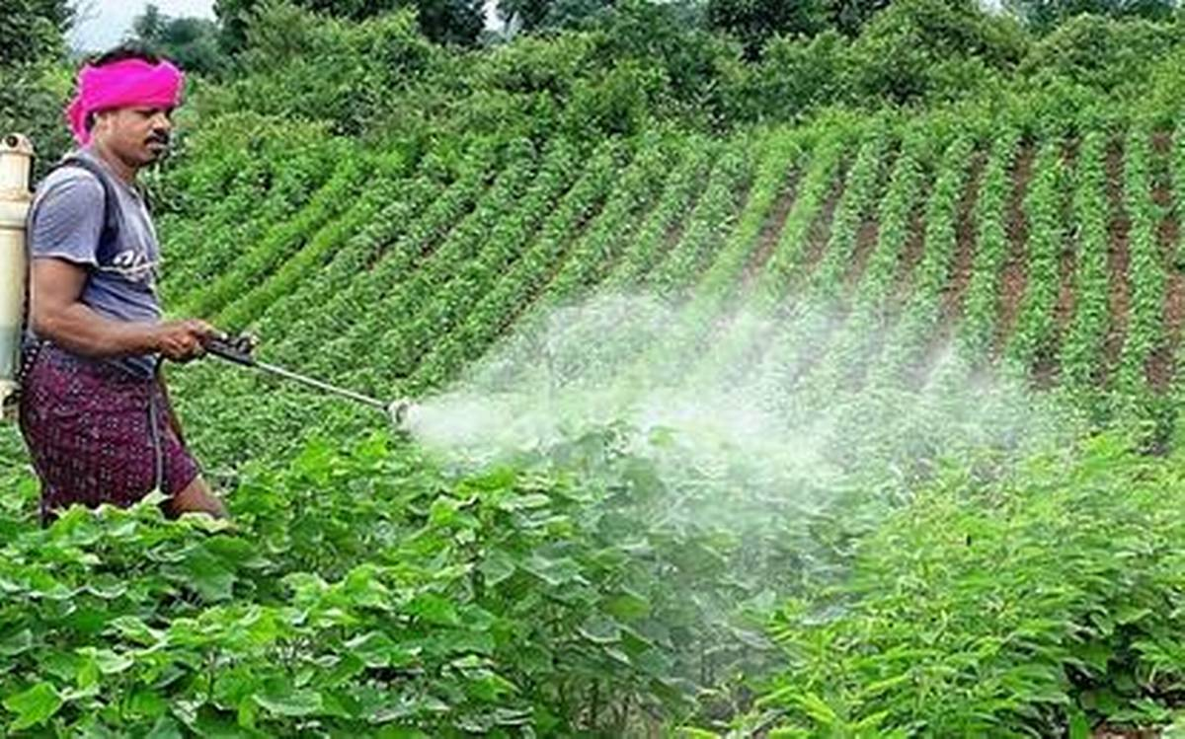
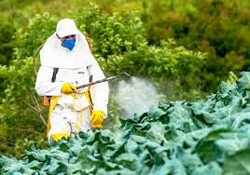
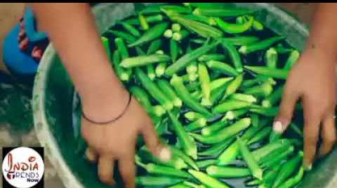
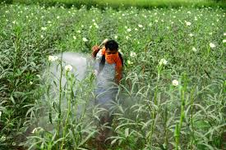
Dear students, here some images are for you.
Pesticides and chemicals are using in vagetables

Slide 9
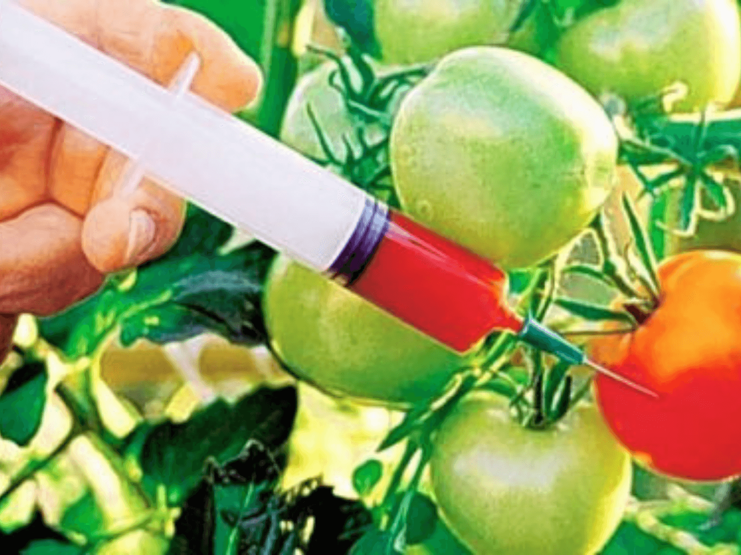
Again use of chemical in vegetables

Slide 10
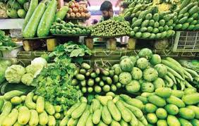
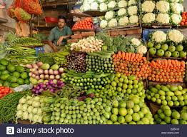
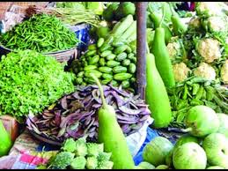
Karwanbazar vegetable market
Gulshan vegetables market
Mohakhali vegetables market

Slide 11
Single work
1.Unsafe levels of ……. is present in the food of our country .
(a)Pesticides (b) poison (c) insect (d) pestilence .
2.What could be the closest meaning for ‘contaminated’.
(a) Harmful (b) polluted (c) wasted (d) rough .

Slide 12
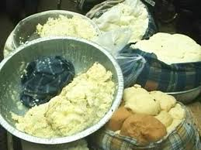
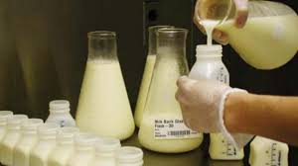
Milk and milk products indicate poor processing procedures

Slide 13
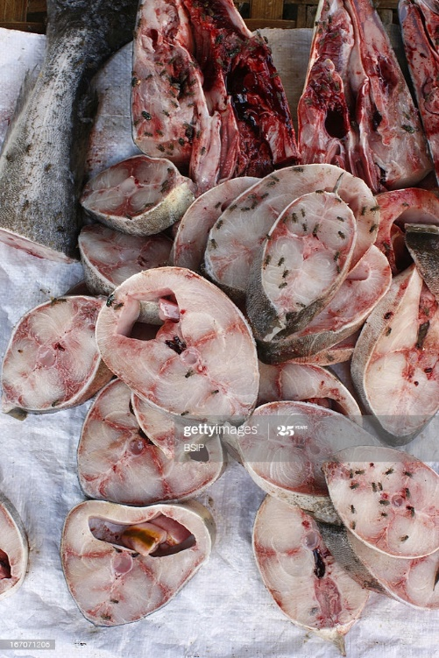
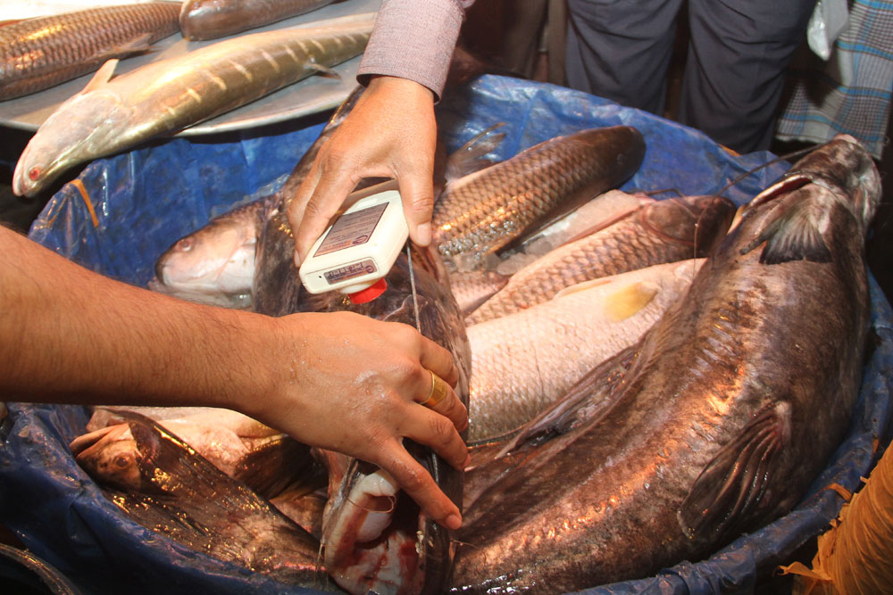
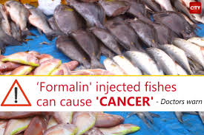
Contaminated fish

Slide 14
Pair work
Make a list of banned pesticides which are used in milk, fruits, fish, and vegetables.

Slide 15
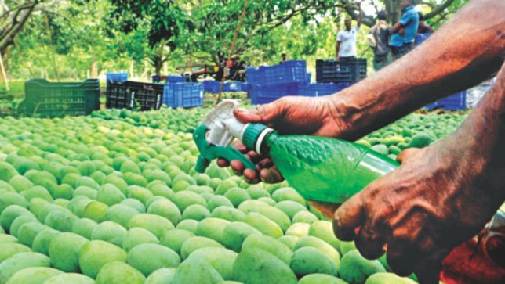
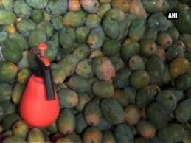
Mango adulteration

Slide 16
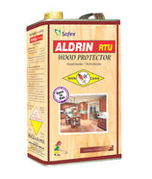
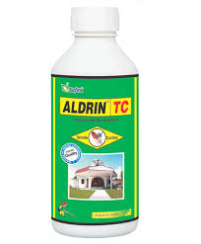
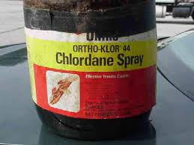
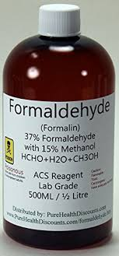
Images of pesticides

Slide 17
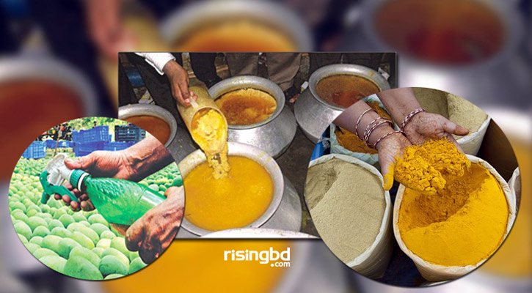
Lead chromate is used in Turmeric power.

Slide 18
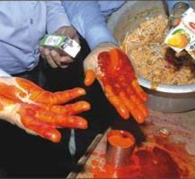

Slide 19
Group work
Read the text and make a flow-chart showing how NFSL conducted the survey on food adulteration.
1.Assessing the level of food adulteration
2
3
4
5
6

Slide 20
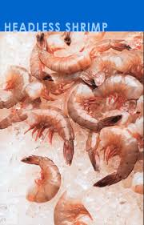
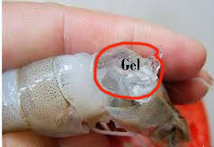
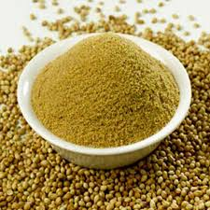
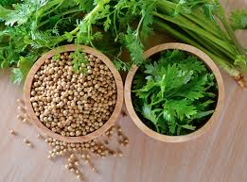
Dear students ,some more images are for you.Imagine about the images.

Slide 21
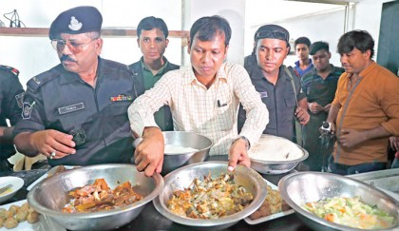

Slide 22
Evaluation
According to the survey, what amount of poisonous products were found in these food samples?

Slide 23
Home work
Write a short note on “food adulteration”.

Slide 24
Thanks to all.

