Slide 1
GOOD MORNING TO ALL.

Slide 2
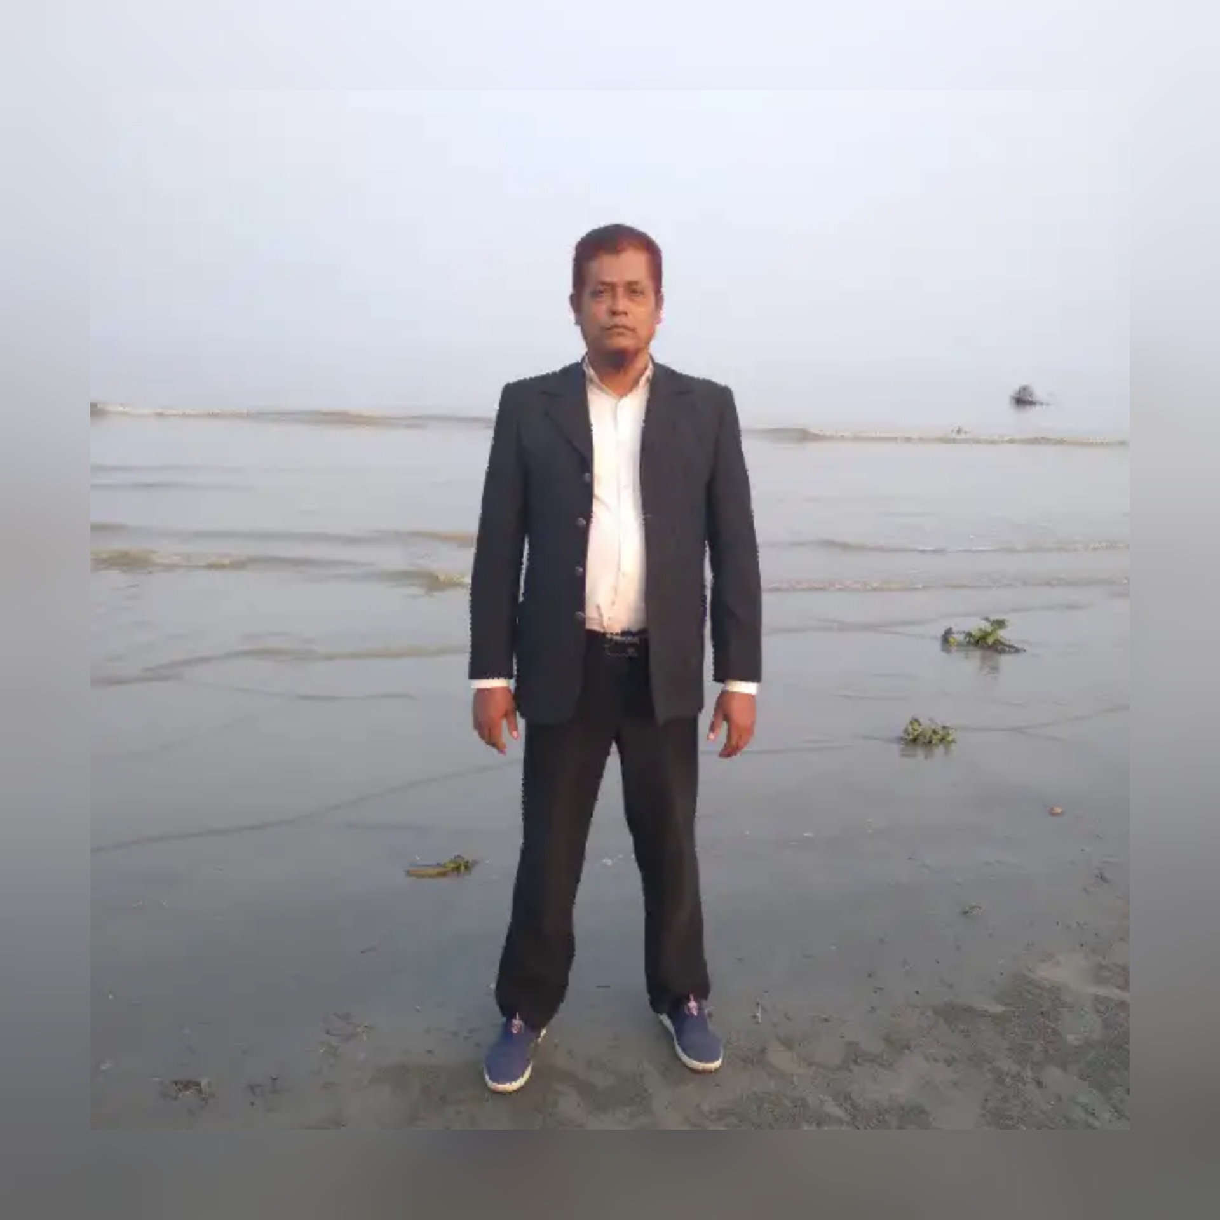
Teachers Identification
Md. Monir Hossain
Assistant Teacher
Ghatlabag Kasurbag Dhakil Madrasah
Chatkhil -Noakhali

Slide 3
Lesson introduction
Class:- SIX
Unite: 1
Lesson: 1 (A)
Time: 45 minutes
Date: 28/o2/2020

Slide 4
Dear students let’s enjoy a video.

Slide 5
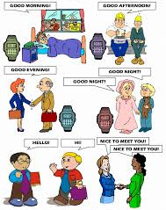
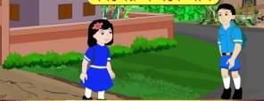
Dear students, what are looking in the pictures ?
The people are exchanging greetings one another.

Slide 6
Learning outcomes:
Listening: Students will be able to---
1.1.1: become familiar with English sounds by
listening to common English words.
Speaking:
2.1.1: greet each other.

Slide 7
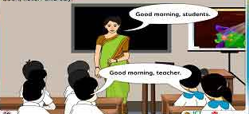
Dear students, look at the picture and say with me.
Good morning.
Good morning.

Slide 8
Dear students, listen to me.
Dear students, my name is Md. Monir
Hossain.I am your English teacher.

Slide 9
Dear students , look, listen and say.
Dear students , what are you looking in picture?.
This is our ‘English For Today’ book.

Slide 10
Dear students, what do we say to meet
with other in the morning ?
We say “Good morning”
Good morning.
Good morning.

Slide 11
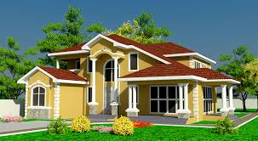
Home task
Dear learners , you will practise today’s
lesson with your parents or elders.

Slide 12
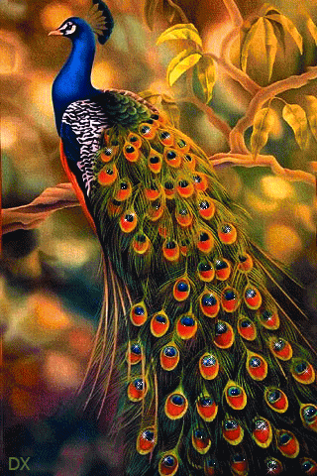
Good-bye my students.

