Slide 1
Welcome

Slide 2
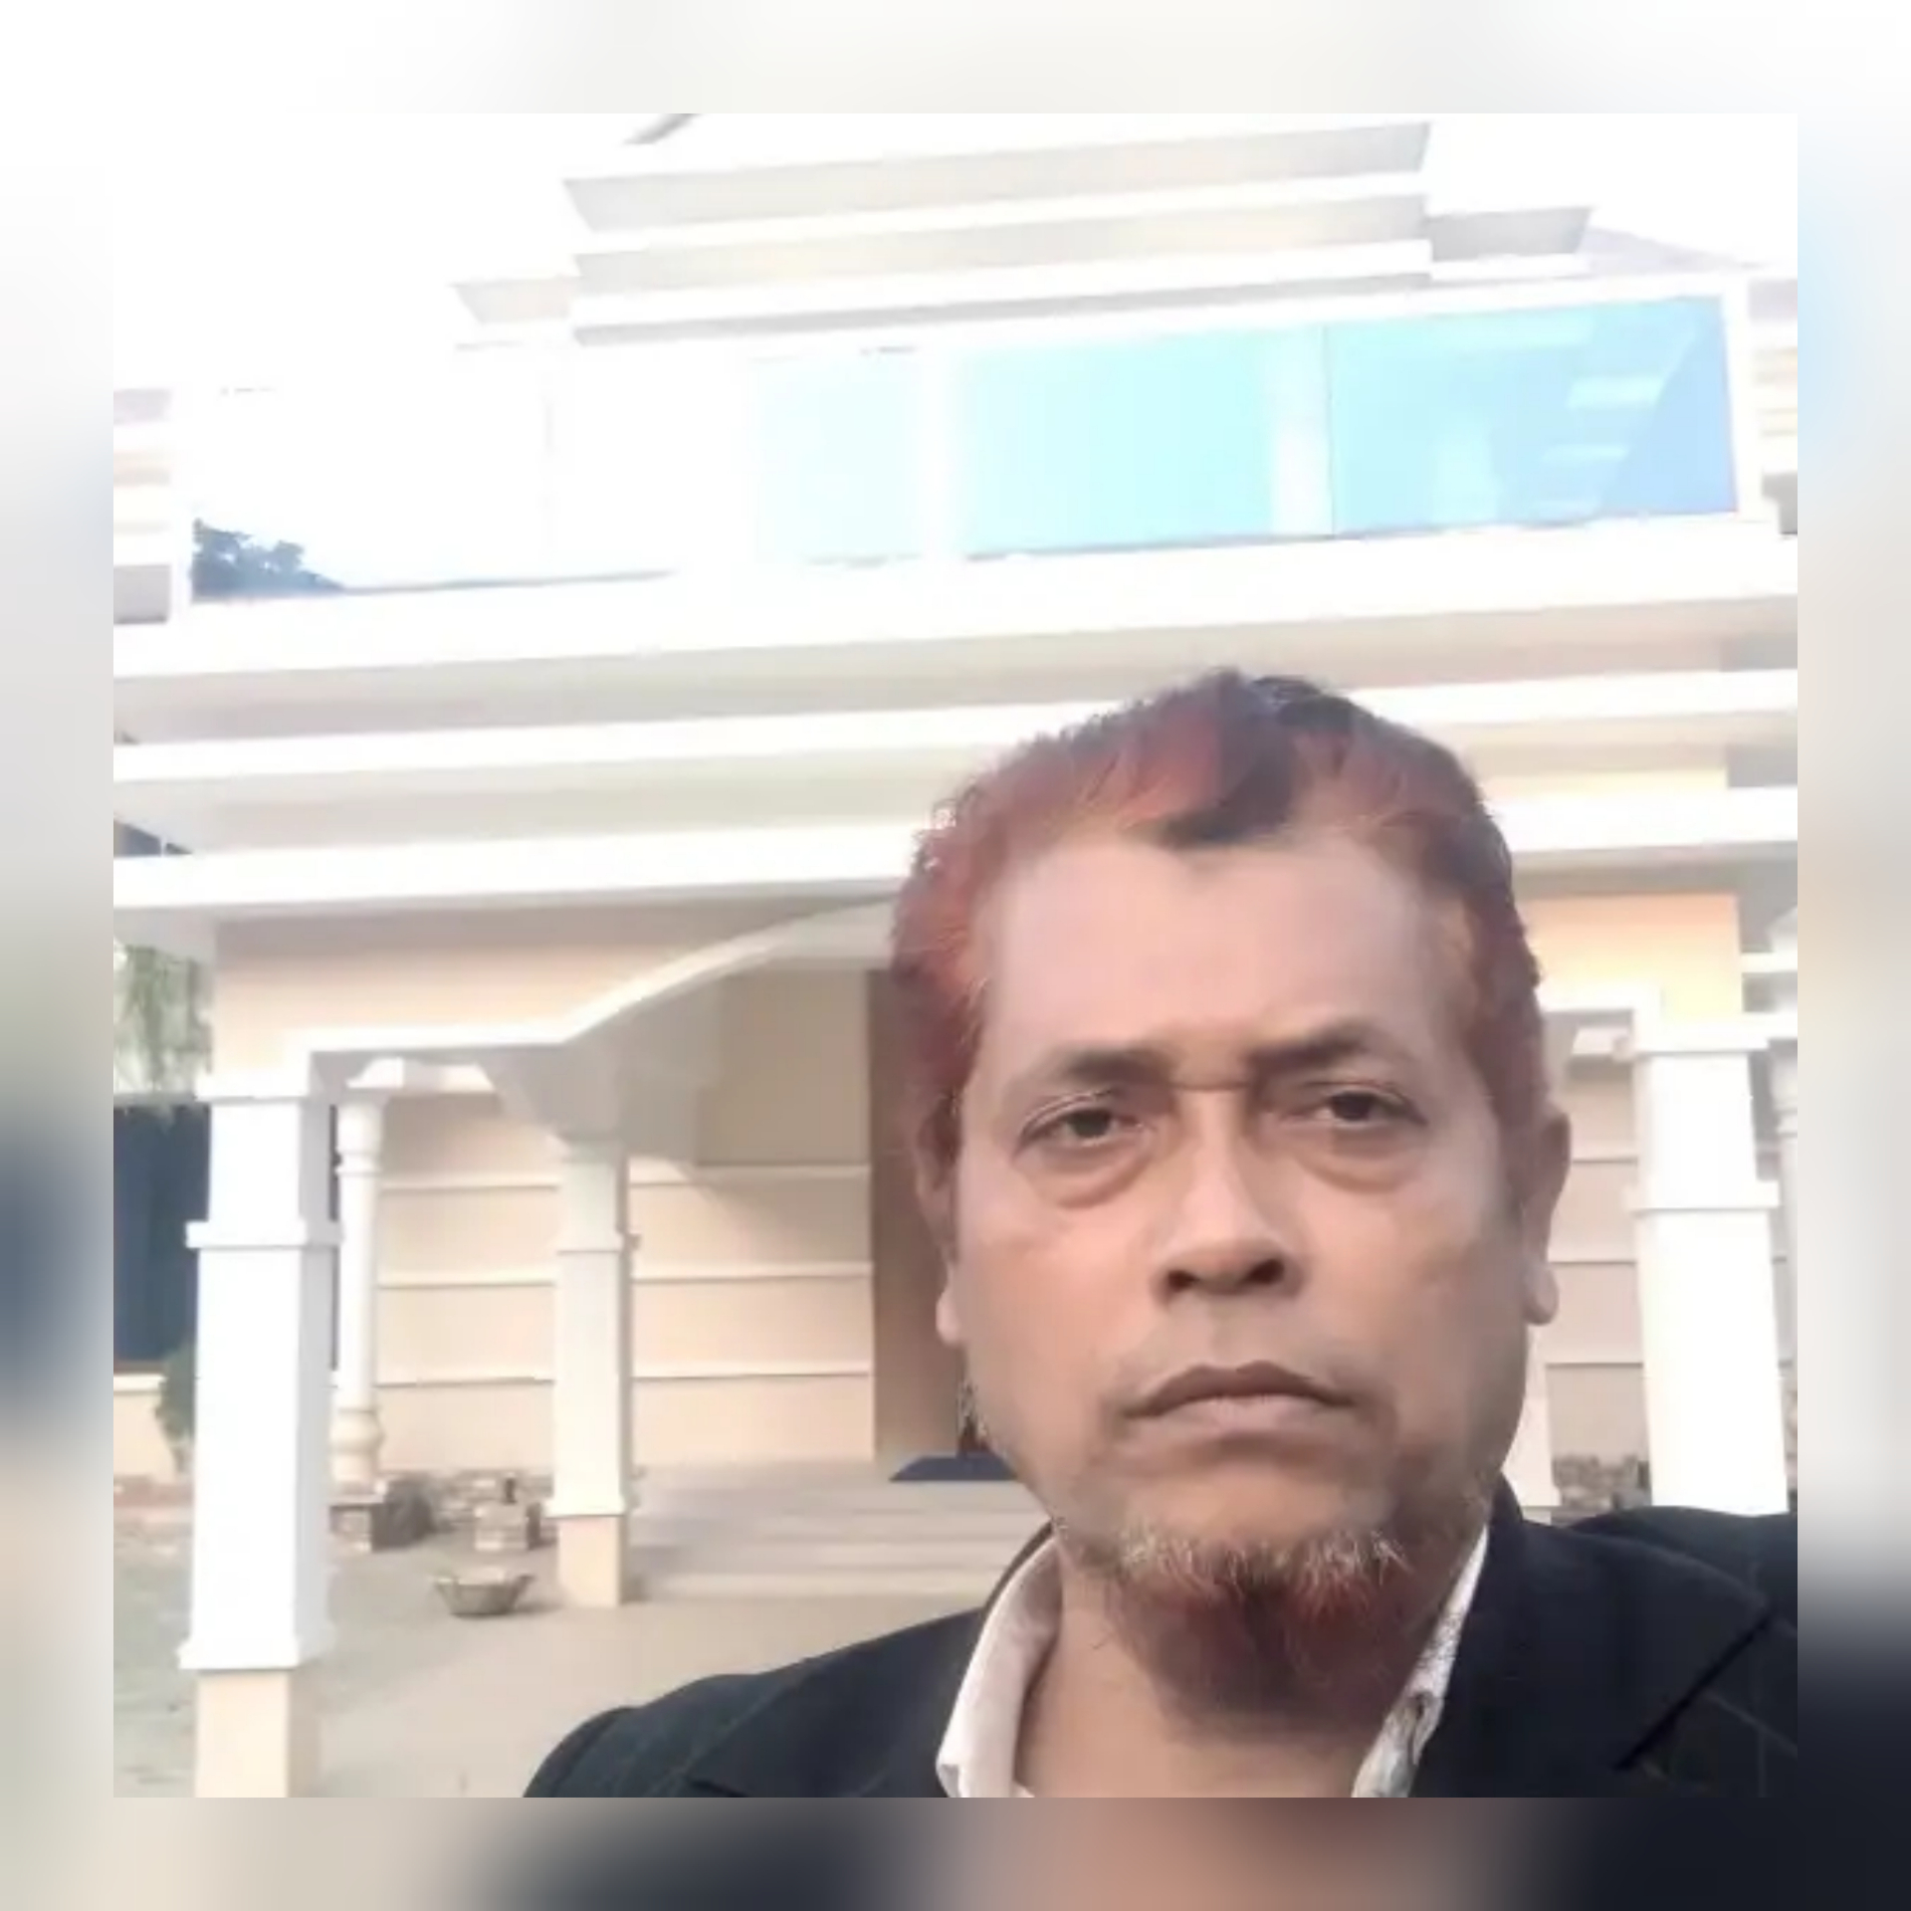
Teacher’s Identity
Md: Monir Hossain
Assistent teacher
Kasurbag dhakil madrasah
monir247060@gmail.comppt

Slide 3
Class – Six
Subject – English 2nd Paper

Slide 4
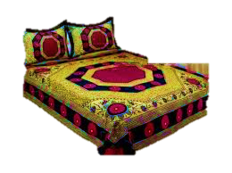
The room is very neatly made

Slide 5
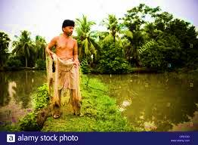
The fisherman is very active

Slide 6
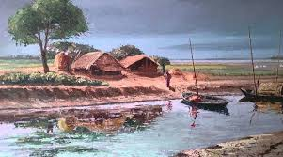
An excellent painting sea

Slide 7
Today’s Topic
Articles

Slide 8
Learning Outcomes
Understand and being able to use a/an.the

Slide 9
Before vowelwewill use ‘an’.
Before consonant we will use ‘a’.

Slide 10
an
Samiya is fond of ___ orange.

Slide 11
Evaluation
A police is a honest person

Slide 12
I eat ___ apple daily.
an

Slide 13
Joynul Abedin was ___ artist.
an

Slide 14
Home work
1. I am ____ student.
2. He is ___ grocer.
3. Banaras is ____ holy city.
4. The world is ___ happy place.
5. Sanskrit is ___ difficult language.
6. Rama has come without __ umbrella.
7. She is ___ untidy girl.
8. He is ___ able teacher.
9. She has made ___ mistake.
10. Do not make ___ noise.

Slide 15
Thanks
Thanks

