Slide 1
Welcome to my class.

Slide 2
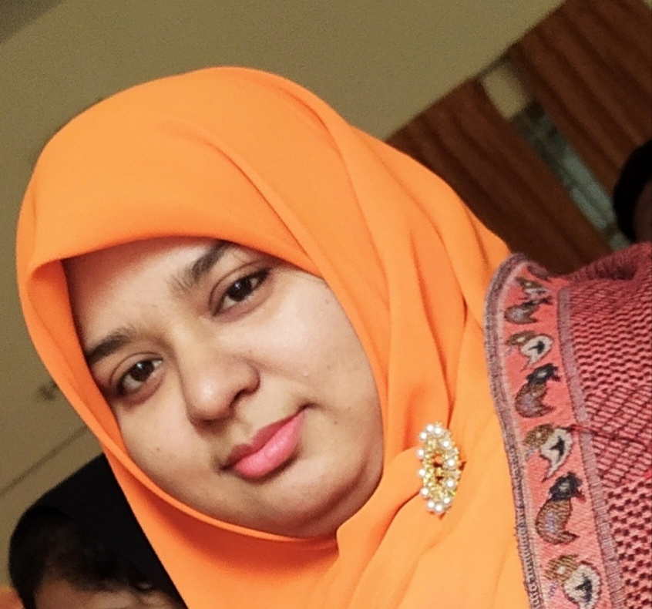
Syeda Nusrat Sarmin
Assistant Teacher
Ayjuddin GPS
Faridpur Sadar, Faridpur

Slide 3
Please, be ready with your EFT book (English for Today book), notebook and pen.

Slide 4
Learning outcomes
By the end of the lesson the students will be able to
Listening:
3.4.1 understand statements made by the teacher and students.
Speaking:
1.1.1 say words, phrases and sentences with proper sounds, stress.
1.1.2 say sentences with proper intonation.
6.2.1 talk about people, objects, events etc.
Reading:
1.5.1 read words, phrases and sentences in the text with proper proper pronunciation, stress and intonation.
1.7.1 read paragraphs, dialogues, stories, letters and other texts.
5.1.4 read silently with understanding personal letters and other texts materials.
Writing:
3.1.1 write words, phrases and sentences using non-cursive capital letters.
3.1.2 write words, phrases and sentences using non-cursive small letters.
6.1.2 use capital letters for proper nouns.
8.1.1 make sentences using words and phrases given in the textbook.

Slide 5
Teaching aids :
Pictures of free time activities, form, language club
Word cards
Poster paper
Slide
CD drive/ audio

Slide 6
No, it’s not.
We have to complete the form.
It’s a form.
What do you see in the picture?
Look at the picture.
Is it complete?

Slide 7
Our today’s lesson is
Completing forms
Unit: 22, Lesson: 7-8, Activity: H & I ;
Page: 89

Slide 8
New Words
Free time
Free time – অবসর সময়
Free time – Pastime/ Leisure,
The time when you do not work

Slide 9
New Words
Application (n)
Application – আবেদনপত্র / দরখাস্ত
Application – Petition, an official request for something

Slide 10
New Words
Enjoy (v)
Enjoy – উপভোগ করা
Enjoy – Like, to get or have
pleasure

Slide 11
New Words
Language club (n)
Language club – ভাষা শেখার সংঘ/ ক্লাব
Language club – Where you learn different languages

Slide 14
H. Listen and read.
TR > SR
Rokeya Khan is Laila’s friend. She is also Bangladeshi. She also goes to Naogaon Primary School, but she is in Class 4. Her birthday is 18 September, 2007. Her father’s name is Anowar Khan and her mother’s name is Aisha Haider. They live at Hospital Road in Naogaon. In her free time, Rokeya enjoys drawing and reading. She signed her English Language Club application on 12 November, 2015.
Rokeya Khan is Laila’s friend. She is also Bangladeshi. She also goes to Naogaon Primary School, but she is in Class 4. Her birthday is 18 September, 2007. Her father’s name is Anowar Khan and her mother’s name is Aisha Haider. They live at Hospital Road in Naogaon. In her free time, Rokeya enjoys drawing and reading. She signed her English Language Club application on 12 November, 2015.
Rokeya Khan is Laila’s friend. She is also Bangladeshi. She also goes to Naogaon Primary School, but she is in Class 4. Her birthday is 18 September, 2007. Her father’s name is Anowar Khan and her mother’s name is Aisha Haider. They live at Hospital Road in Naogaon. In her free time, Rokeya enjoys drawing and reading. She signed her English Language Club application on 12 November, 2015.

Slide 16
Rokeya Khan
18 September, 2007
Bangladeshi
Aisha Haider
Anowar Khan
Hospital Road, Naogaon.
Naogaon Primary School
Four
Drawing and reading
12 November, 2015
SGW

Slide 17
PW
Fill in the gaps.
fr_e time
n_ me
l_ve
nati_nality
e
a
i
o

Slide 18
Evaluation
Write ‘True’ for correct statement or ‘False’ for incorrect statement.
Laila is fond of chess.
Laila dislikes to run in the park.
Bithi likes swimming.
Bithi is not a talkative person.
False
False
False
True

Slide 19
Home Work
Write 10 sentences about
your free time.

Slide 20
Keep smiling.
Goodbye,
dear students.

