Slide 1
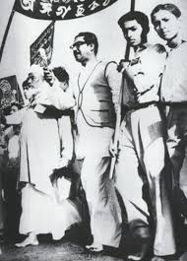
Sheikh Mujibur Rahman
GOOD MORNING

Slide 2
Identity
Md Shafiqul islam
Assistant Teacher
Sonatan darussannat dakhil Madrasha , kawnia, Rangpur.
Mail:shafiqulislam42347@gmail.com
English 1st paper
Class: Eight
Unit: Five
Lesson: One
Date:05/01/2021

Slide 3
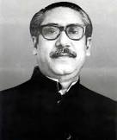
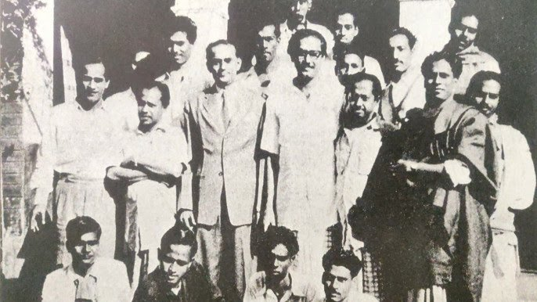
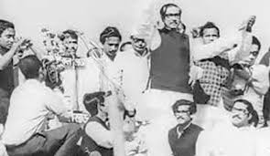
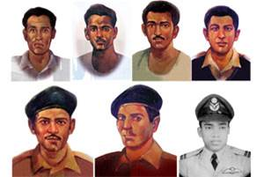
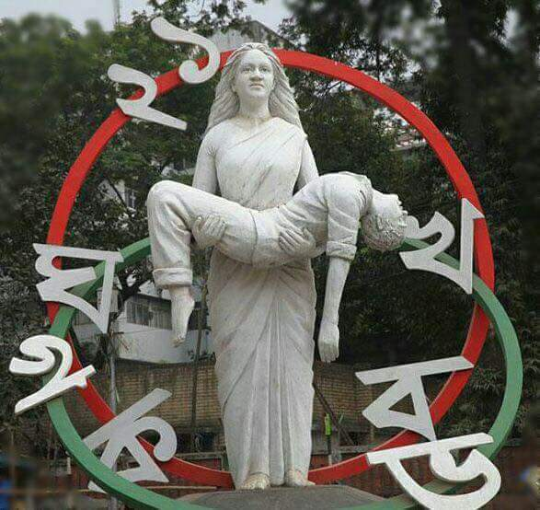
LOOK AT THE PICTURE

Slide 4
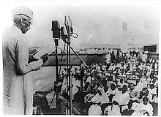
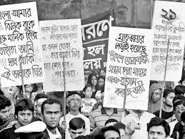
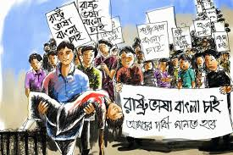
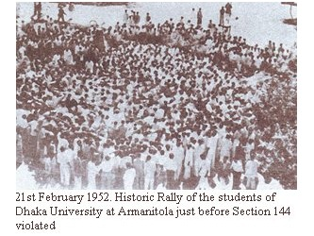
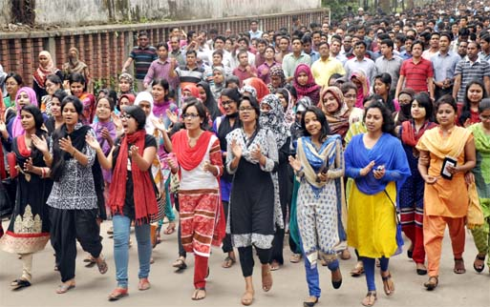
LOOK AT THE MORE PICTURE

Slide 5
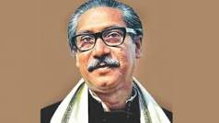
TODAYS TOPIC
Bangabandhu and the Language Movement

Slide 6
Learning Outcome
By the end of the lesson student will be able to-
Lesson information.
Read and understand text.
Word meaning.
Choose the best answer from the alternative.
Read the lesson and answer the question.
Fill in each gaps with suitable words from the text.

Slide 7
WORD MEANING
Language ---------------ভাষা,
Significant --------------তাৎপর্যপূর্ণ,
Movement -------------আন্দোলন
Organizing --------------আয়োজন
Declared ----------------ঘোষনা করা
Announcement -------ঘোষনা
Identity ------------------পরিচিতি
Protests -----------------প্রতিবাদ
Statement --------------বিবৃতি
Custody ----------------তত্বাবধানে
Including ----------------অন্তরভুক্ত
Tribute -----------------শ্রদ্ধা
Gathering --------------জমায়েত
Imposed ----------------আরোপিত
Notes:
িচিততি

Slide 8
Describing Text
Sheikh Mujibur Rahman was one of the few student leaders who played a significant role in turning the language movement into a mass movement.

Slide 9
As a student leader, he was the central figure in organizing mass gatherings , rallies and strikes for raising awareness against the discriminatory language policy of Pakistan.

Slide 10
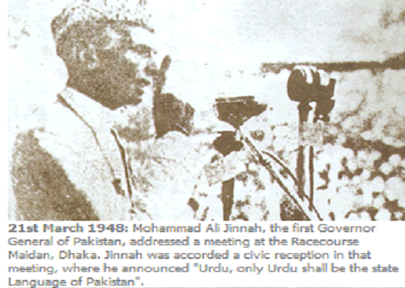
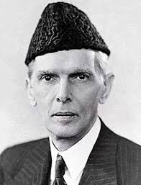
The language movement started when the Governer General of Pakistan Muhammad Ali Jinnah ,declared ‘’Urdu shall be the state language of Pakistan’’ on 19 March 1948 at the Racecourse Maidan while addressing a public gathering.

Slide 11
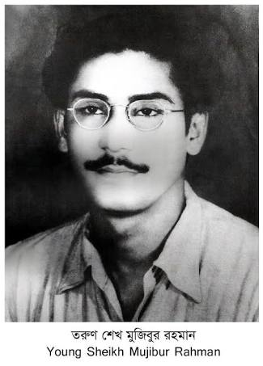
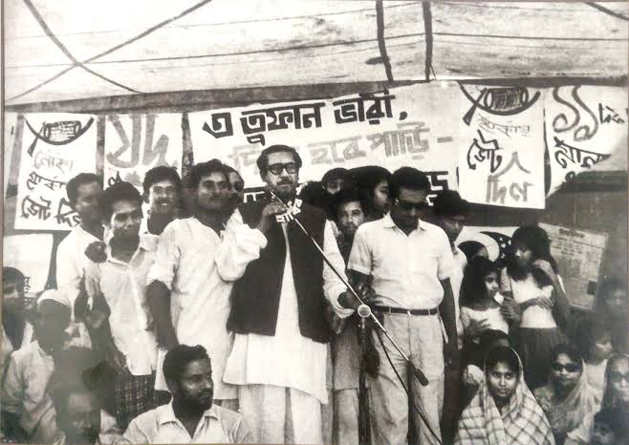
It was the time when young Mujib started organizing the student front of Muslim League in East Pakistan. He was proud of his Bengali identity and very active to initiate strikes and protests against the language policy of Pakistan government.

Slide 13
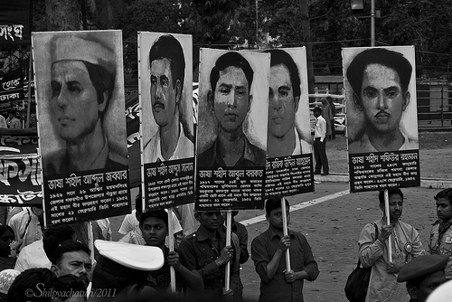
Describing text
The police opened fire and killed a number of students including Abdus Salam,Rafiq Uddin Ahmed, Abdul Barkat, Abdul Jabbar and others.

Slide 15
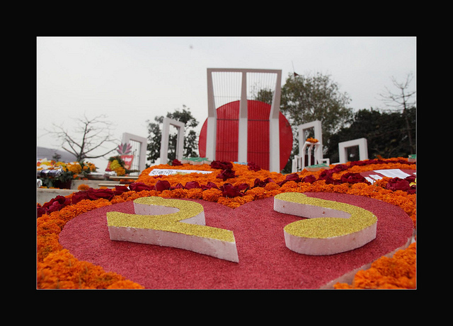
In his autobiography , Sheikh Mujibur Rahman says,…’’’we decided in the meeting in my room to observe 21 February as State Language Day and to form a committee that day to conduct the movement to establish Bengali as the state language.’’

Slide 16
Silent Reading

Slide 17
Individual Work
What happened on 21 February in 1952?

Slide 18
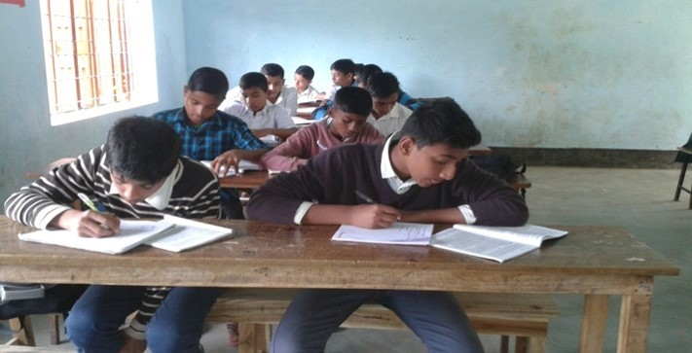
GROUP Work
Choose the best answer from the alternative:
Sheikh Mujibur Rahman played a significant role in our language Movement. What does the underlined words mean here?
(a) famous (b) important (c ) infamous (d) active
The protesting students tried to defy Section 144 imposed by the government. What does the underlined words mean in this sentence?
(a) to refuse (b) to agree ( c) to accept (d) to obey
What’s the meaning the word ‘’ autobiography’’ in the passage?
(a) the story of a person’s life written by somebody else (b) the story of a person’s life written by his friends
(c ) the story of a person’s life written by that person himself (d) the story of a person’s life written by journalist
Which of the following words is the meaning of ‘’ central ‘’ in the passage?
(a) most important (b) less important (c) unimportant (d) popular
5. We decided in the meeting in my room to observe 21 February as State Language Day’’. What does the underlined word mean?
(a) to celebrate (b) to maintain (c ) to understand (d) to arrange

Slide 19
EVALUATION
Read the text again to answer the following question:
1. Where was Sheikh Mujibur Rahman during the language movement in 1952 ?
2. Why do you think Mujib struggled for establishing Bengali as the state language?
3. What happened on 21 February in 1952 ?
4. Why does the police opened fire and killed a number of students?
5. Why do we observe 21 February as the International Mother language Day?

Slide 20
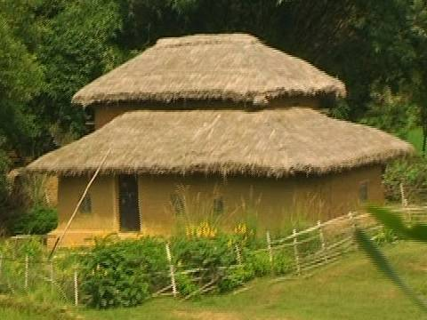
Home Work
Fill in each gaps with suitable words from the text:
We should (a)--------------our clothes regularly. Dirty clothes give off bad smell and (b)-----------germs. We should wear socks and shoes when we (c )---------out to protect our feet from dust and germs. It is also important to wash (d)----------before meals and after using the toilet. We should (e) -----------------brush our teeth twice a day.

Slide 21
THANK YOU ALL STUDENT

