Slide 1
Good Morning

Slide 2
Introduction
Mohammed Hossain
Assistant teacher
Monipur gps
Shahrasti, Chandpur
hossainmd603@gmail.com
Class:Play
Subject:English
Time:40 mins

Slide 3
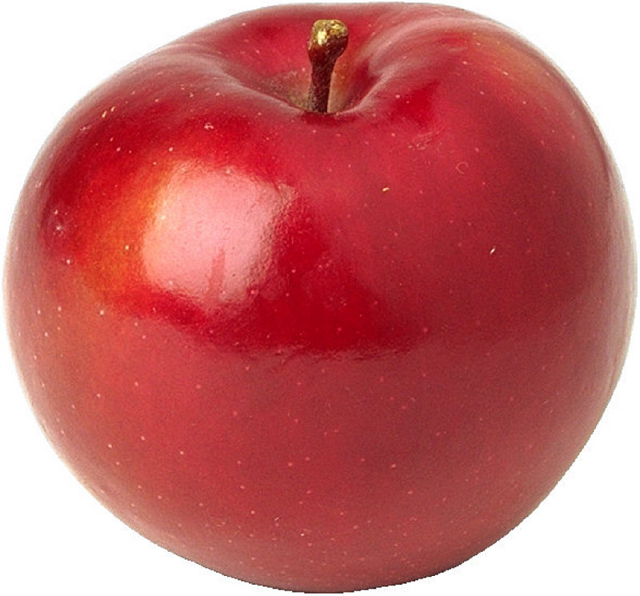
What can you see in this picture?
Ant, Apple
.

Slide 4
Look, listen and say. Trace in the air.
W.C.W
A
Apple
.

Slide 5
Look, listen and say. Trace in the air.
W.C.W
A
Ant
.

Slide 6
Look, listen and say. Trace in the air.
W.C.W
A
Arm
.

Slide 8
Find The Letter
A

